Slide 1
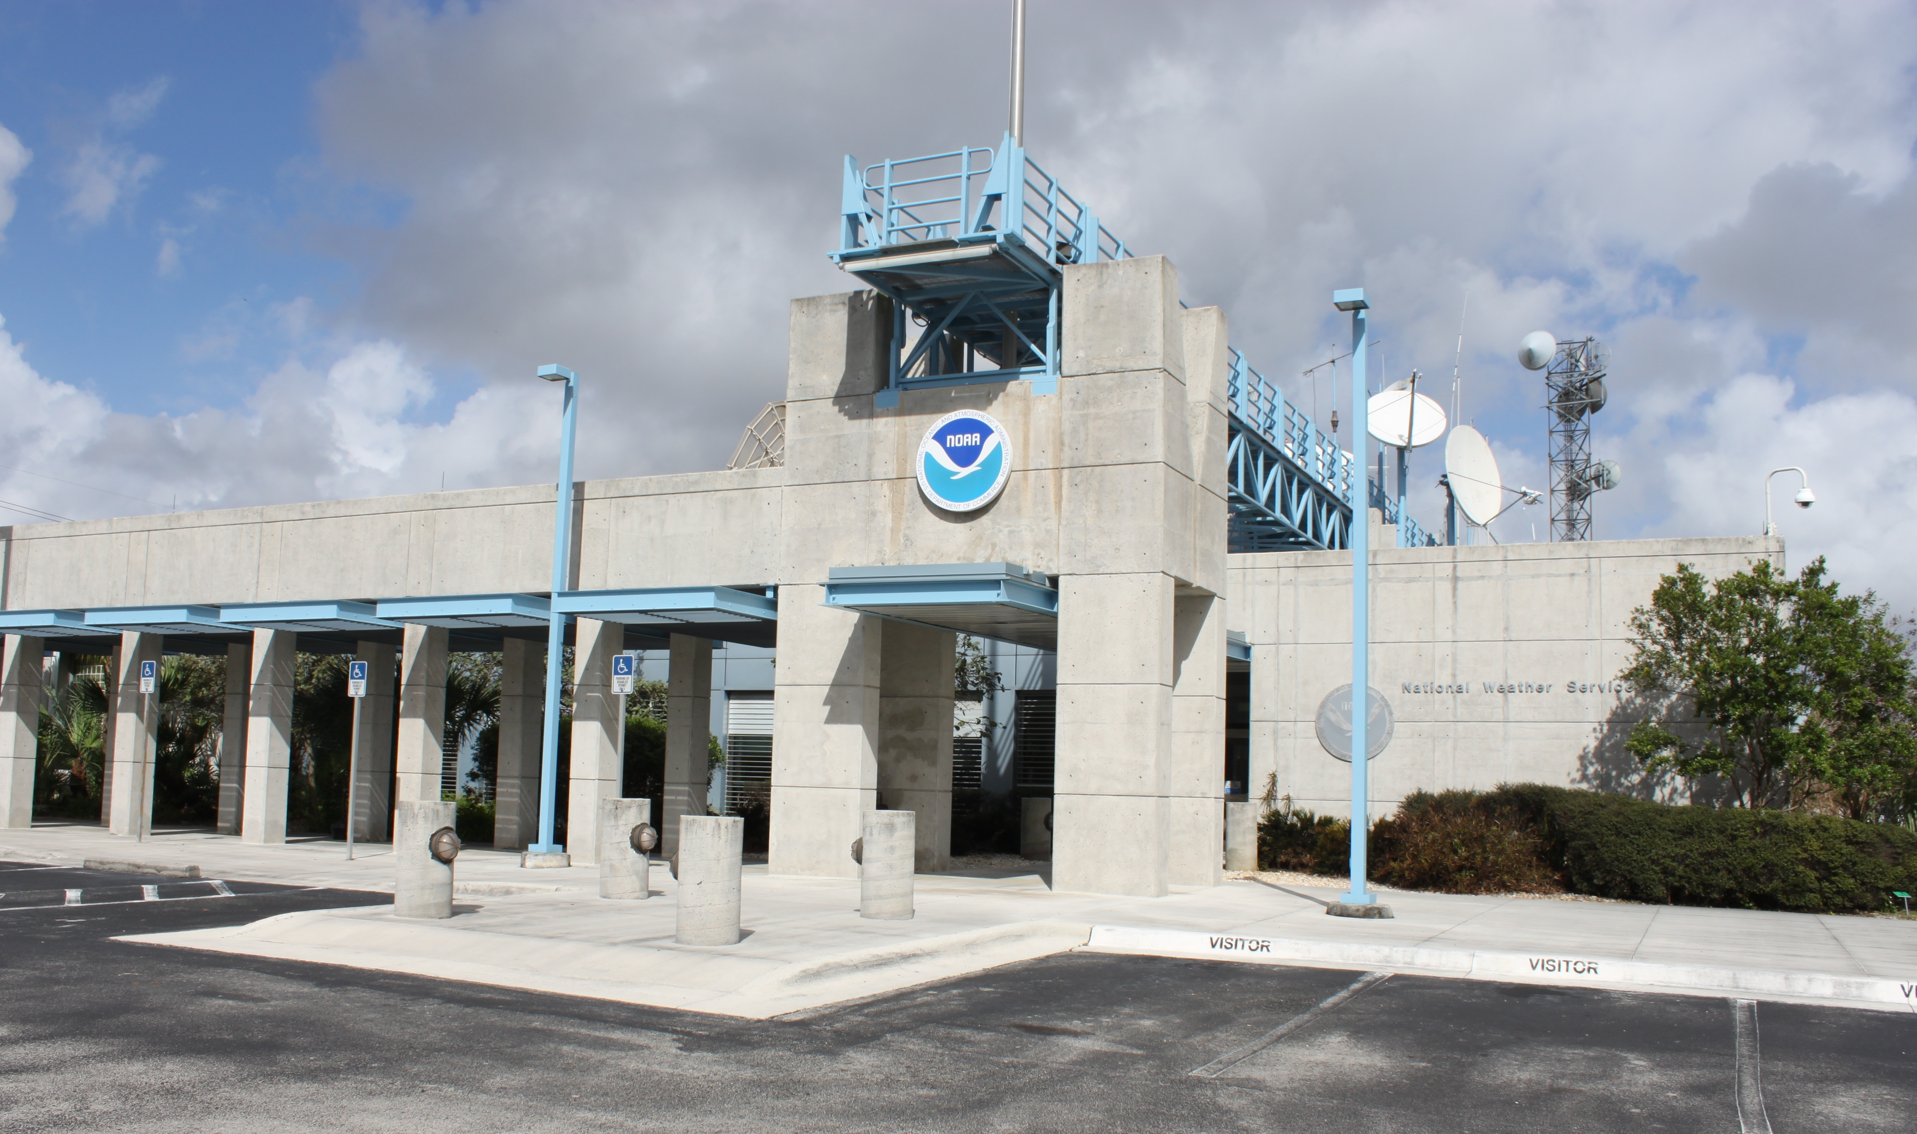

National Hurricane
Center Update
2017
Daniel Brown
Warning Coordination Meteorologist

Slide 2
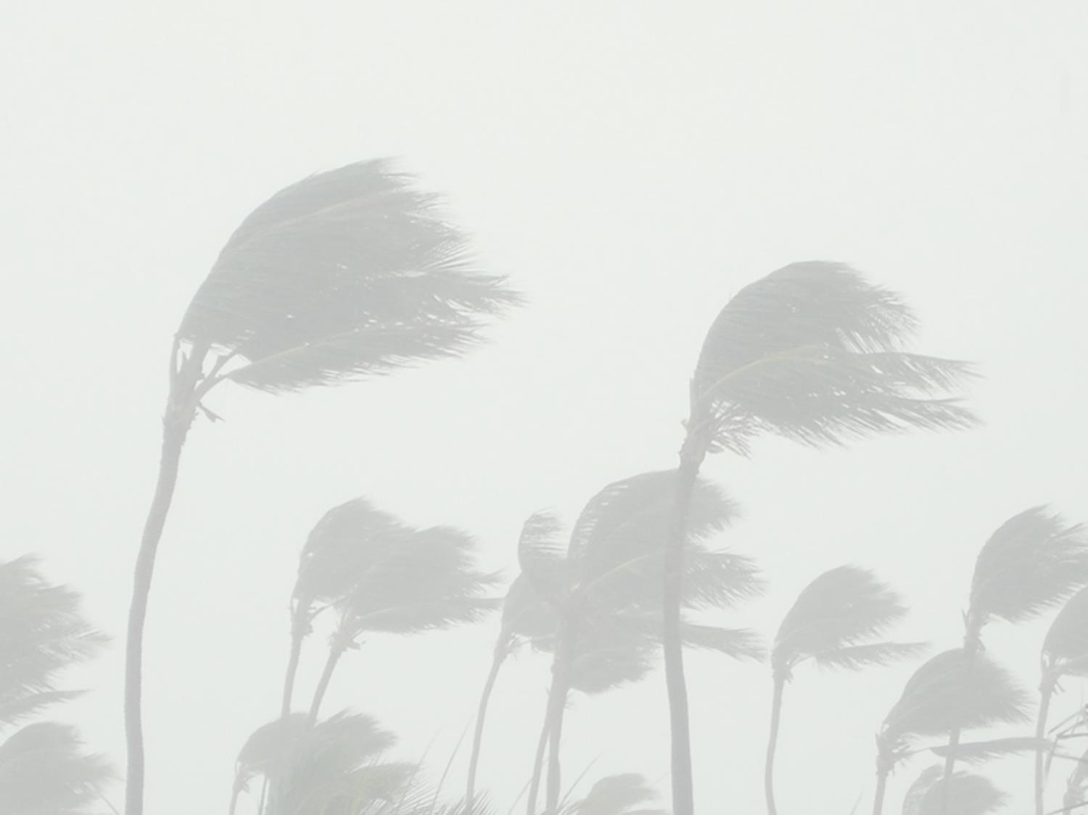

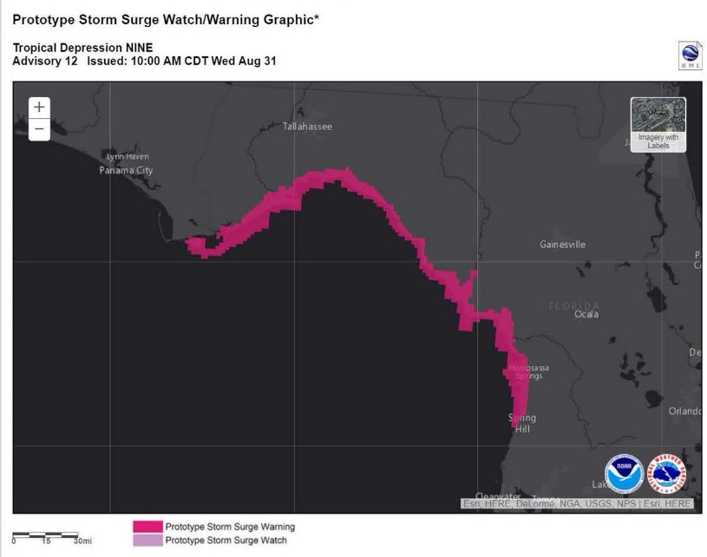
Storm Surge Watch/Warning
Storm Surge Watch and Warning will become operational in 2017.
W/W will be communicated using:
  Graphic on NHC website
  Watch/warning section of the NHC Public Advisory using coastal breakpoints
  NWS WFO Hurricane Local Statements
  Approximate representation in terms of zones in National and WFO TCV products.
  NDFD grid
SUMMARY OF WATCHES AND WARNINGS IN EFFECT:
A Hurricane Warning is in effect for…
* Anclote River to Indian Pass Florida
A Storm Surge Warning is in effect for…
* Aripeka to Indian Pass Florida

Slide 3
Storm Surge Watch/Warning
Definitions and Call-to-Action
Storm Surge Warning
  There is a danger of life-threatening inundation from rising water moving inland from the shoreline somewhere within the specified area, generally within 36 hours.
  This is a life-threatening situation. Persons located within these areas should take all necessary actions to protect life and property from rising water and the potential for other dangerous conditions. Promptly follow evacuation and other instructions from local officials.
Storm Surge Watch
  There is the possibility of life-threatening inundation from rising water moving inland from the shoreline somewhere within the specified area, generally within 48 hours.

Slide 4
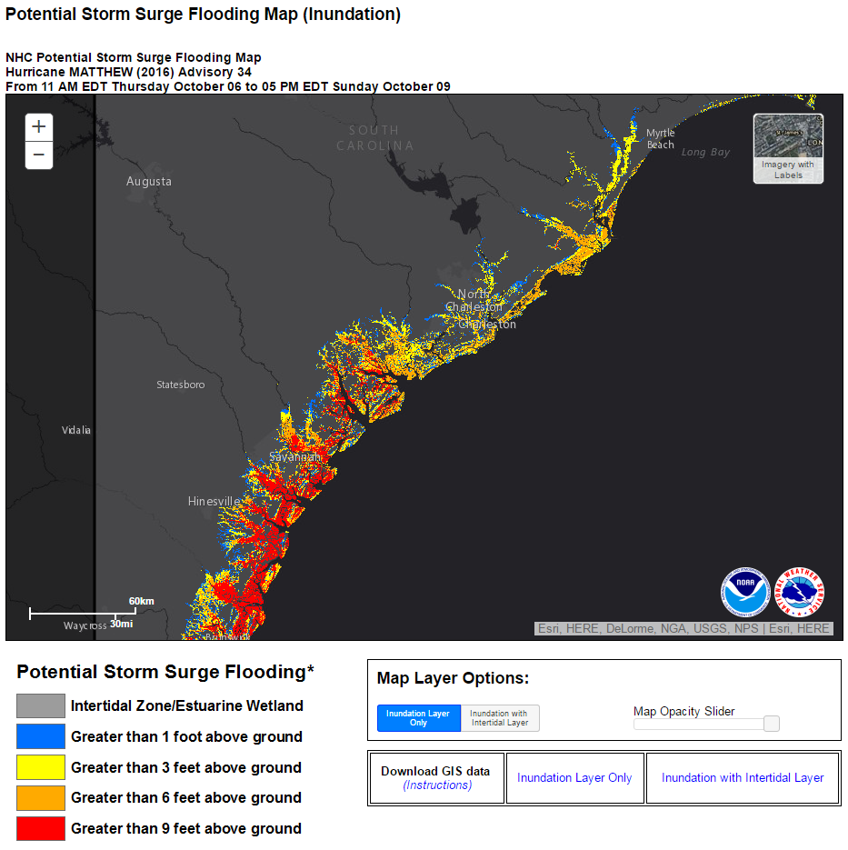
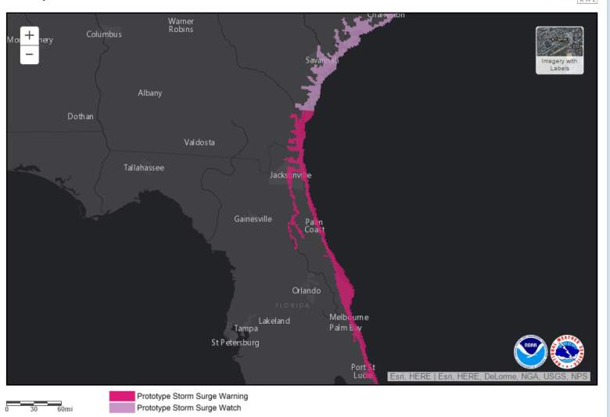
Potential Storm Surge Flooding Map
How does this differ from the warning?
The Potential Storm Surge Flooding Map is for decision makers, whereas the Storm Surge Watch/Warning is intended for the general public.
The Potential Storm Surge Flooding Map provides objective quantitative guidance on where inundation could occur. The Storm Surge Watch/Warning is subjectively determined and not quantitative, and simply identifies those areas at risk for life-threatening inundation.
The Potential Storm Surge Flooding Map does not depict expected inundation, rather, it estimates a reasonable worst-case scenario (10% chance of being exceeded) at any individual location.

Slide 5
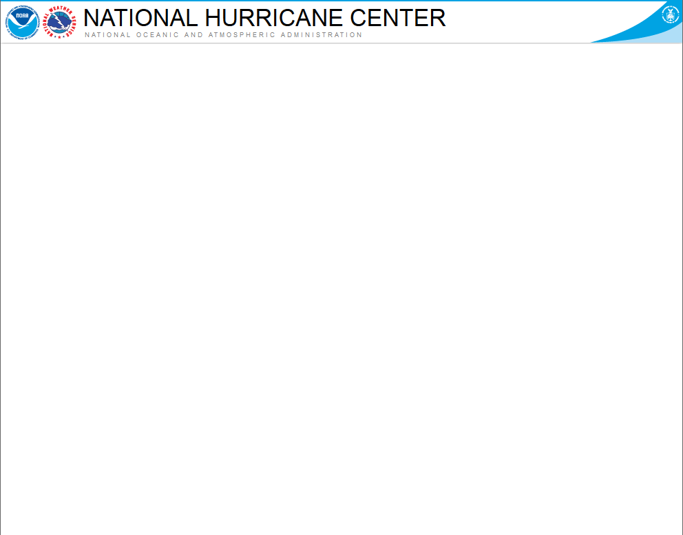
Storm Surge Values in
NHC Public Advisory
Highest storm surge inundation expected to occur anywhere within broad stretches of coastline. Not point-specific.
Introduced when a watch or warning is issued.
Values in the Public Advisory will differ from those in the Potential Storm Surge Flooding Map, since that map depicts point-specific reasonable worse case scenarios.
HAZARDS AFFECTING LAND
------------------------------------------
Storm Surge: The combination of a dangerous storm surge and the tide will cause normally dry areas near the coast to be flooded by rising waters moving inland from the shoreline.
The water is expected to reach the following heights above ground if the peak surge occurs at the time of high tide...
Destin to Indian Pass...1 to 3 feet
Indian Pass to Chassahowitzka...4 to 7 feet
Chassahowitzka to Aripeka...2 to 4 feet
Aripeka to Bonita Beach...1 to 3 feet
Florida-Georgia line to Cape Fear...1 to 3 feet

Slide 6

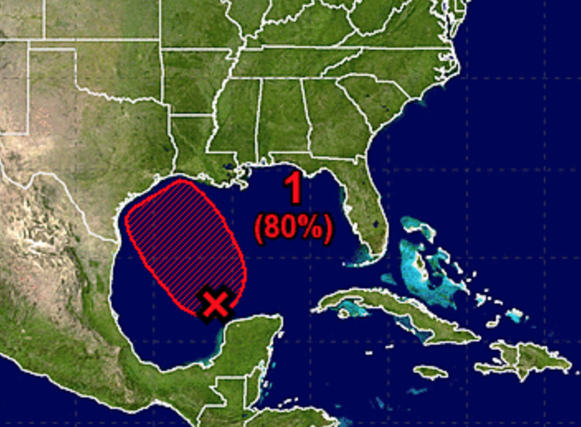
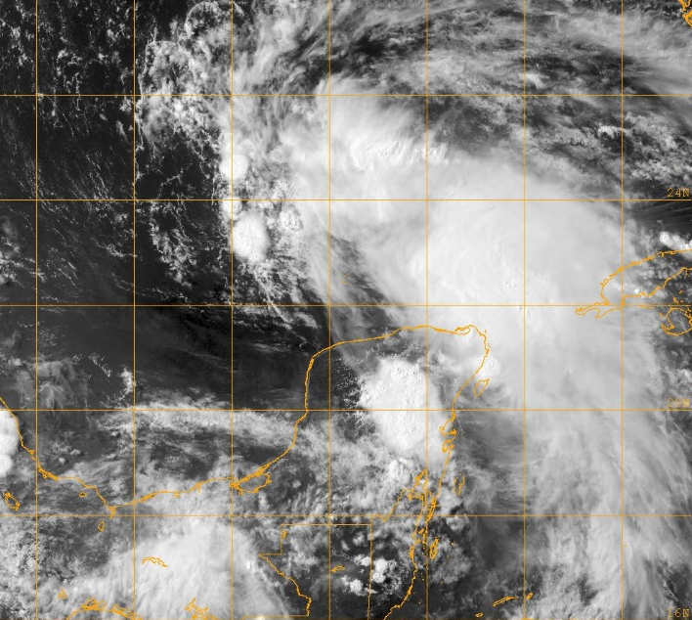
Watches and Warnings Before Tropical Cyclone Formation
NHC has the option to issue advisories, watches, and warnings for disturbances that are not yet a tropical cyclone but which pose a threat of bringing tropical storm or hurricane conditions to land within 48 hours.
Regular Tropical Storm and Hurricane Watch and Warning criteria would apply
  Watch – conditions possible within 48 h
  Warning – conditions expected within 36 h
Systems would be identified as Potential Tropical Cyclones
  Same numbering system as depressions – “One”, “Two”, etc.

Slide 7
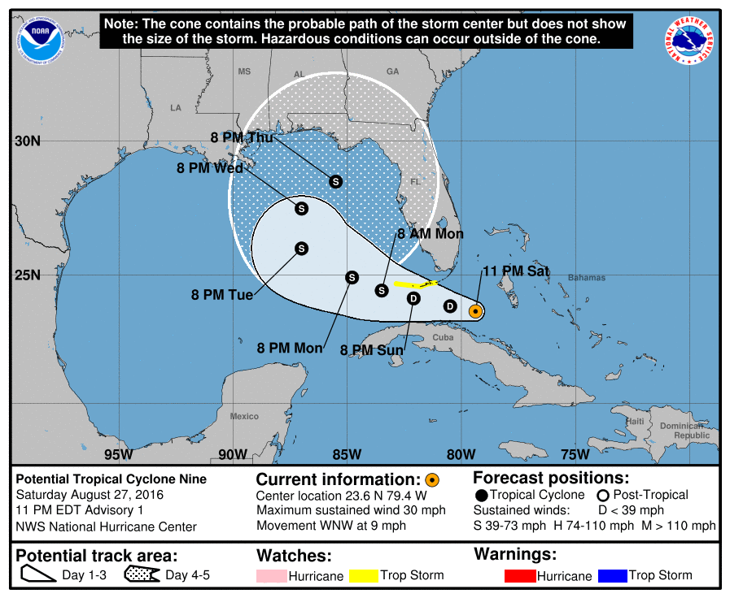
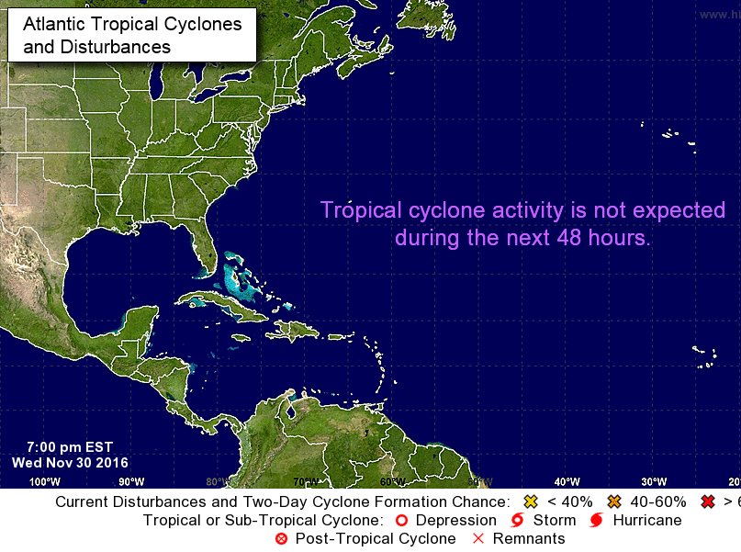
Watches and Warnings Before Tropical Cyclone Formation
Accompanied by the standard suite of NHC advisory products at standard advisory times
  Public Advisory (including Intermediates)
  Forecast Advisory
  Discussion
  Wind Speed Probabilities
  Cone graphic
  Storm surge products, as needed
Genesis probabilities will appear in both the Tropical Weather Outlook and the Public Advisory.
The Graphical TWO will no longer display a formation area for these systems, to avoid confusion with the (now available) 5-day track forecast and cone graphic.
Nine
X

Slide 8
Watches and Warnings Before Tropical Cyclone Formation
Issued only for systems threatening land within the watch/warning time frame.
Advisory packages will be discontinued when watches and warnings are no longer necessary. This could result in occasional gaps in product issuance when the threat is not imminent.
POTENTIAL TROPICAL CYCLONE ONE PUBLIC ADVISORY NUMBER 1
NWS NATIONAL HURRICANE CENTER MIAMI FL AL012016
400 PM CDT WED JUN 5 2016
...TROPICAL DISTURBANCE OVER THE EAST-CENTRAL GULF OF MEXICO EXPECTED TO BECOME A TROPICAL STORM...
...TROPICAL STORM WARNING ISSUED FOR PORTIONS OF THE WEST COAST OF FLORIDA...
SUMMARY OF 400 PM CDT...2100 UTC...INFORMATION
-----------------------------------------------
LOCATION...25.3N 86.5W
ABOUT 310 MI...500 KM SW OF TAMPA
ABOUT 320 MI...510 KM SSW OF APALACHICOLA FLORIDA
MAXIMUM SUSTAINED WINDS...35 MPH...55 KM/H
PRESENT MOVEMENT...N OR 360 DEGREES AT 3 MPH...6 KM/H
MINIMUM CENTRAL PRESSURE...1010 MB...29.92 INCHES
WATCHES AND WARNINGS
--------------------
CHANGES WITH THIS ADVISORY...
A Tropical Storm Warning has been issued fro the west coast of Florida from Boca Grande to Ochlockonee River.
SUMMARY OF WATCHES AND WARNINGS IN EFFECT...
A Tropical Storm Warning is in effect for...
* The west coast of Florida from Boca Grande to Ochlocknee River
A Tropical Storm Warning means that tropical storm conditions are expected somewhere within the warning

Slide 9
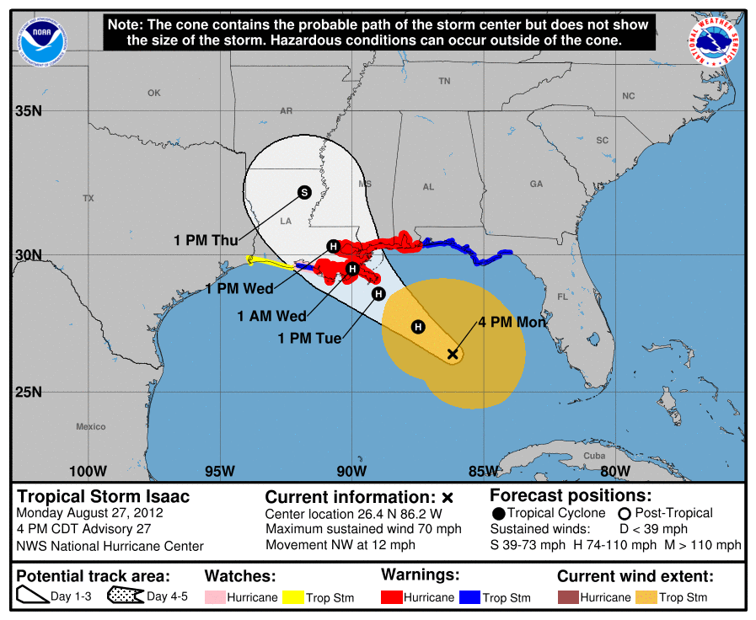
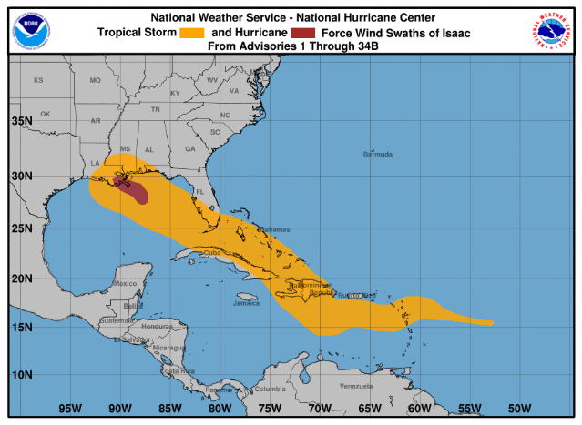
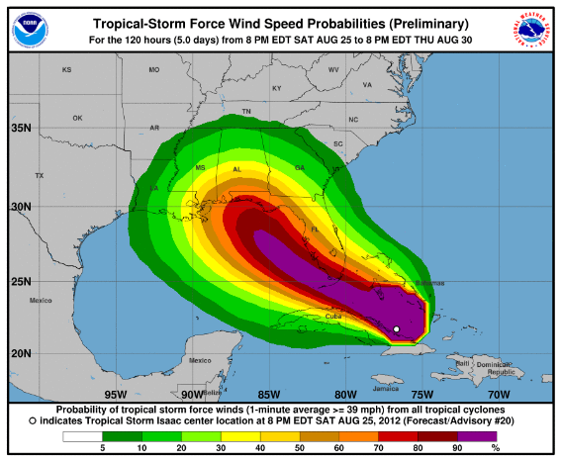
Update to NHC Graphical Products
NHC will be updating the look of its tropical cyclone advisory graphics.
Graphics suite will have consistent background maps and colors and a “cleaner” look and feel.
Storm size information (initial wind field) can now be toggled onto the cone graphic. This will reinforce that hazardous conditions occur outside the cone.

Slide 10
National Tropical Cyclone Watch/Warning Product (TCV)
Irene Watch/Warning Breakpoints/Advisory Number 22
NWS National Hurricane Center Miami FL AL092017
830 AM EST Wed Jan 11 2017
.Hurricane Irene
MDZ021>023-025-VAZ078-084-086-095-098-099-523>525-110830-
/O.UPG.KNHC.SS.A.1009.000000T0000Z-000000T0000Z/
/O.NEW.KNHC.SS.W.1009.170111T1330Z-000000T0000Z/
/O.CON.KNHC.HU.A.1009.000000T0000Z-000000T0000Z/
830 AM EST Wed Jan 11 2017
$$
New National TCV compiles all coastal and inland tropical cyclone wind and surge watches and warnings into a single product.
Because of the time required to compile all of the tropical cyclone W/W information from the WFOs, the National TCV will be delayed relative to its previous availability.
WFOs will still issue their Local TCVs as they become available.
TCV is a zone-based product, and therefore only approximately conveys the extend of warnings along the coast (no breakpoints).

Slide 11
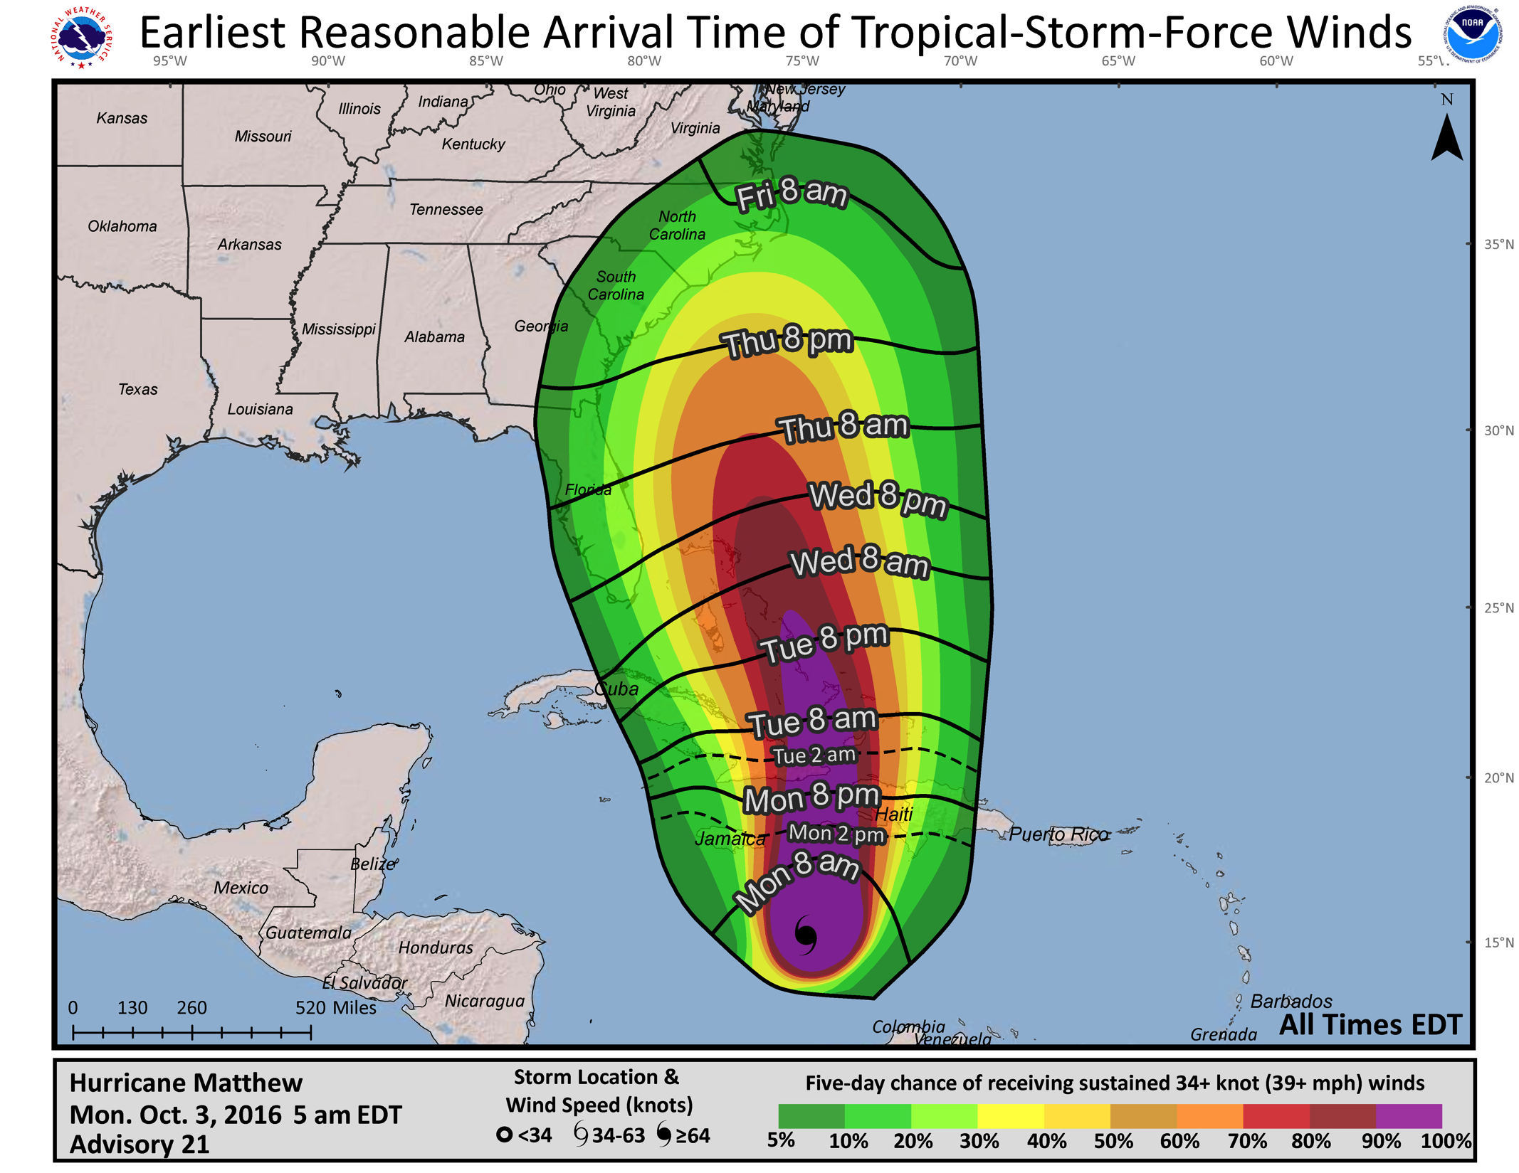
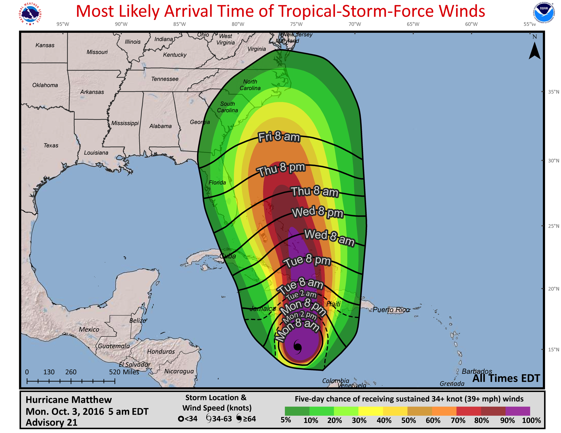
Experimental Time of Arrival Graphic
Arrival of TS-force winds is a critical planning threshold. Preparations become dangerous once winds reach TS force.
Graphic accounts for forecast uncertainty (track/intensity/size) from the same realizations used to create the NHC wind speed probability products.
Primary graphic depicts the time window that individuals can safely assume will be free from tropical-storm-force winds (“earliest reasonable” arrival time - no more than a 10% chance of onset).
A secondary graphic will show the “most likely” arrival time – that is, the time before or after which the onset of tropical-storm-force winds is equally likely.

Slide 12
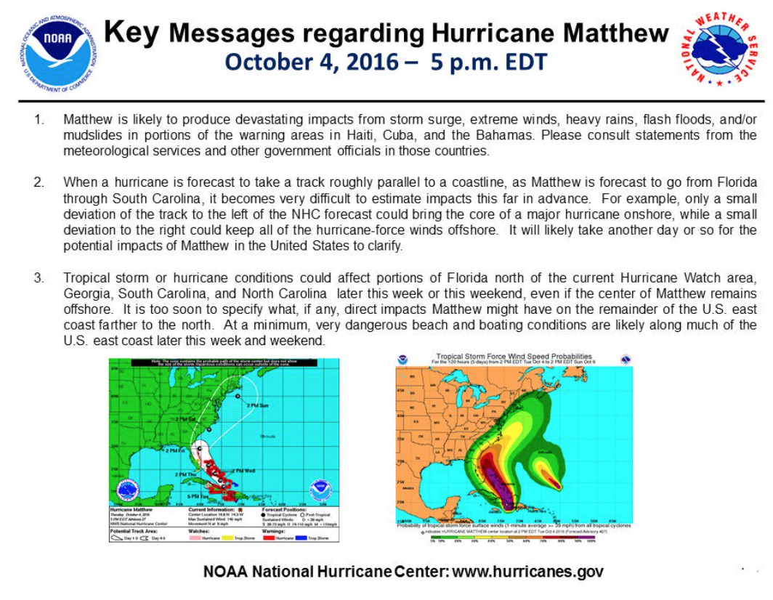
Enhanced Messaging
Key messages will continue to be included in Discussion & shared on Social Media

Slide 13
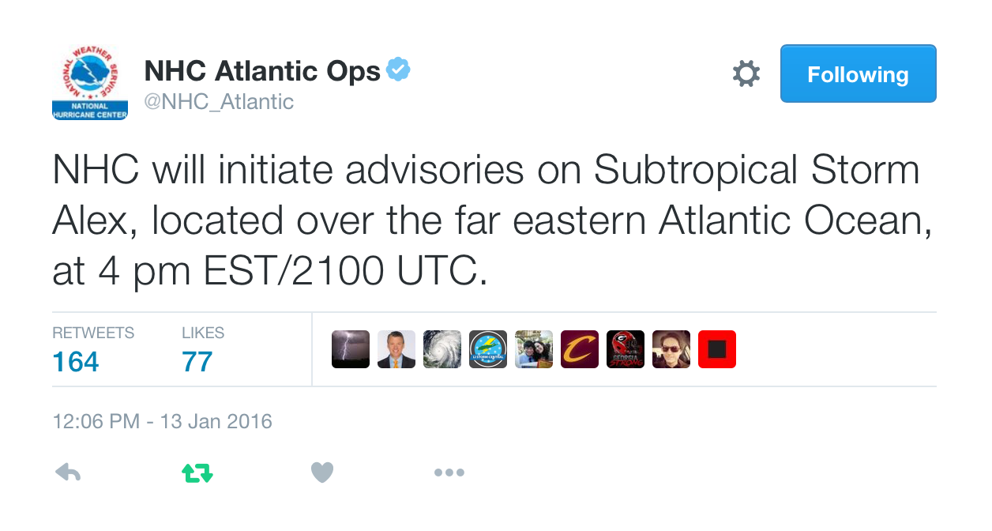
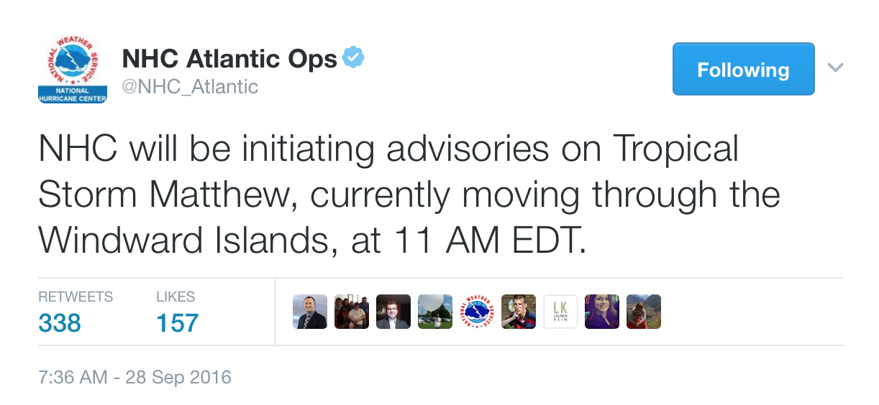
Enhanced Messaging
NHC Special Messages
An example of special messages that are posted to the NHC website and Twitter simultaneously to indicate when advisories will be initiated.

Slide 14
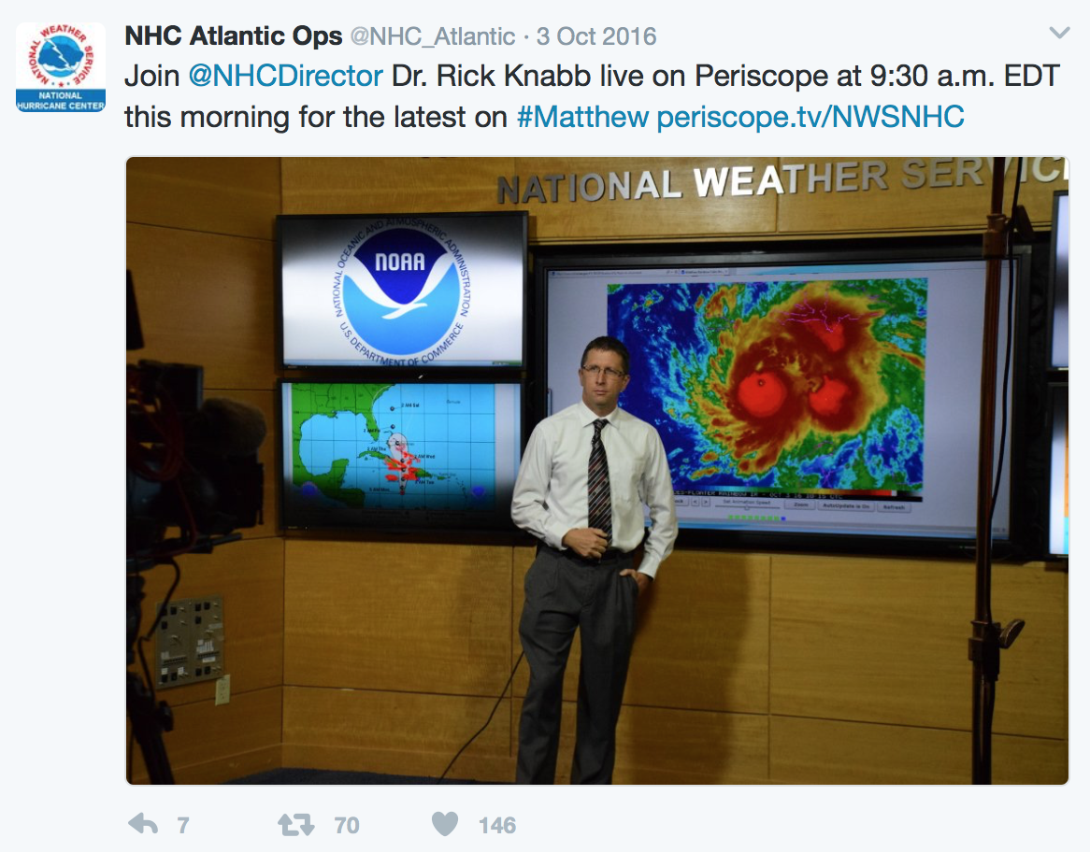
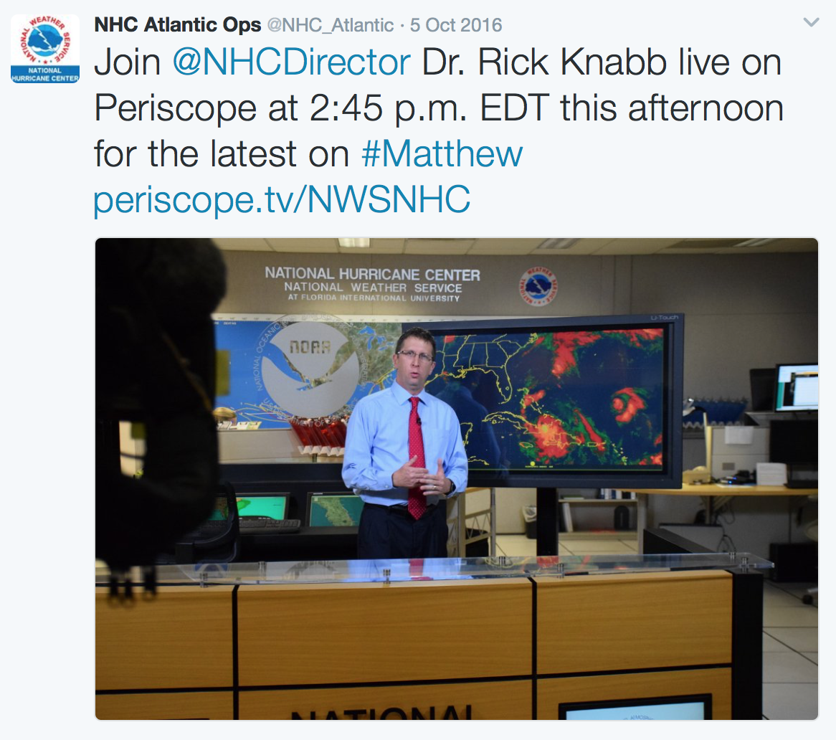
NHC on Periscope
NHC Director led live broadcasts during hurricanes Hermine and Matthew.

Slide 15
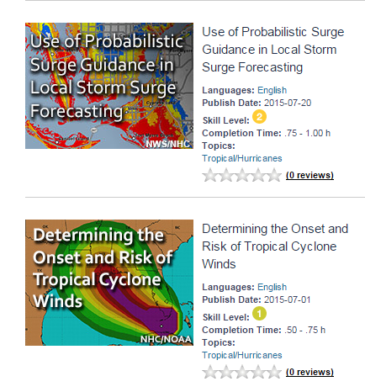
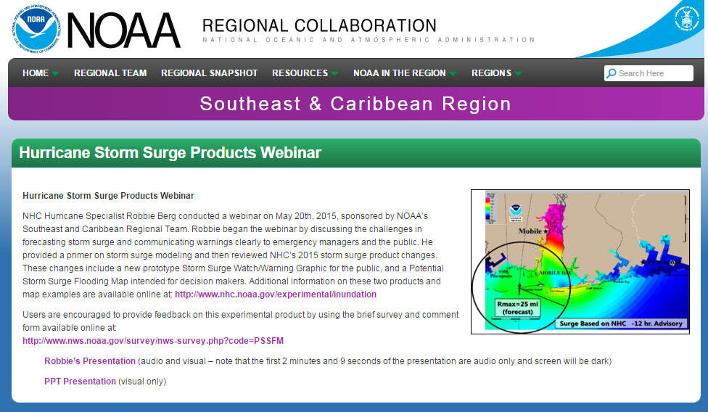
Online Webinars & Training
Storm surge and tropical cyclone related COMET modules online
  Introduction to Tropical Cyclone Storm Surge
  Storm Surge and Datums
  Forecasting Tropical Cyclone Storm Surge
  Determining the Onset and Risk of Tropical Cyclone Winds
  Tropical Cyclone Forecast Uncertainty
  Real-Time Storm Surge Products
Webinar’s sponsored by NOAA’s Southeast & Caribbean Regional Team
  Planned for May/early June
  Geared toward emergency managers and broadcast meteorologists

Slide 16
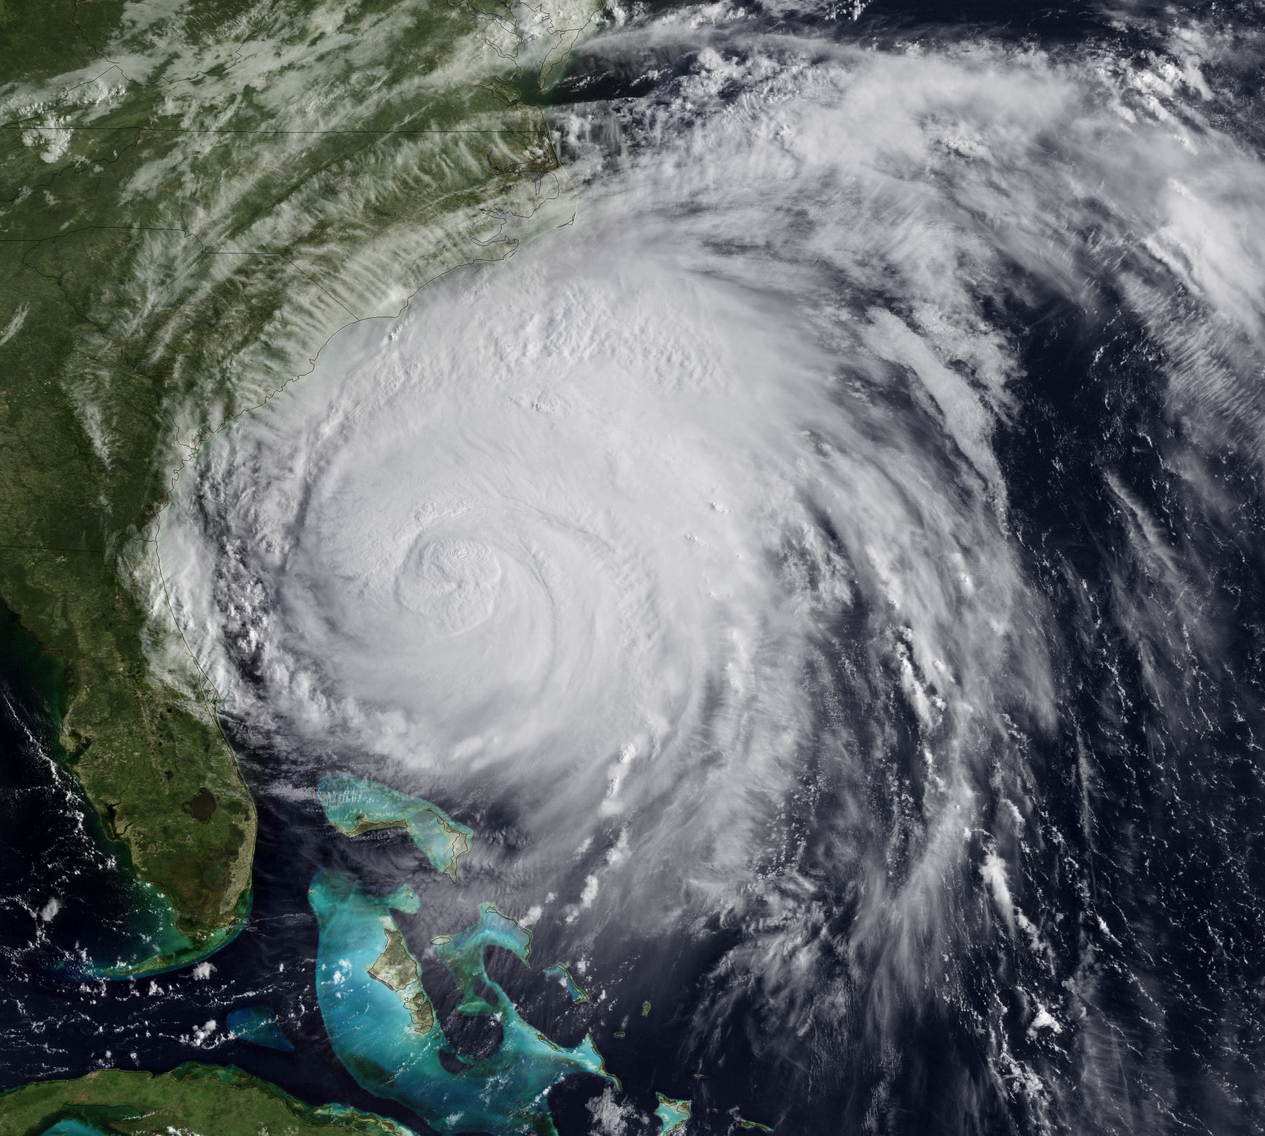
Questions/Comments

