Slide 1
“Weird Weather”
From Anticyclones to Zephyrs
Chris Fogarty
Canadian Hurricane Centre
ALLways Presentation
March 6 2026

Slide 2
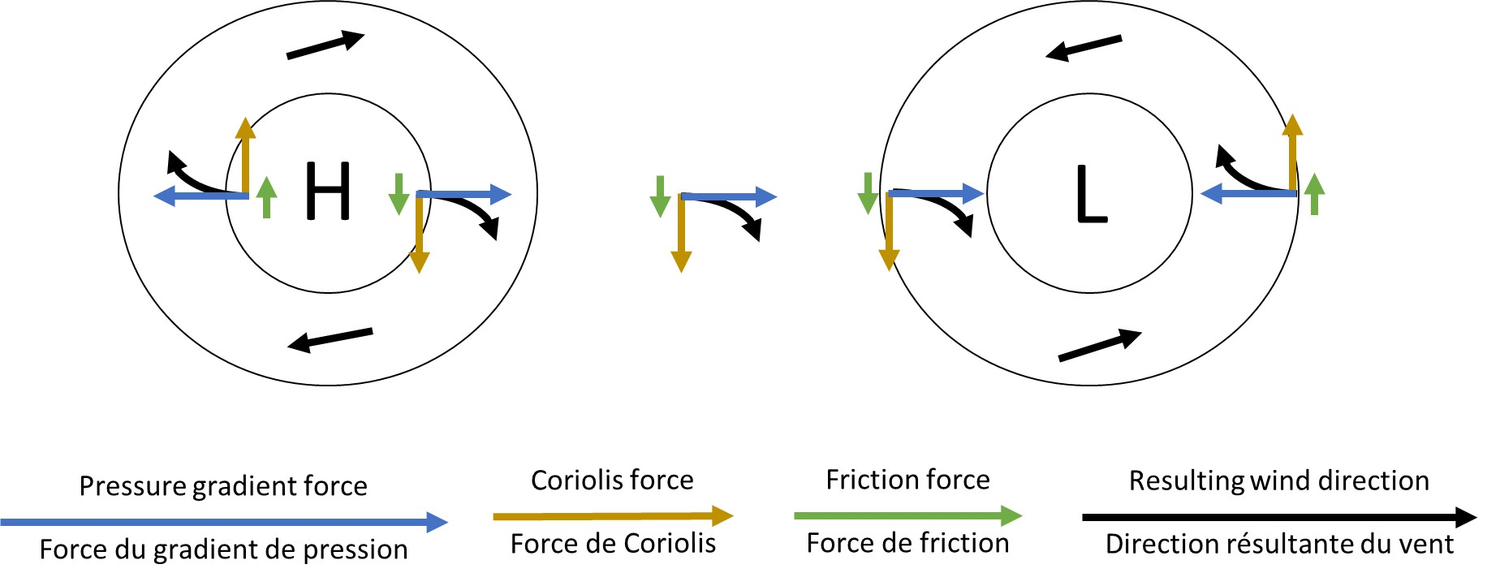
Anticyclone – High pressure

Slide 3
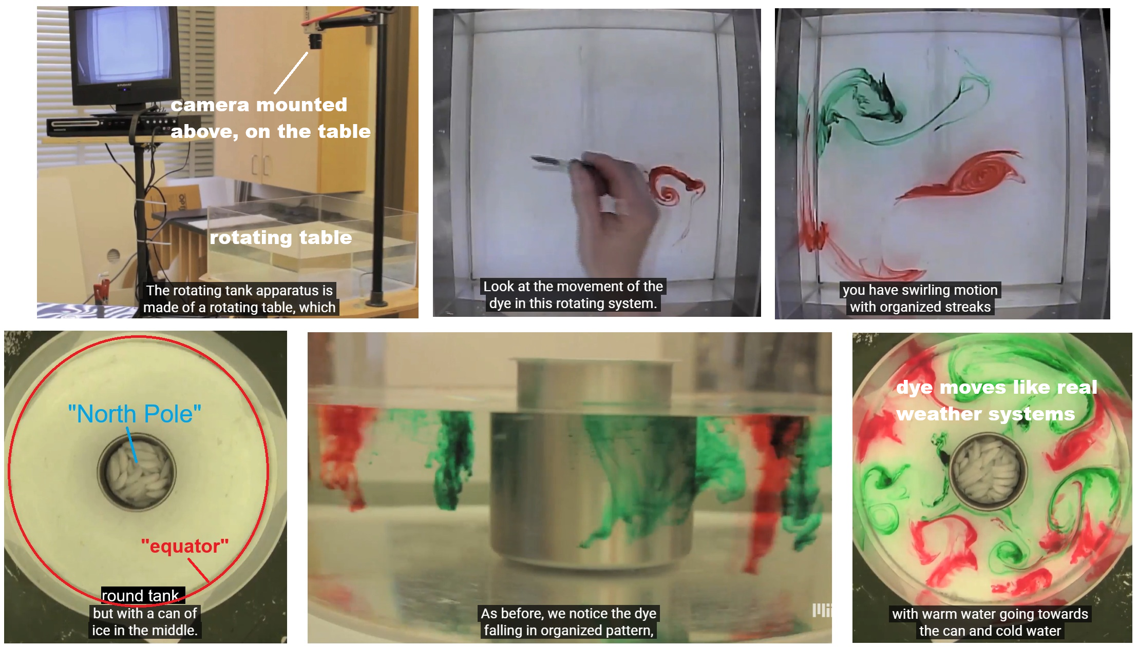
Weather systems explained – laboratory water tank
video
Before adding dye drops,
dip fingers into the water
a number of times to replicate natural ‘chaos’ in nature

Slide 4
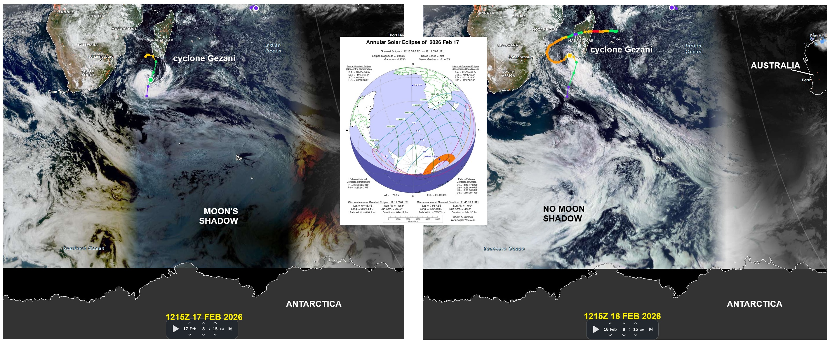
Eclipse – recent solar eclipse from satellite

Slide 5
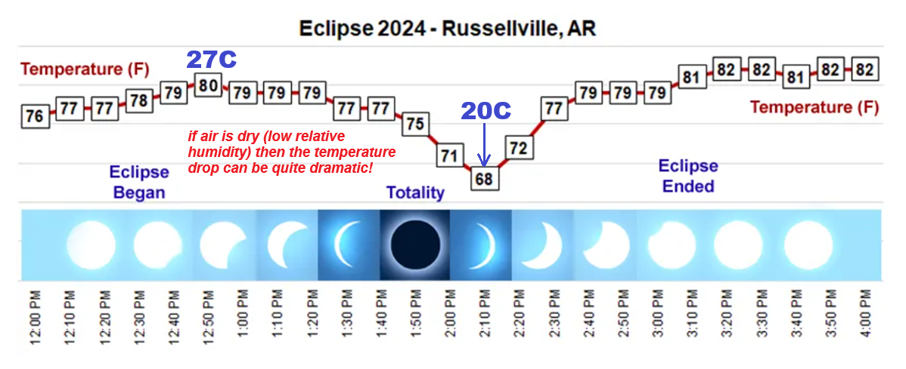
Eclipse – total solar - temperature changes

Slide 6
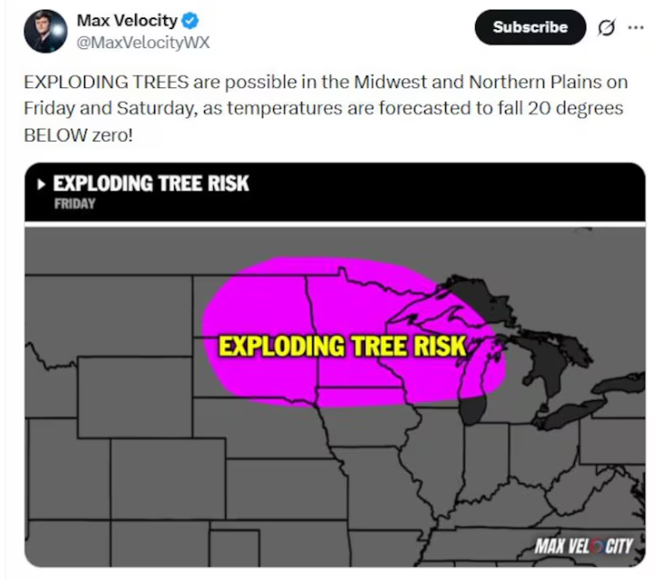
Exploding trees!? (late January 2026)
Not exactly – but trees can crack when they are moist from perhaps excess moisture in the fall then rapid freeze in a winter airmasss
Frost “quakes” – similar phenom – happens in ground or rafter in your roof – loud banging b/c freezing water expands

Slide 7
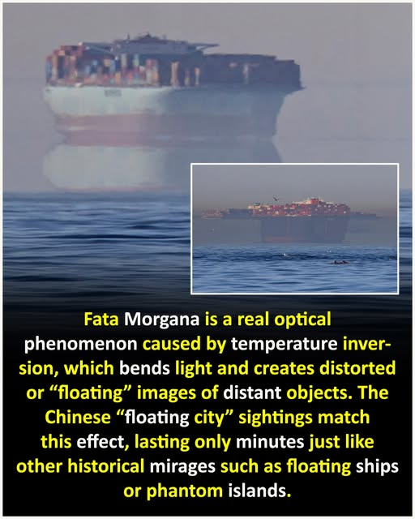
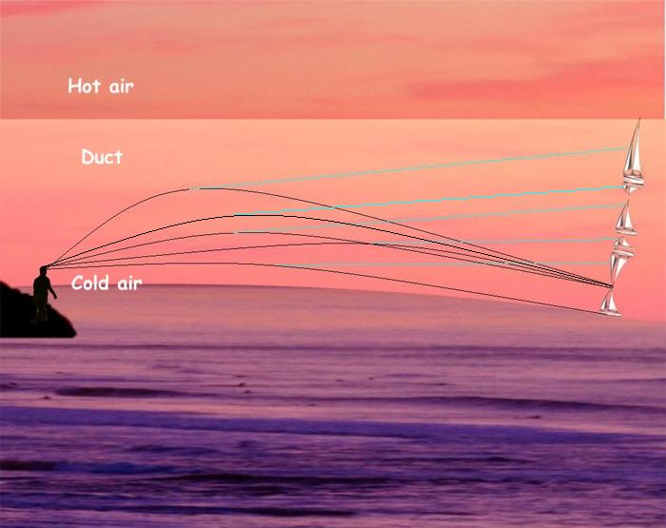
Fata Morgana – floating ship mirage

Slide 8
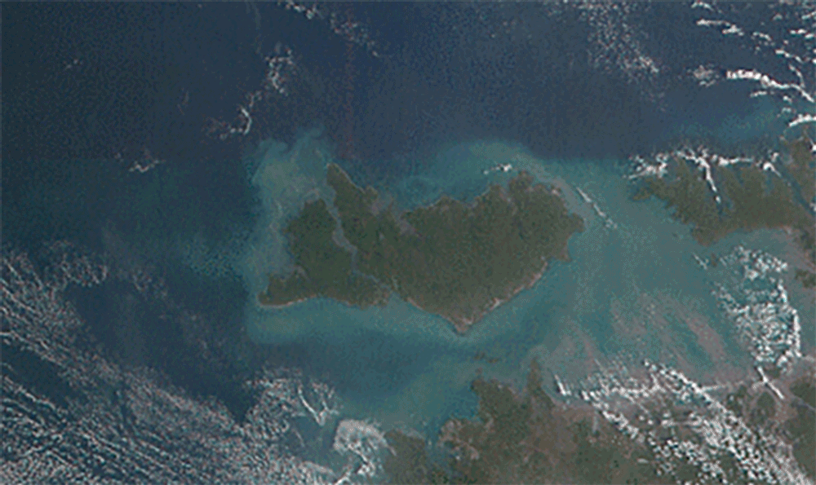
Hector the Convector – some weather phenomenon have special names based on their location and predictability

Slide 9
Other well-known / Colloquial terms / named weather phenomenon
Alberta Clipper
Bomb Low/Cyclone
Chinook
Colorado Low
Foehn Winds (European origin – similar to Les Suetes in Cape Breton)
Haboob – dust storm (Arabic term related to sand/blasting)
Nor’Easter
Pineapple Express
Tule Fog

Slide 10
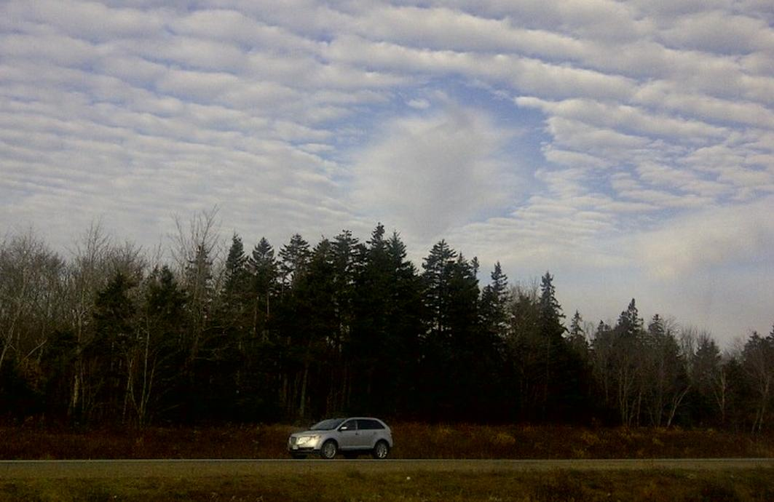
Hole Punch Cloud (5 Nov 2013 near YHZ)

Slide 11
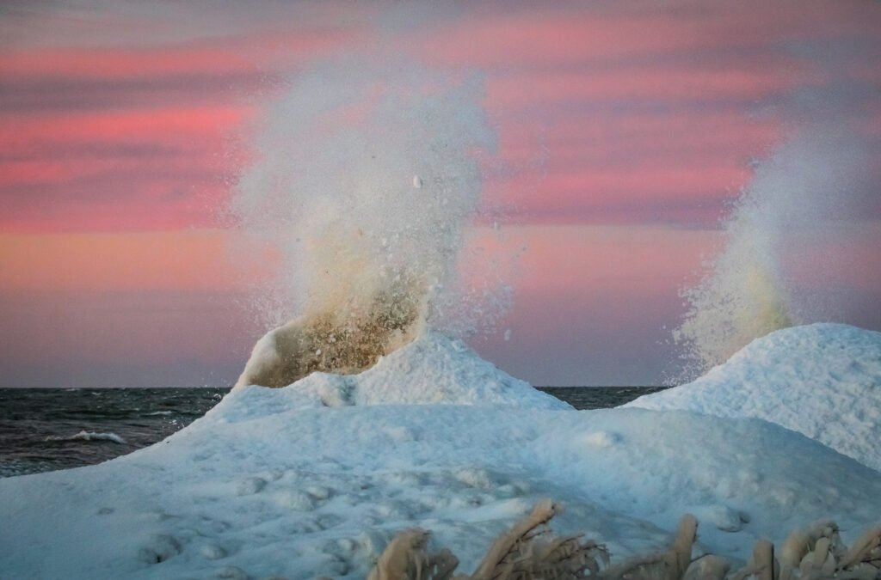
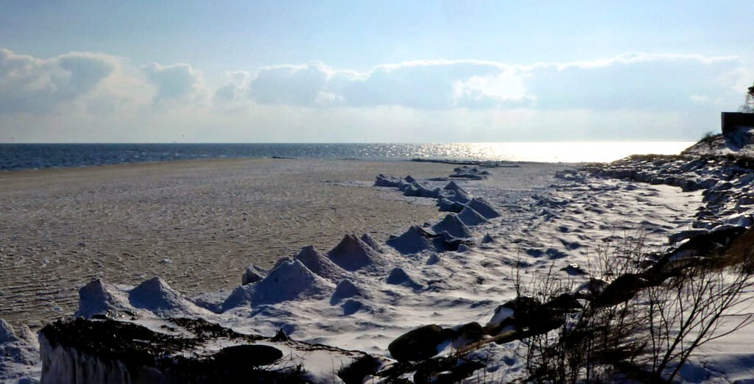
Ice Volcanoes

Slide 12
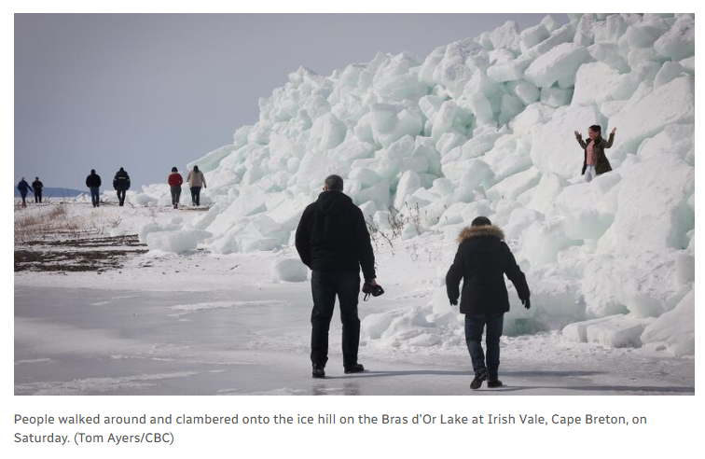
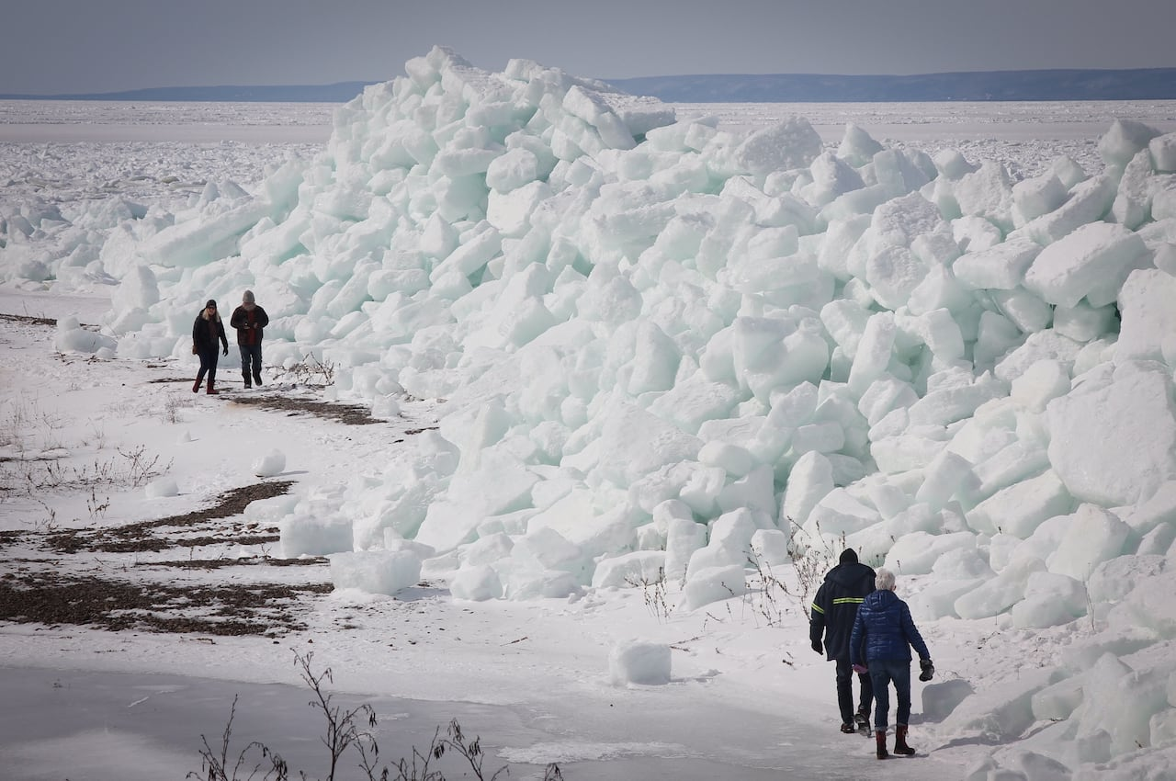
Ice rafting / Ice walls
March 2019 southern Bras D’Or Lakes – almost like a “storm surge” but of ice

Slide 13
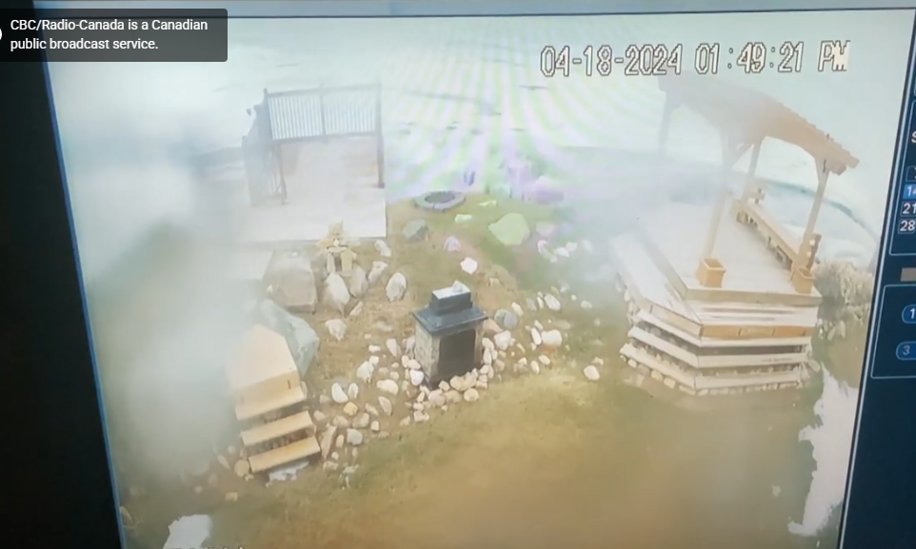
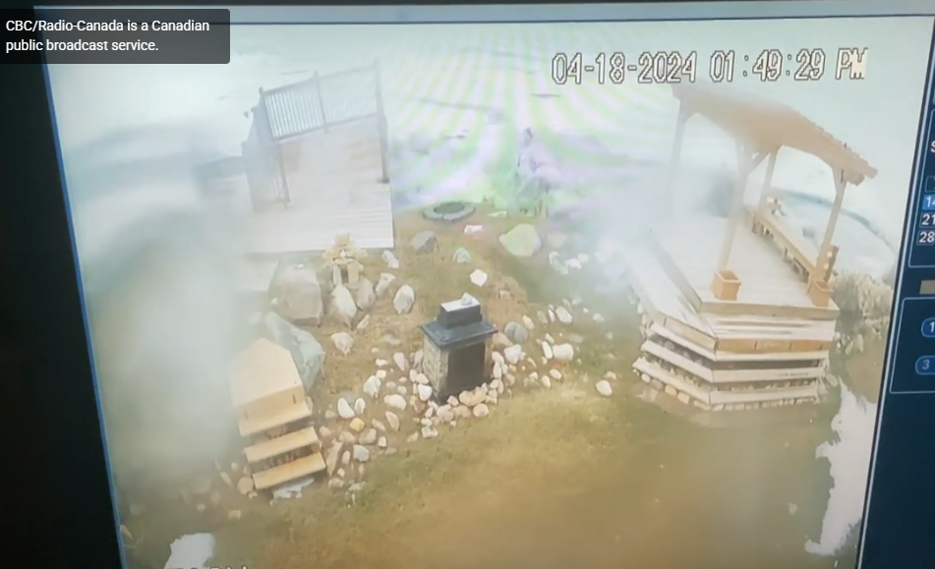
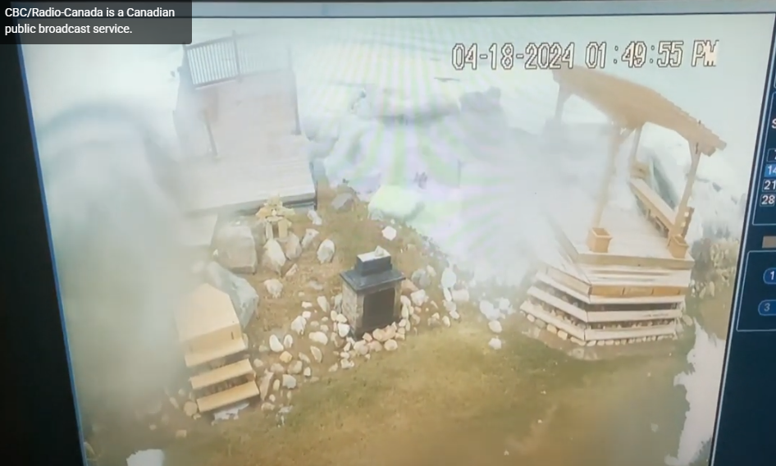
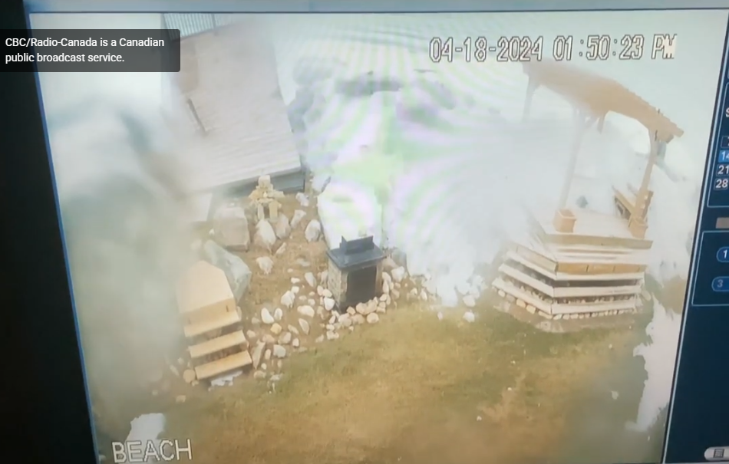

Slide 14
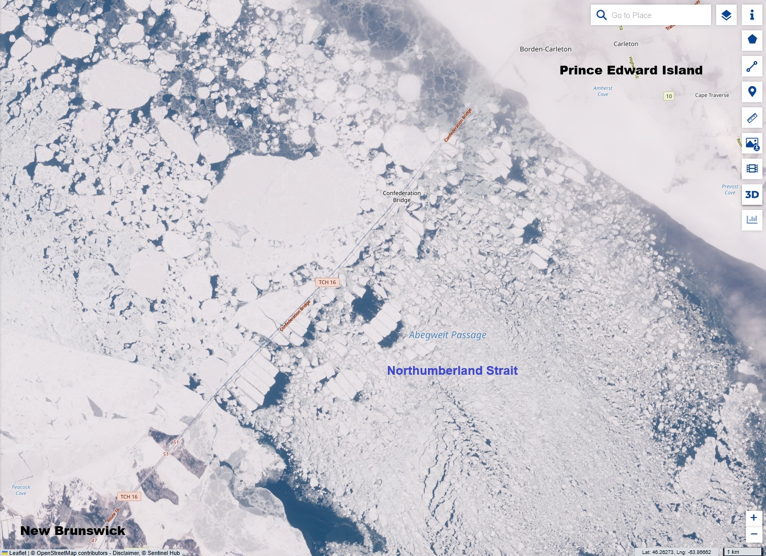
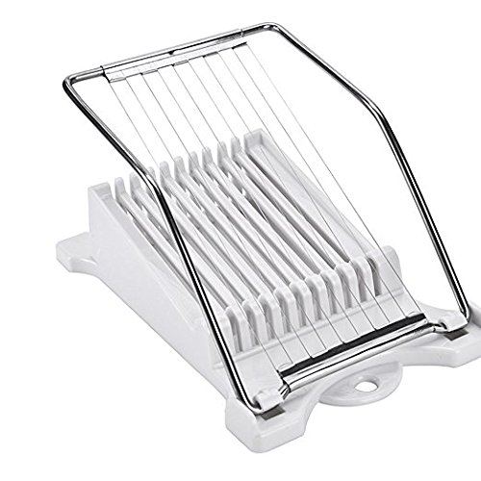
Super high-resolution satellite showing Confederation bridge piers slicing up sea ice

Slide 15
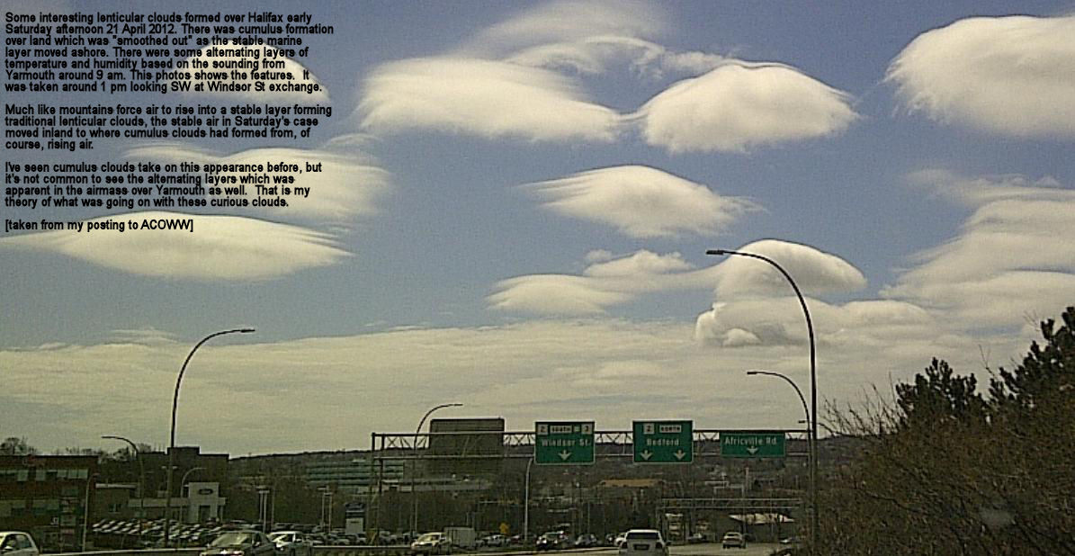
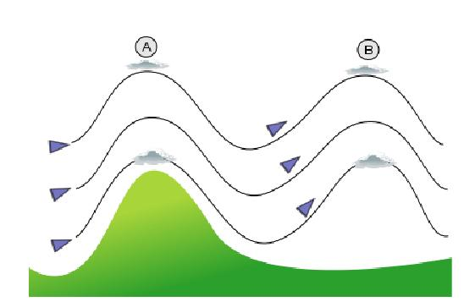
Lenticular clouds – 21 April 2012
Index of /Photos/Lenticular_Clouds_Halifax_21April2012/

Slide 16
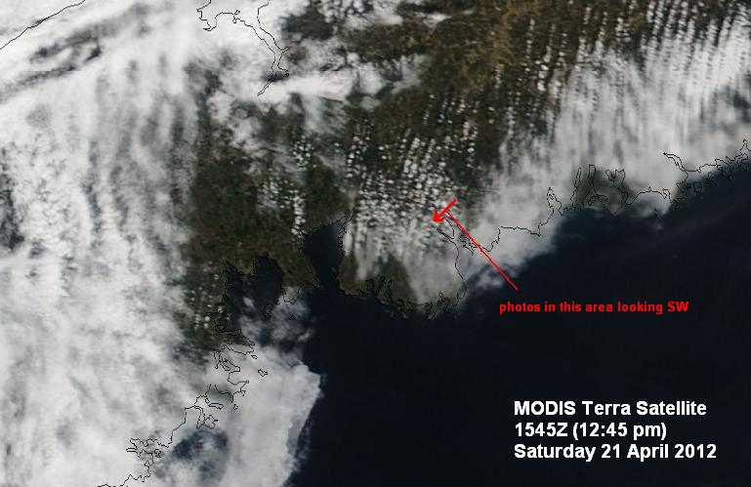
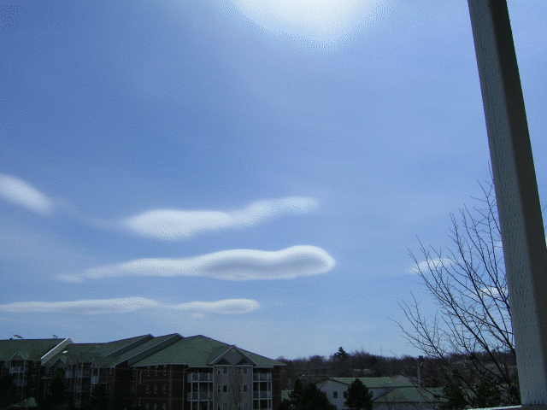

Slide 17
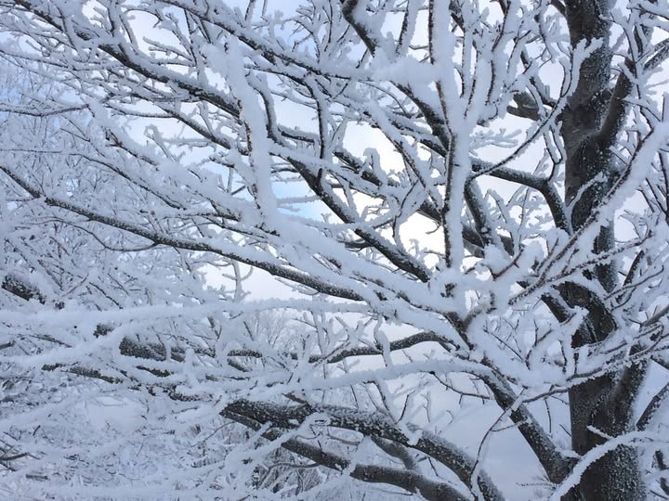
Rime Icing (Jan 10 2017 Sullivan’s Pond)

Slide 18
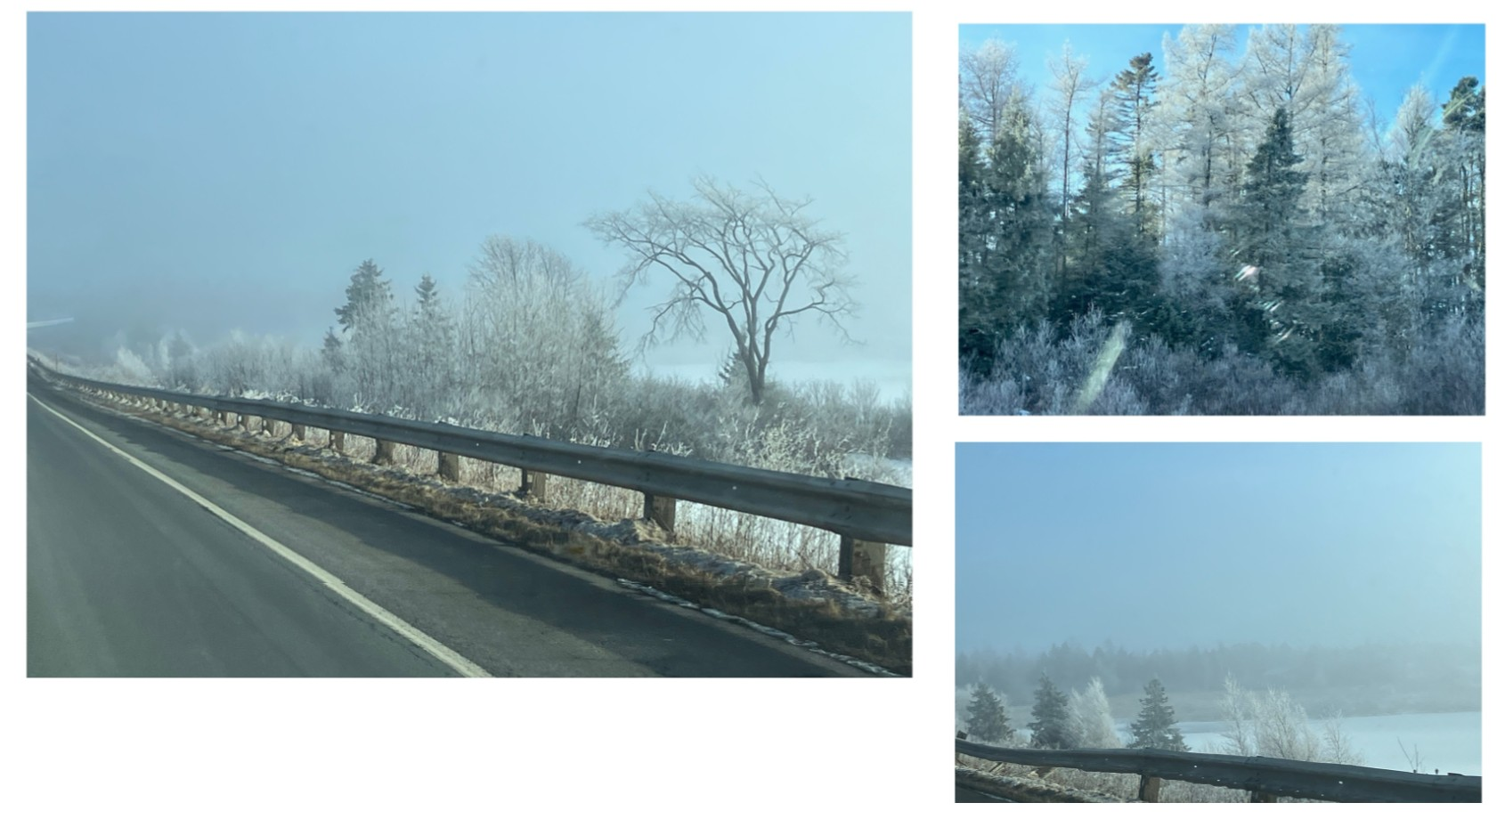
Rime Dec 28 2024 near Truro

Slide 19
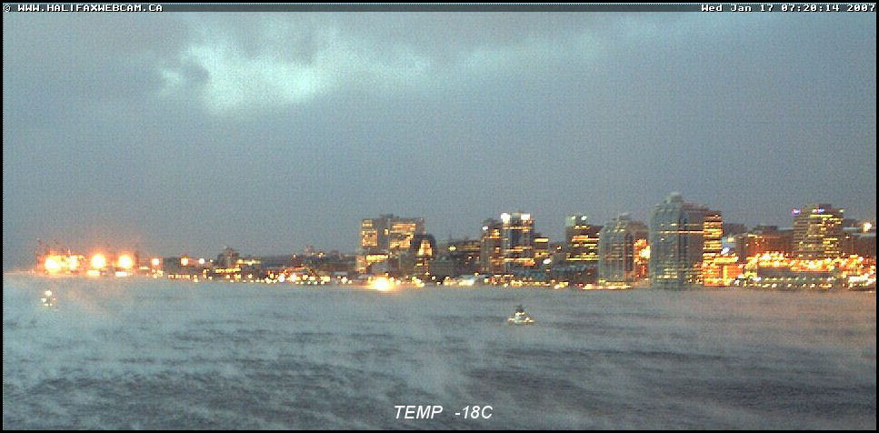
Sea smoke – Jan 17 2007

Slide 20
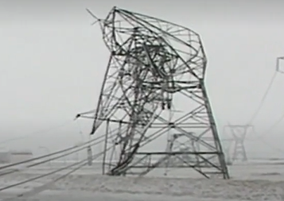
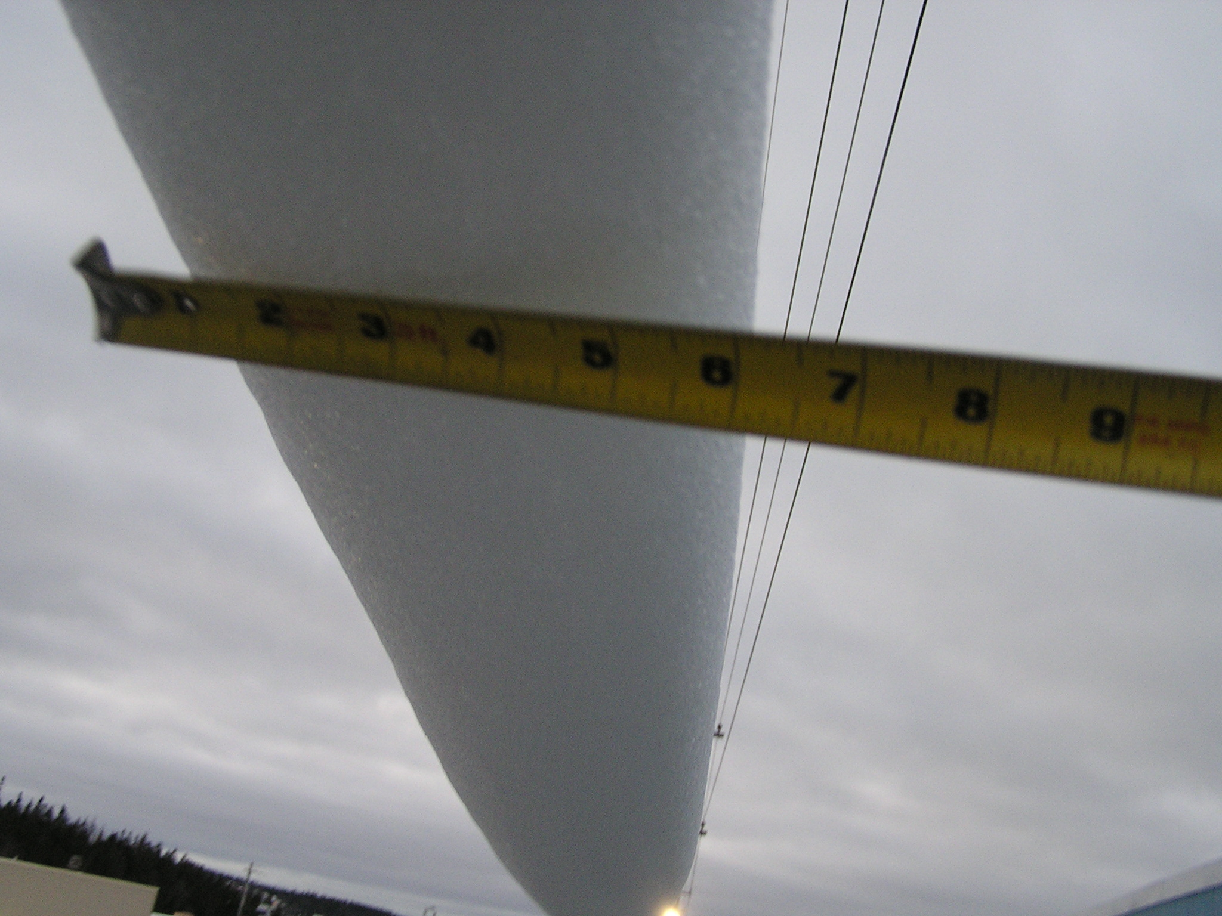
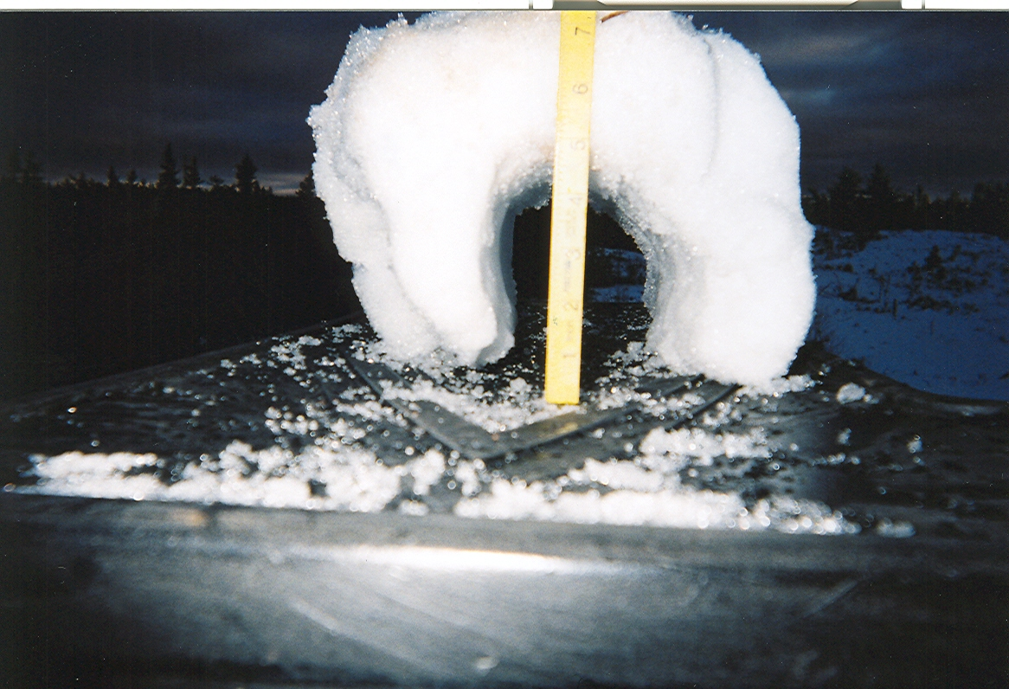
Snow Cylinders
Burnside – Dartmouth Nov 2004 – temp and dew point
very near 0.0C over extended period of time plus wind

Slide 21
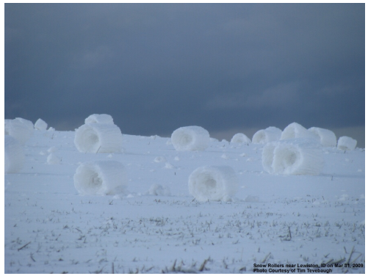
Snow Rollers

Slide 22
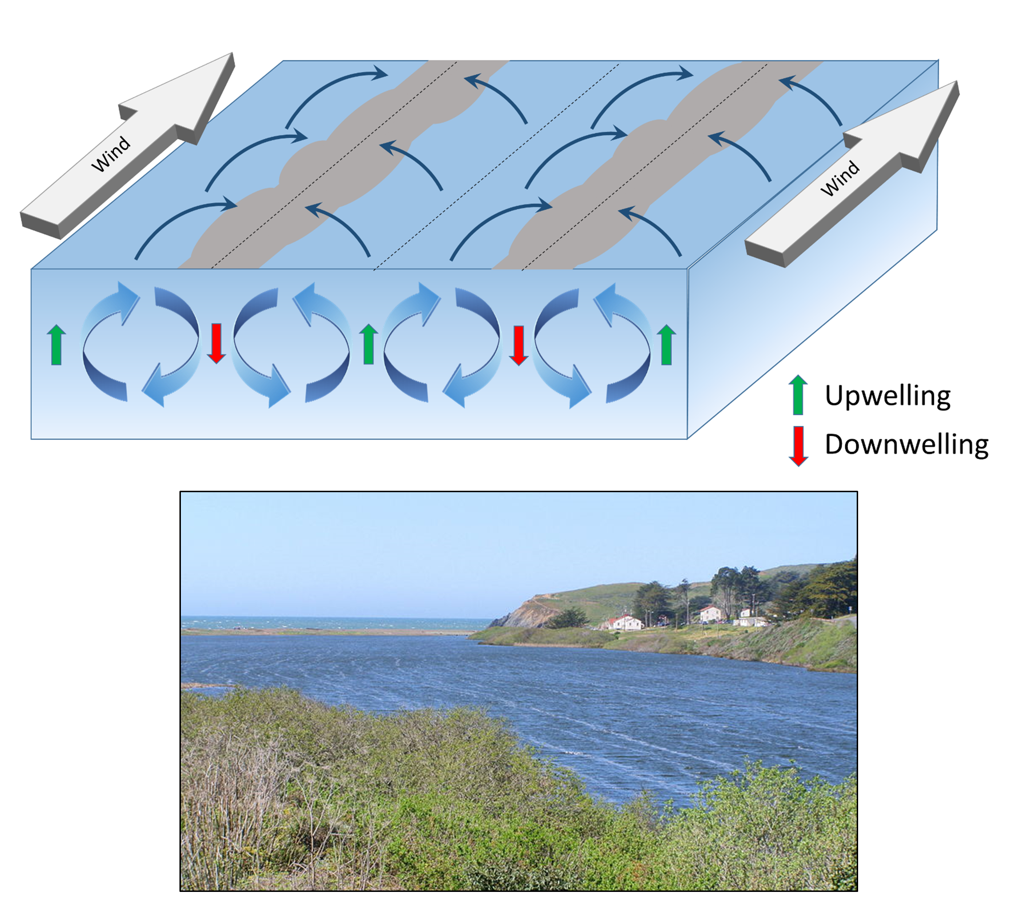
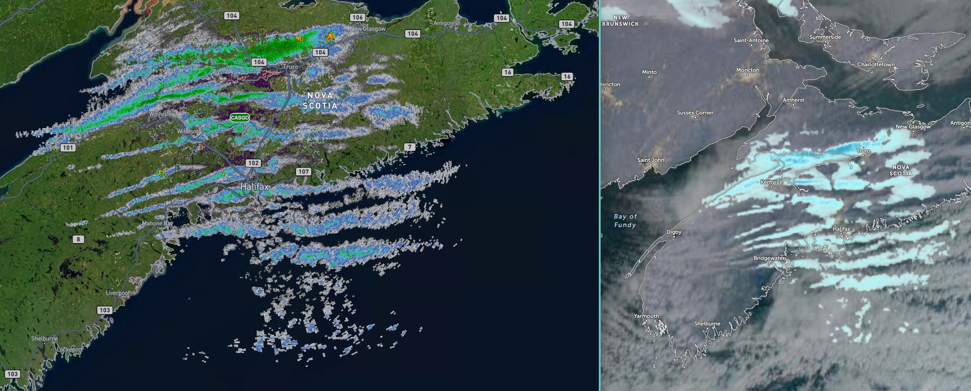
Snow Streamers – Jan 2 2026
Cold airmasses bring snow squalls and key contributor
To higher winter snowfalls in the “snow belts”

Slide 23
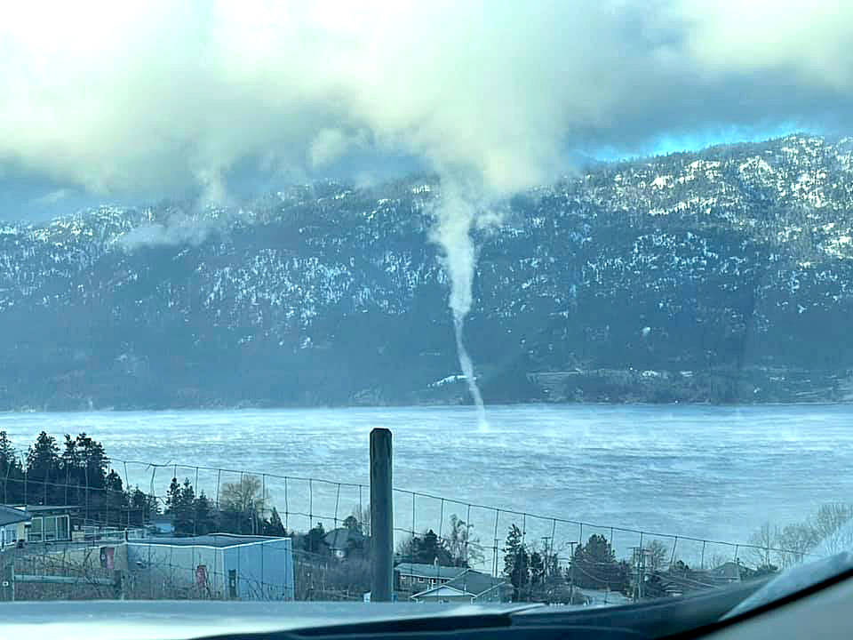
Steam Devil (related to ‘dust devil’)
Also related to ‘steam fog’ aka ‘arctic sea smoke’

Slide 24
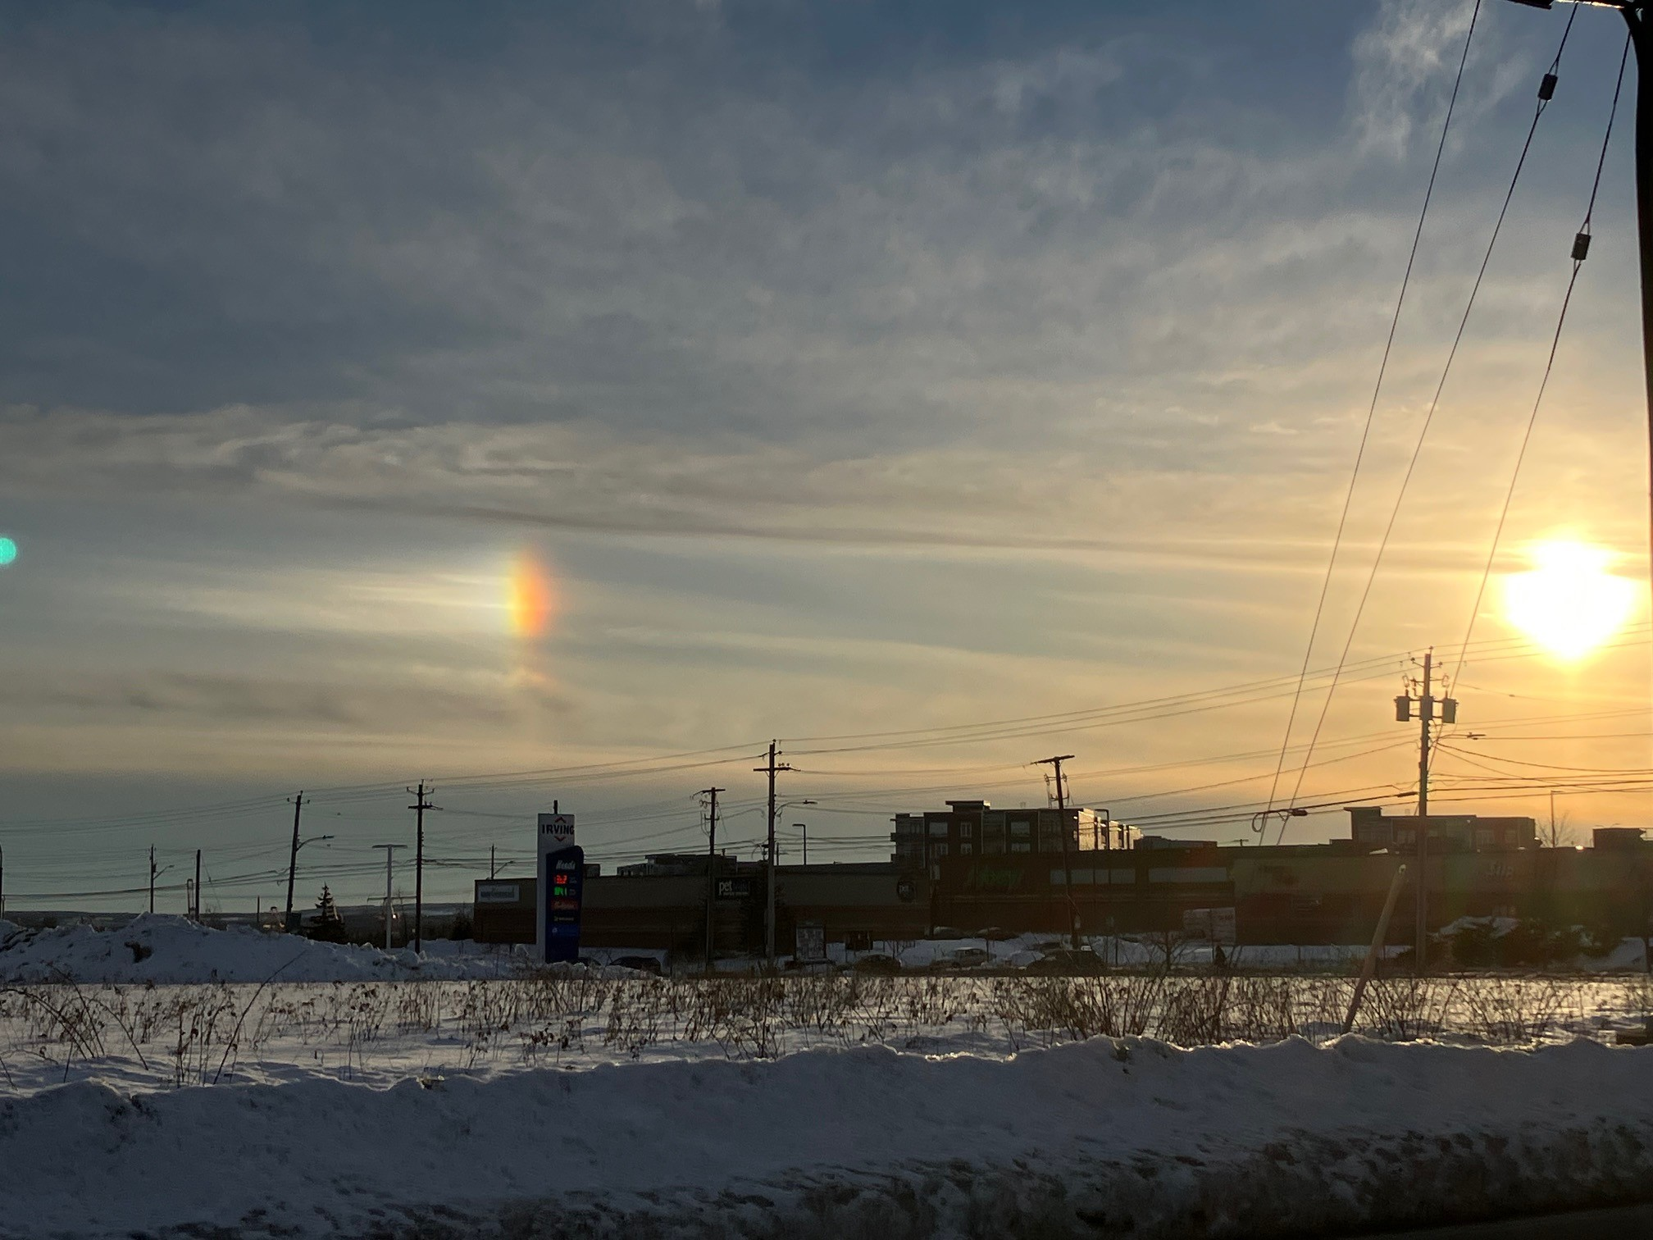
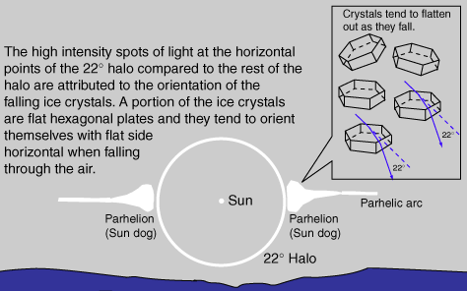
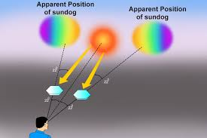
Sundogs Feb 20 2026 Halifax

Slide 25
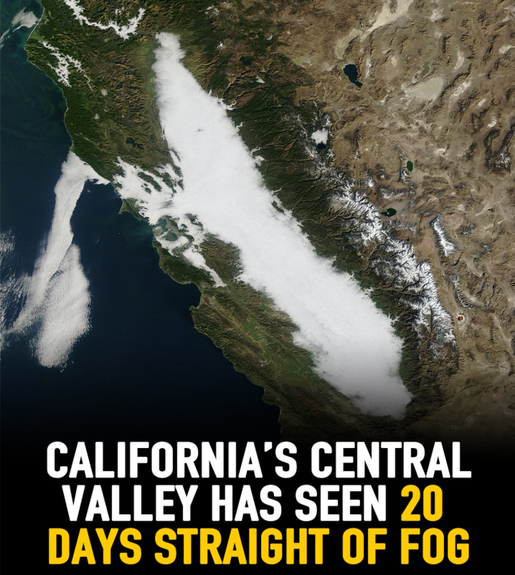
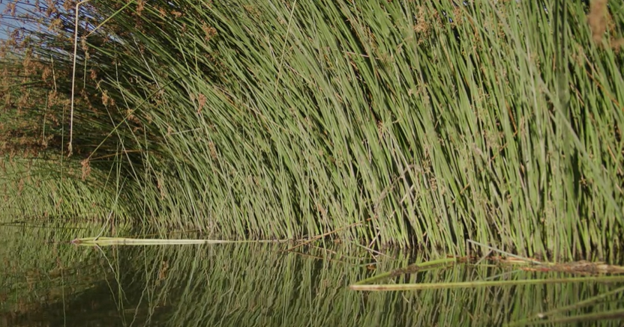
Tule Fog
Tule grass

Slide 26
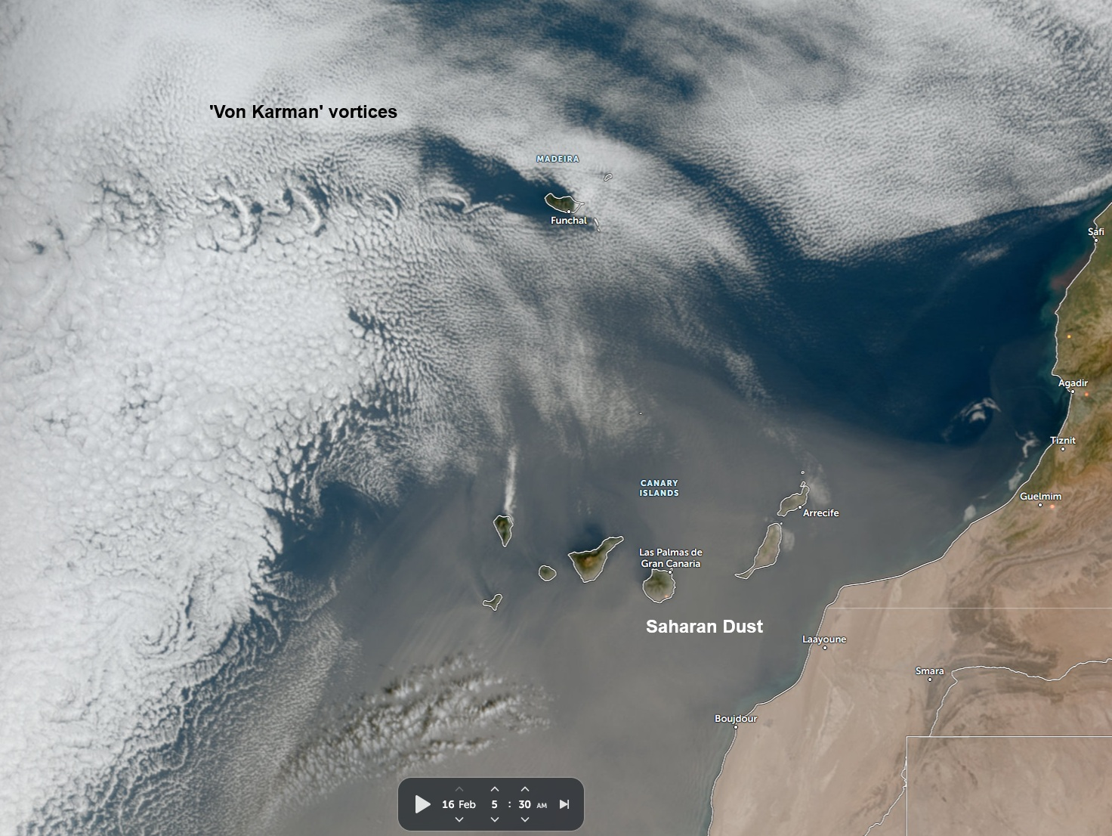
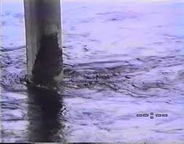
Von Karman vortices
Feb 16 2026 – Madeira Island Portugal

Slide 27
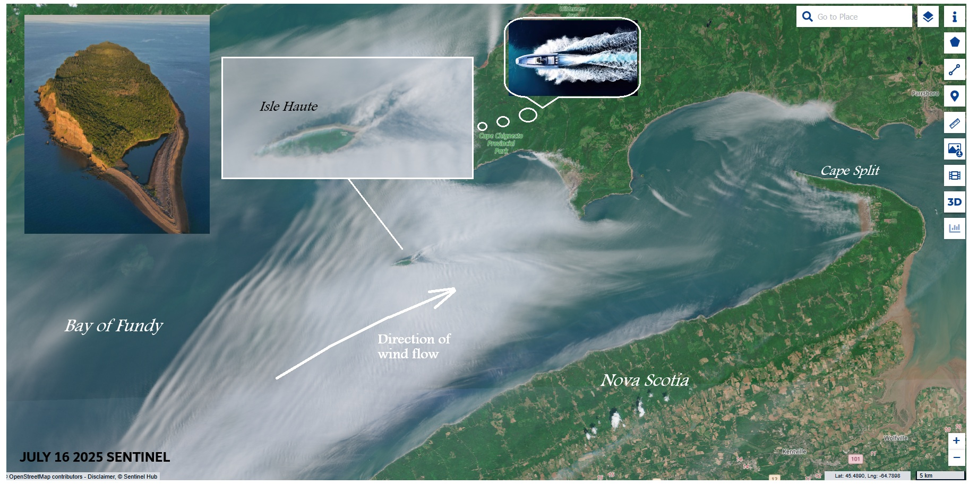
Wake clouds July 16 2025

Slide 28
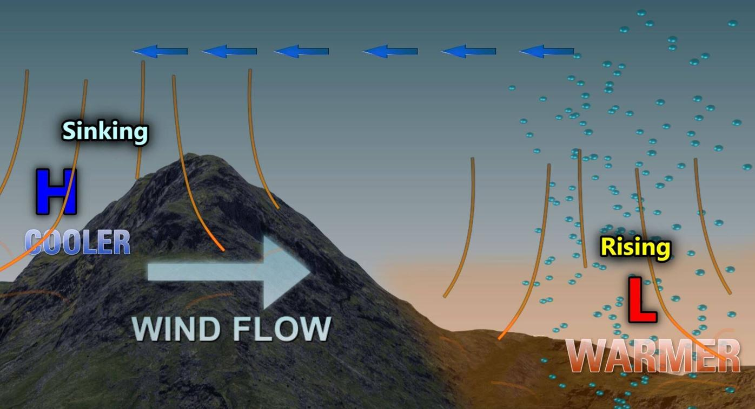
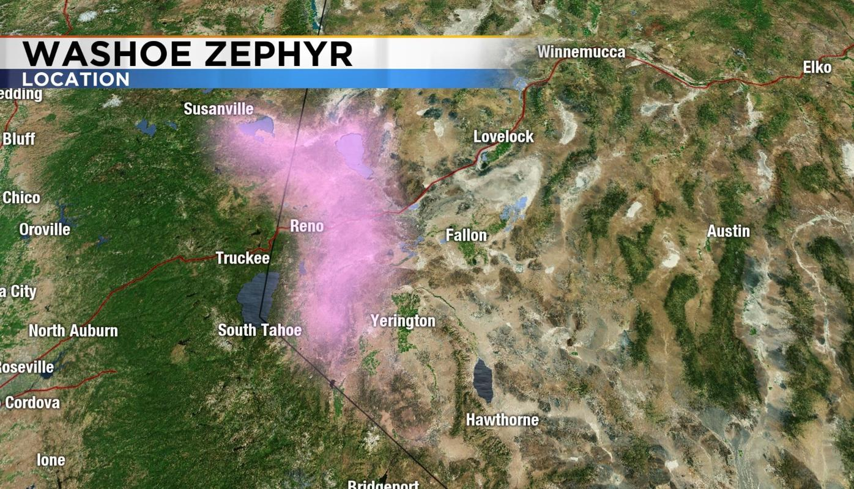
Zephyr – the ‘Washoe Zephyr’

Slide 29
Hurricane History in Canada

Slide 30
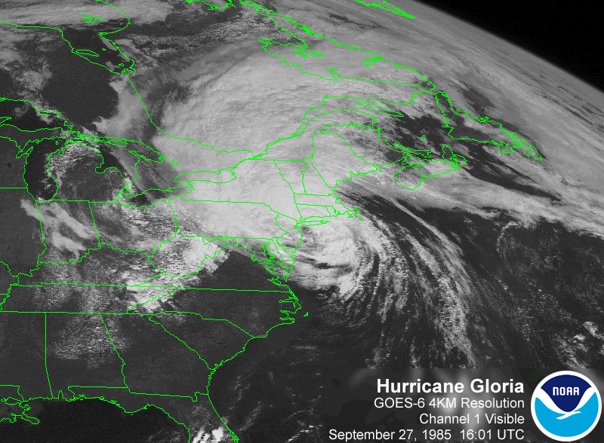
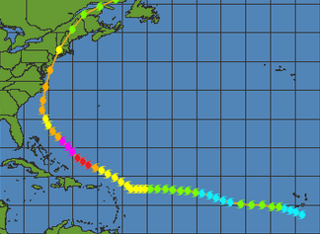

Slide 31
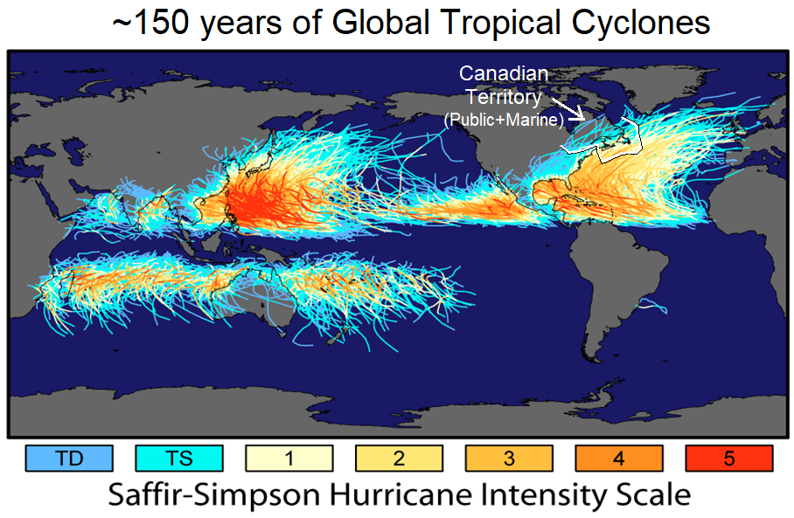
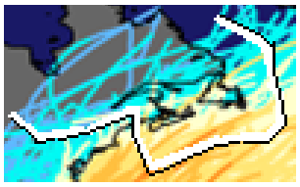

Slide 32
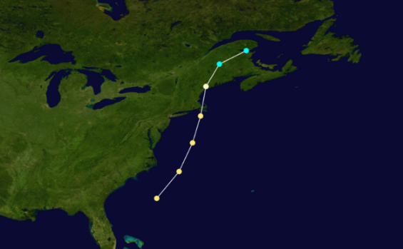
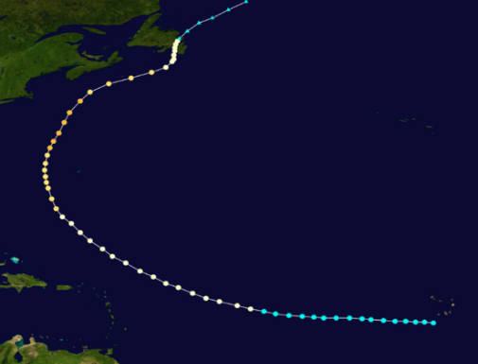
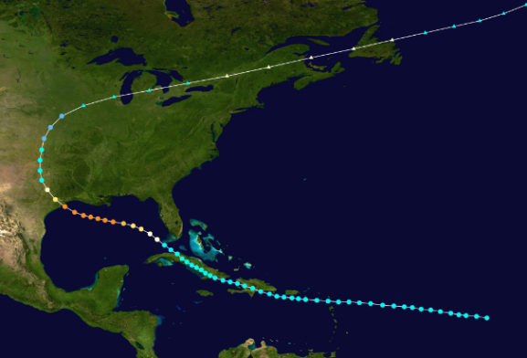








On average there is 1 severe event (>100 million $ damages) every ~10-15 years
“Great Nova Scotia
Cyclone”
Aug 1873
“Galveston Hurricane”
Sept 1900
“Saxby Gale”
Oct 1869
“Hazel”
Oct 1954
“Edna”
Sept 1954
“Great August Gale”
1927
“Escuminac Disaster”
Jun 1959
“Juan”
Sept 2003
“Igor”
Sept 2010
“Beth”
Aug 1971
“Fiona”
Sept 2022
Abnormally long gap of ~30 years = complacency

Slide 33






Impacts in Canada
Juan 2003
Chantal 2007
Florence 2006
Noel 2007
Gabrielle 2001
Hazel 1954

Slide 34






Impacts in Canada
Beth 1971
Bill 2009
Earl 2010
Dorian 2019
Igor 2010
Hanna 2008

Slide 35







FIONA 2022

Slide 36



Morrison’s Beach, PEI

Slide 37


Mt Thom, Pictou Co., NS
Near Louisbourg, NS

Slide 38

Key aspects related to Climate Change

Slide 39
Other notes on Climate Change
Even if the weather didn’t change, the fact we are building lives and structures near the ocean (which we know is rising in may places) means increasing losses
More pollution (microscopic aerosols, “dirt”) in atmosphere = more precipitation from clouds – rain drops start with a nucleus of dirt/aerosol
Hurricanes: larger size (due higher humidity in atmosphere) and higher peak intensity; not necessarily more of them

Slide 40

Are we getting more storms? (Hurricanes) – history below for Eastern Canada
during the weather satellite era

Slide 41
CONTACT/RESOURCES
Chris Fogarty, PhD (@Cyclone_Fogarty) / X
Chris Fogarty, PhD (@cyclone-fogarty.bsky.social) — Bluesky
Email: chris.fogarty@ec.gc.ca
https://www.novaweather.net/novaweather_mainpage.pdf
https://Canada.ca/hurricanes

