Slide 1

The Canadian Hurricane Centre
Dr. Chris Fogarty, Manager – Canadian Hurricane Centre,
Dartmouth, NS, Canada
ECCC/MSC/ASPC-CHC

Slide 2
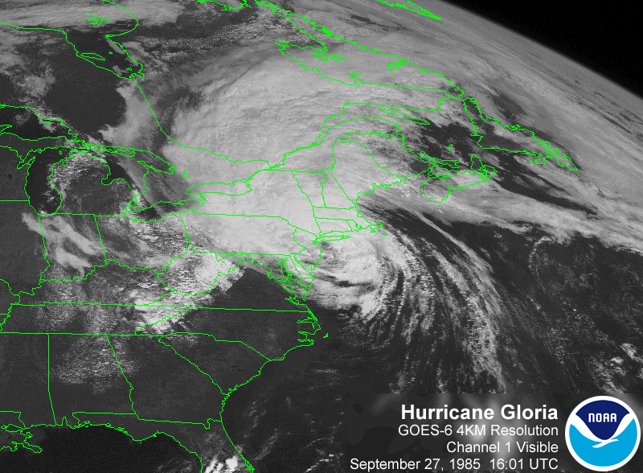
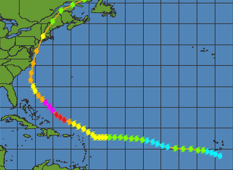

Slide 3
Origins of the CHC: all started with Hurricane Gloria in 1985
Canadians had to rely largely on neighboring New England forecasts / newscasts
Storm impact in Eastern Canada was much less than anticipated due to considerable confusion in the media / general public
Not knowing any different at the time, Canadians basically translated the destruction of Gloria in the eastern U.S. into Canada
Little understanding of the extratropical transition (ET) process then
The CHC officially designated 2 years later in 1987 – one lead forecaster (program lead) and subset (~9) of weather office forecasters maintained training and forecast experience in tropical cyclones/ET
The CHC is overtime-staffed on an event basis with still ~9 staff specializing in tropical meteorology that also work regular ASPC desks

Slide 4
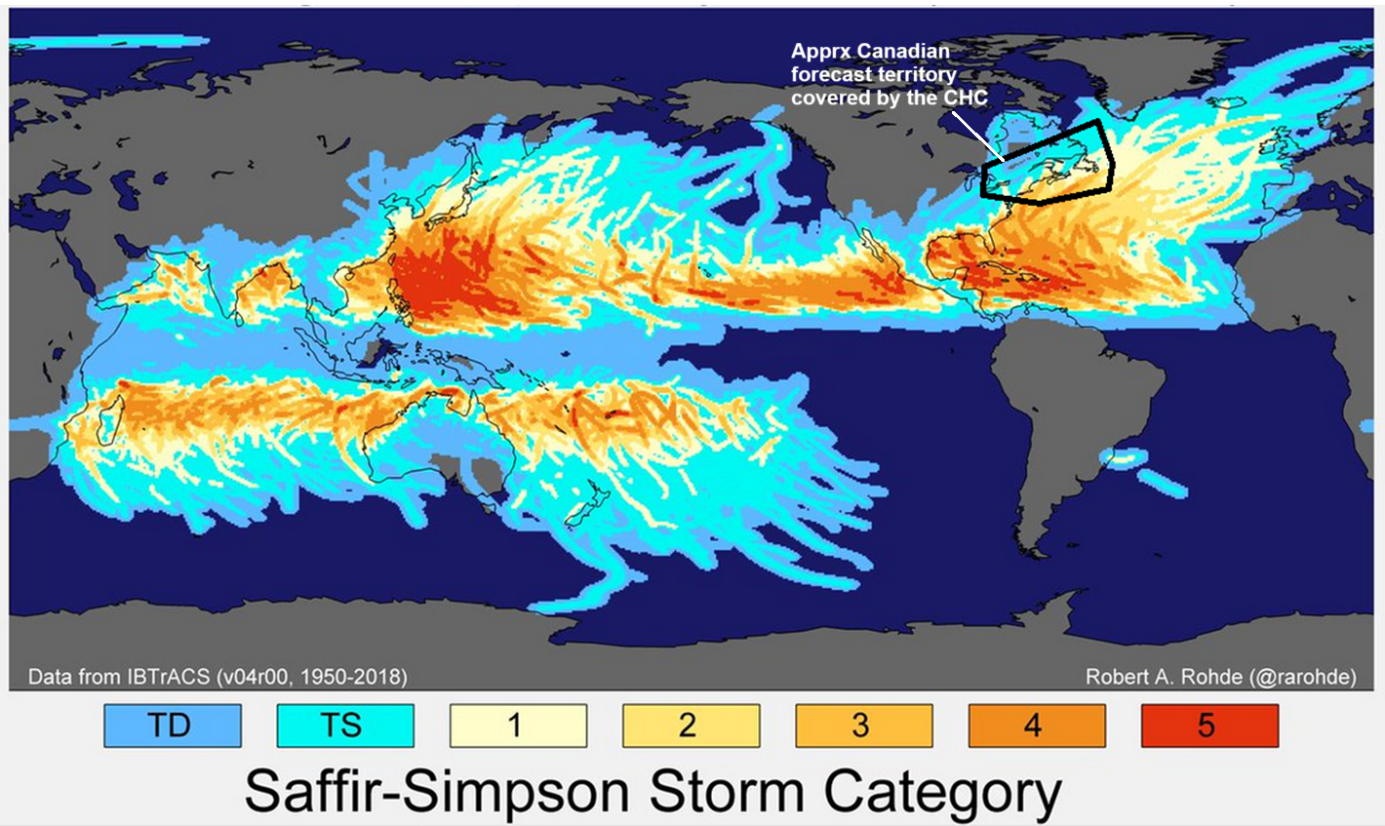
Big Picture – where the CHC fits
~70 years of global tracks of Tropical Cyclones (TCs)

Slide 5

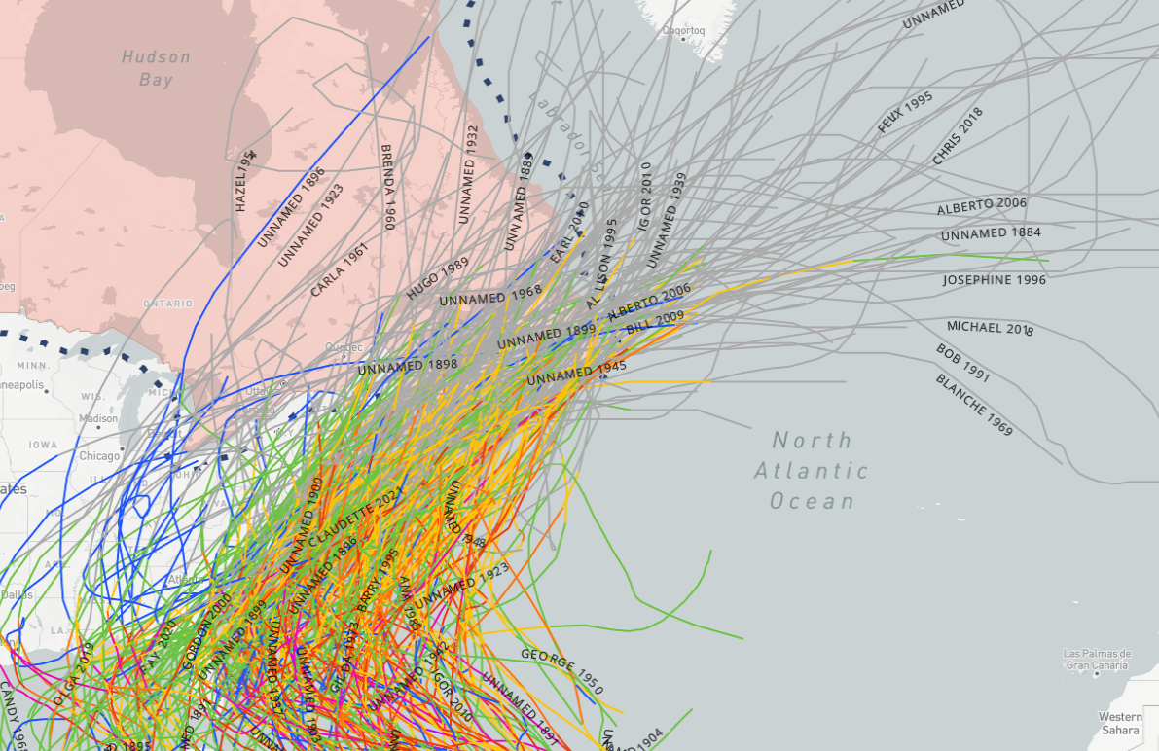

Tropical Cyclones in Canada
Since 1850, over 300 storms of tropical origin have tracked into Canadian land territory – even more in offshore ‘200 mile limit’ zone

Slide 6
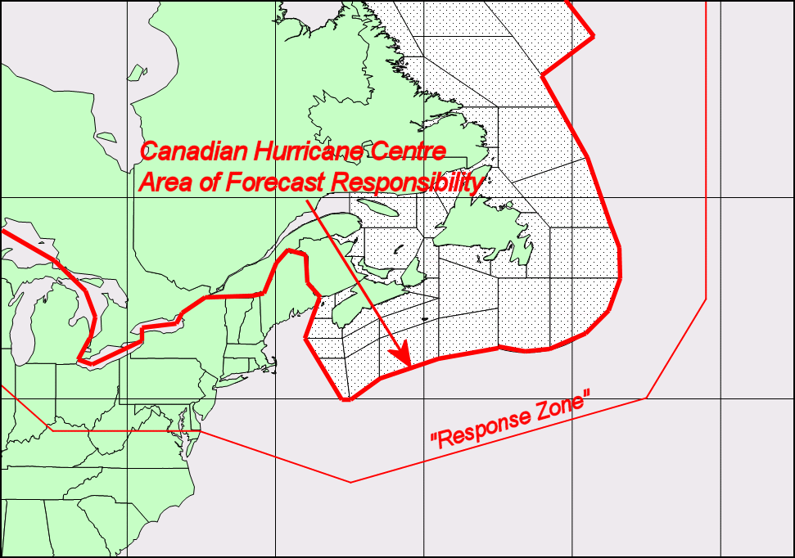
Canadian Hurricane Centre
Response Zone
On average, 1 or 2 storms directly affect Canadian land regions each year Another 2 or 3 typically threaten our offshore waters
1 or 2
2 or 3

Slide 7
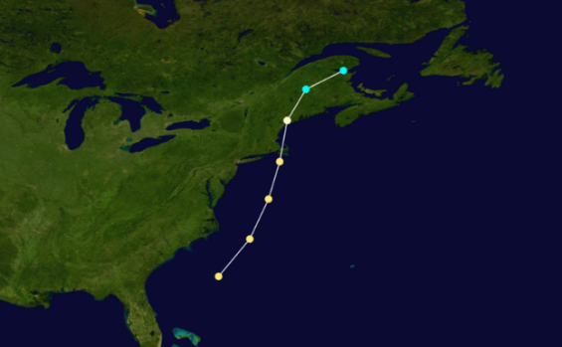
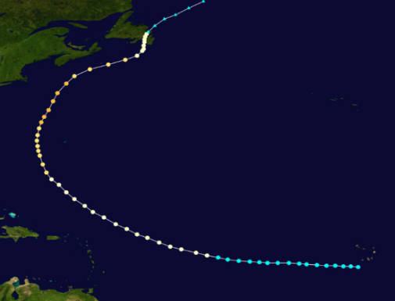
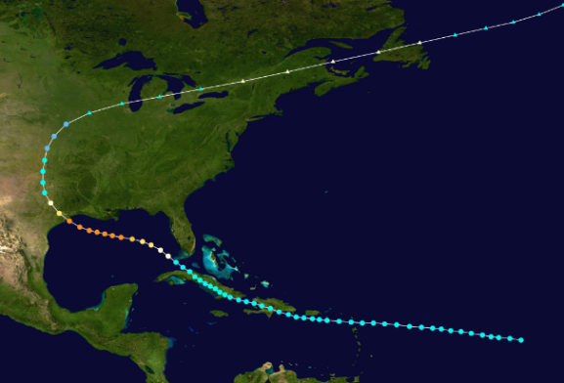
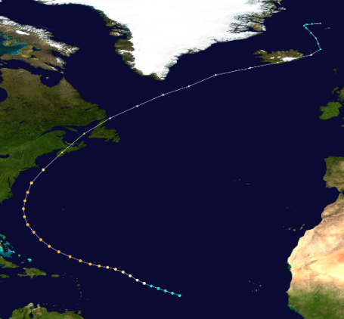
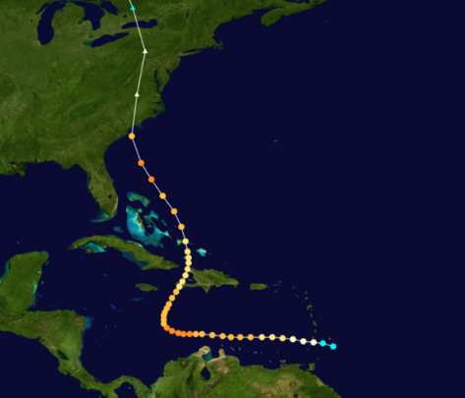
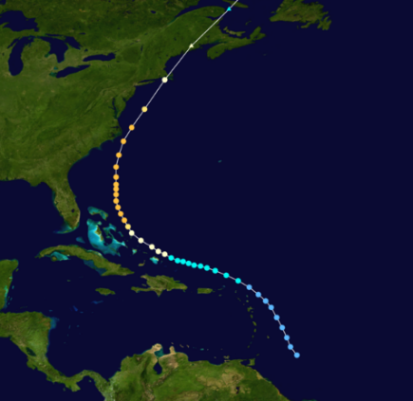
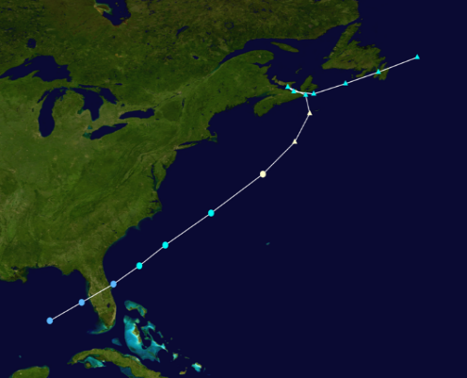
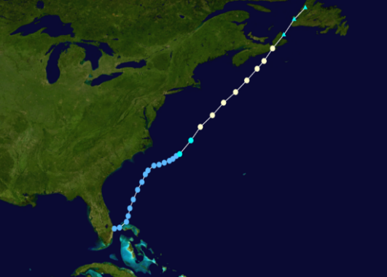
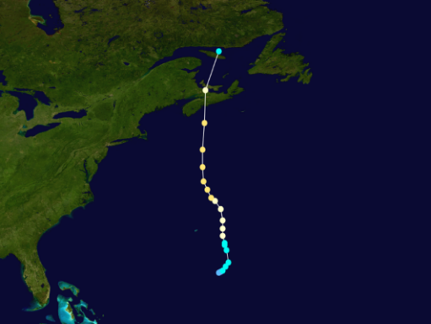
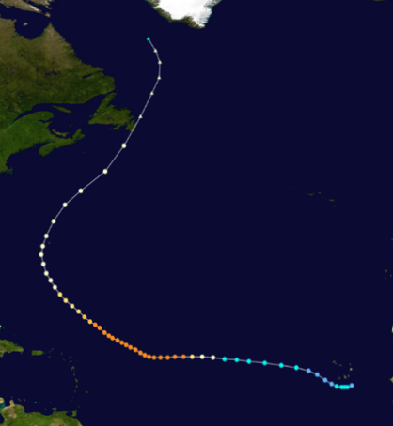
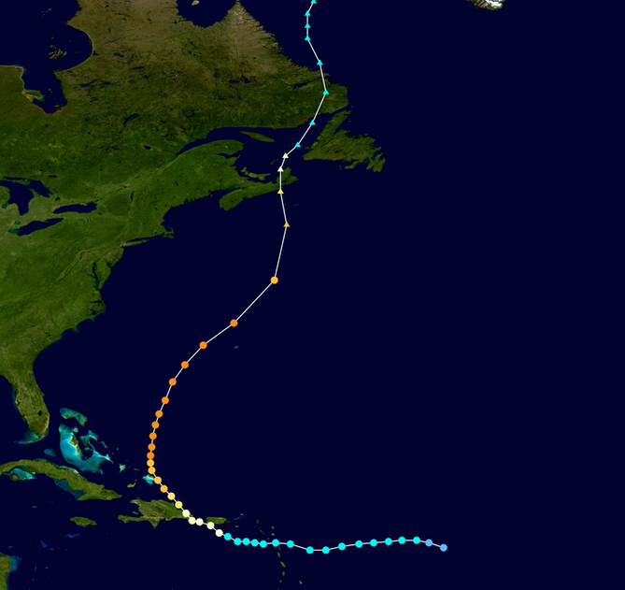
On average there is 1 severe event (>100 million $ damages) every ~10-15 years
“Great Nova Scotia
Cyclone”
Aug 1873
“Galveston Hurricane”
Sept 1900
“Saxby Gale”
Oct 1869
“Hazel”
Oct 1954
“Edna”
Sept 1954
“Great August Gale”
1927
“Escuminac Disaster”
Jun 1959
“Juan”
Sept 2003
“Igor”
Sept 2010
“Beth”
Aug 1971
“Fiona”
Sept 2022
Abnormally long gap of ~30 years = complacency

Slide 8
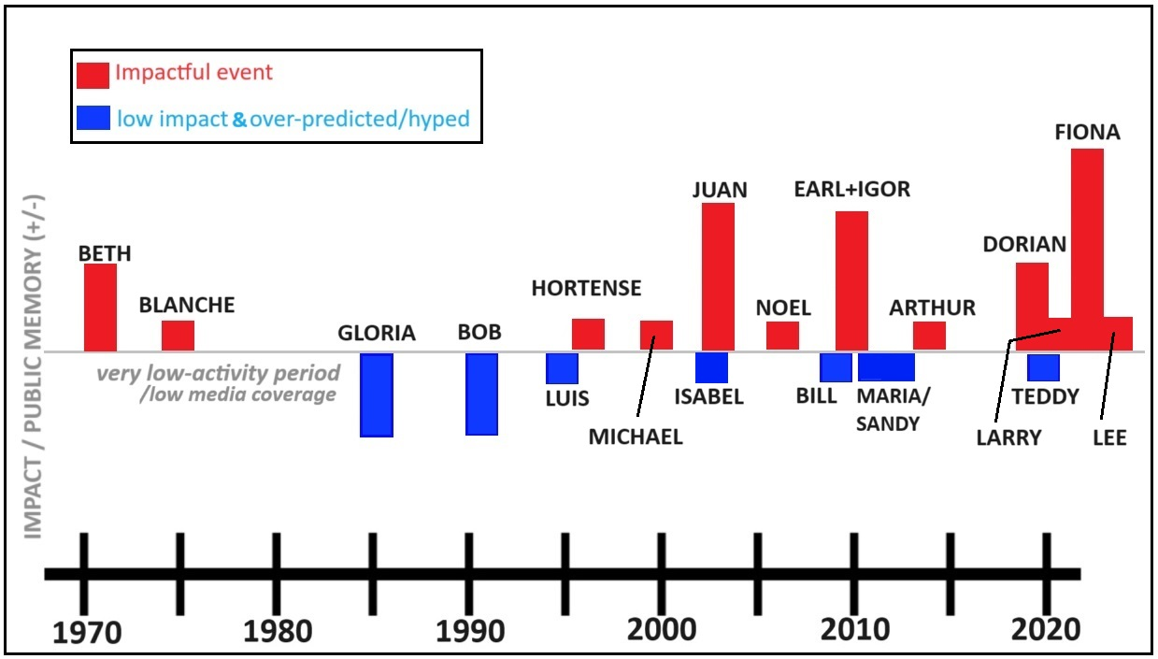
Storm History and Public Awareness
Subjective accounting of tropical cyclone events on public impression, awareness, memory over the past ~50 years in Atlantic Canada
Just so happens that we
(meteorologists AND public)
have lots of recent experience
with impacts
More red than blue means a more weather-aware / weather-ready nation

Slide 9
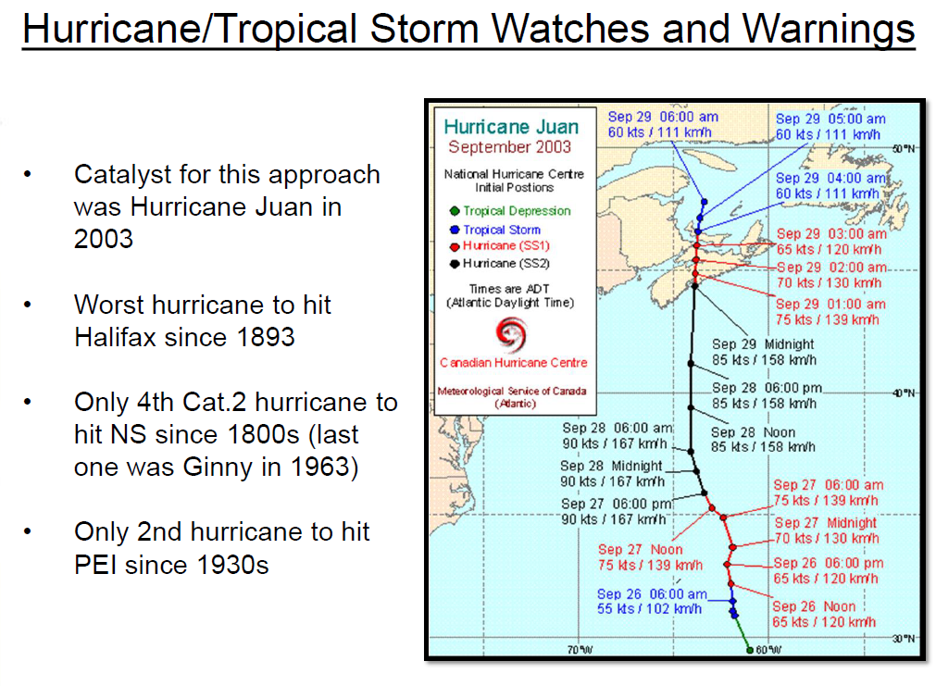
Gloria was pivotal, and so was Juan
Bellwether event leading to
MSC establishing official
hurricane alerts for Canada
5 now - FIONA

Slide 10
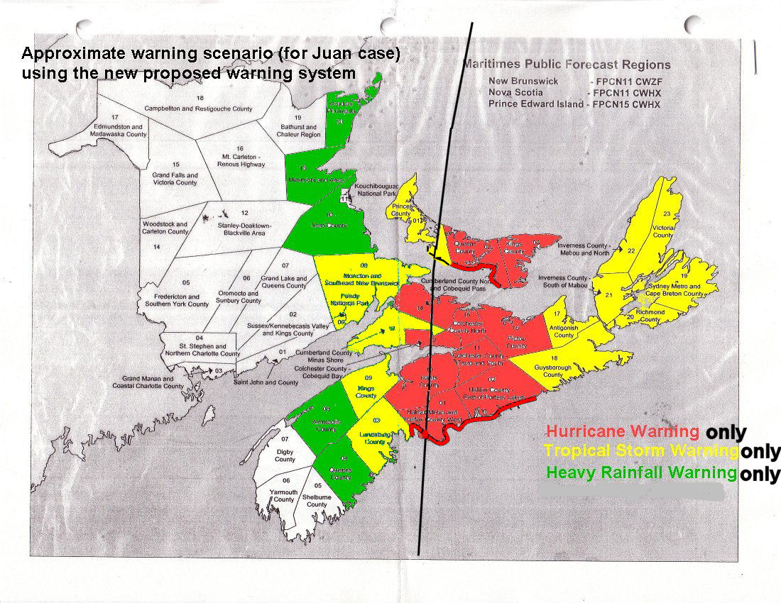
IF warning program existed before Juan, the alerts may have looked like this:

Slide 11
CHC Products
WOCN31 – TC Information Statements
FXCN31 – TC Technical Information Statements -> Track Maps and Geospatial files
WTCN31 – TS/Hurricane Warnings
WWCN31 – TS/Hurricane Watches
Issue frequency 6 hourly
Notes:
11

Slide 12
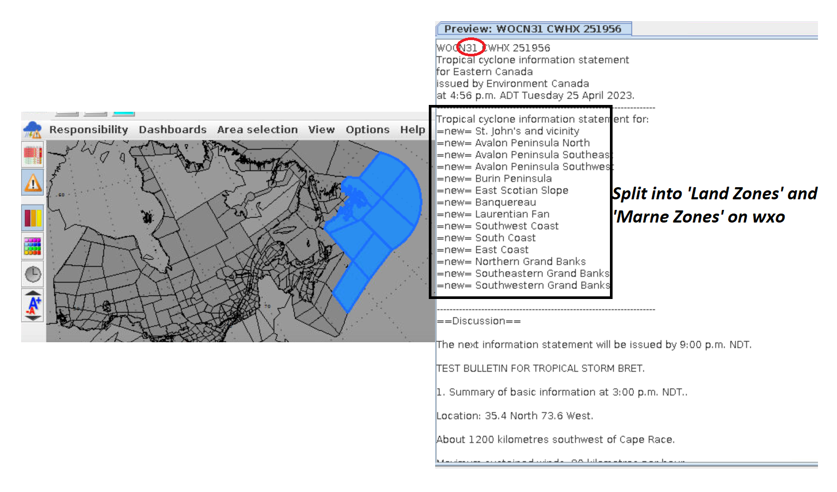
Software used to assemble the tropical alerts
Marine and land coverage:

Slide 13
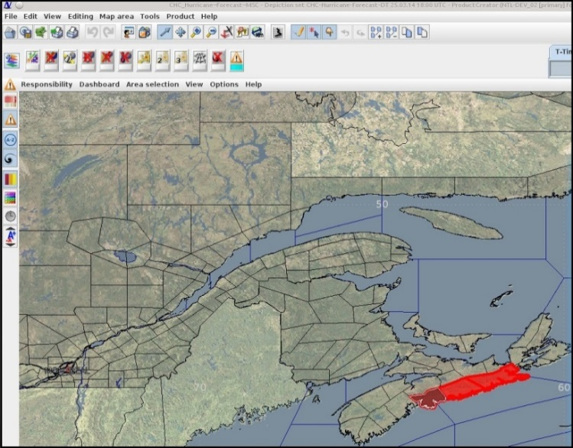
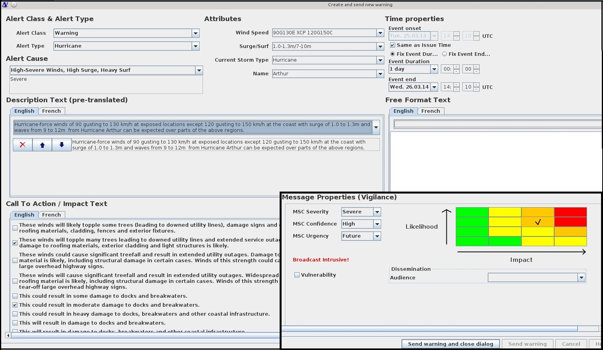
Alert production software at CHC – we’re fully
NinJo/DMS-based production
The software system makes maintaining
Consistency among the forecasters much easier
with pre-established phrasing built in

Slide 14
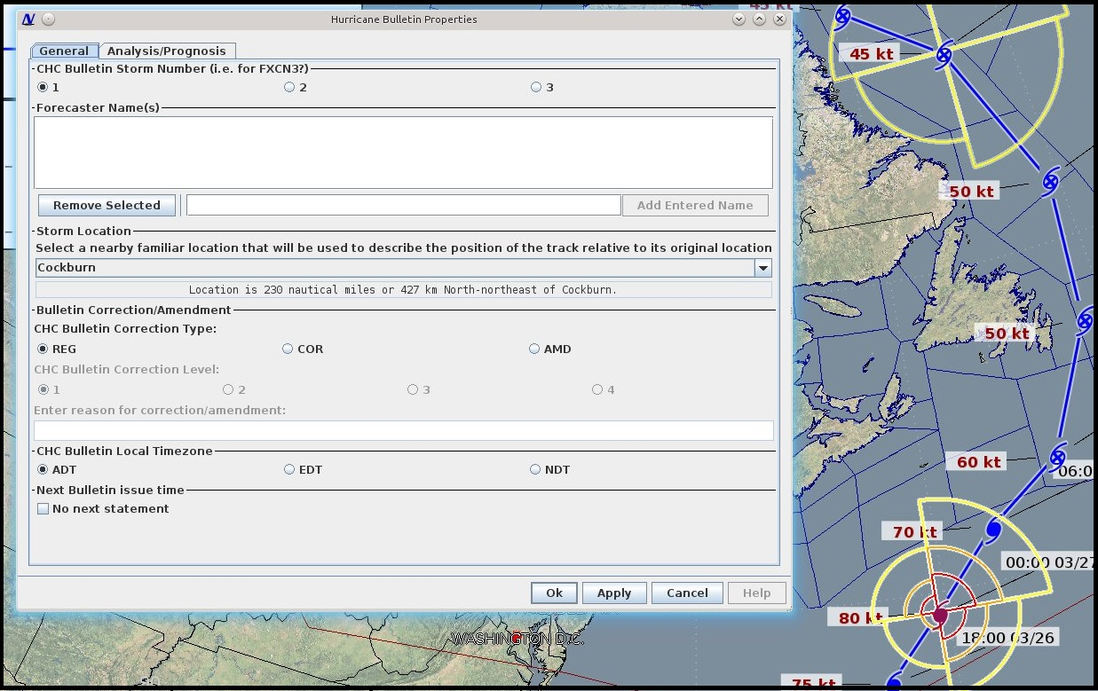

Technical bulletin production
meteorologists break it down this way
into manageable/editable pieces to
maintain the human component to the
forecast process
Software takes care of structure with a few user controls. Allows forecaster to focus on free-form content - less time worrying about structure and formats.

Slide 15
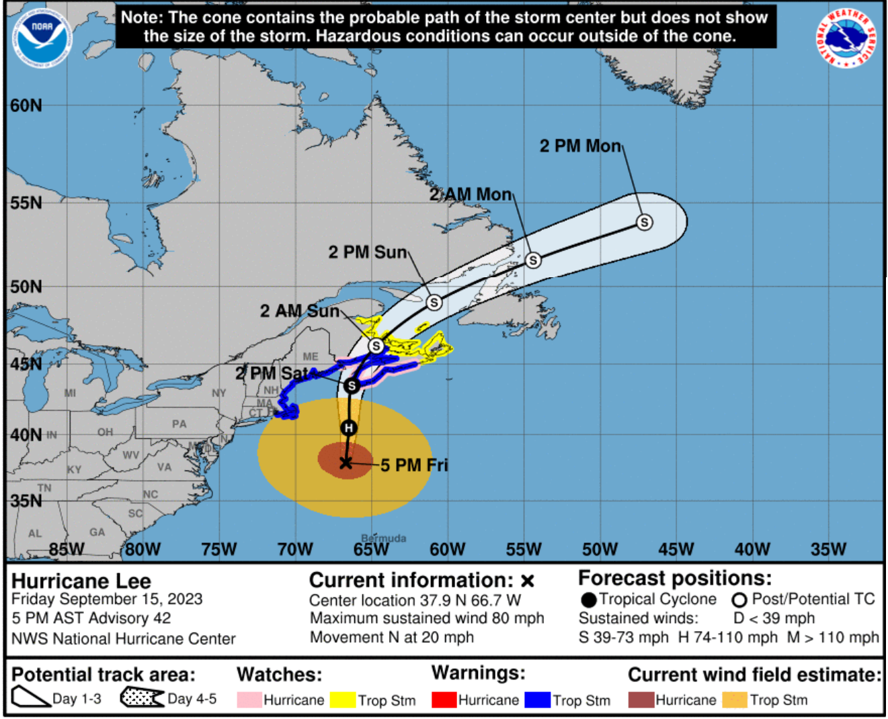
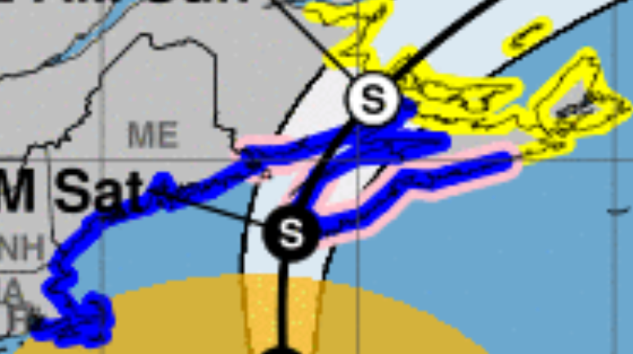
We work very closely with the
NHC in Miami. They display
CHC’s alerts

Slide 16
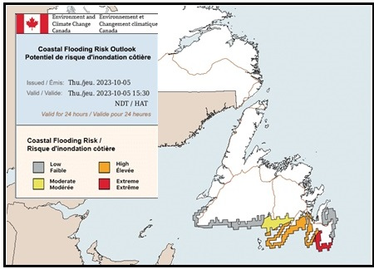
New tools required to help people understand risk of coastal flooding

Slide 17
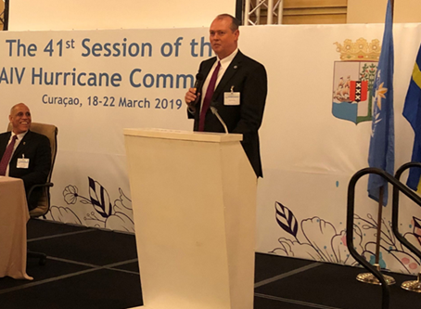
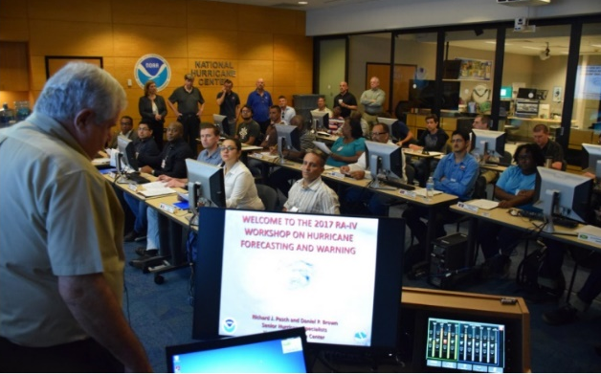
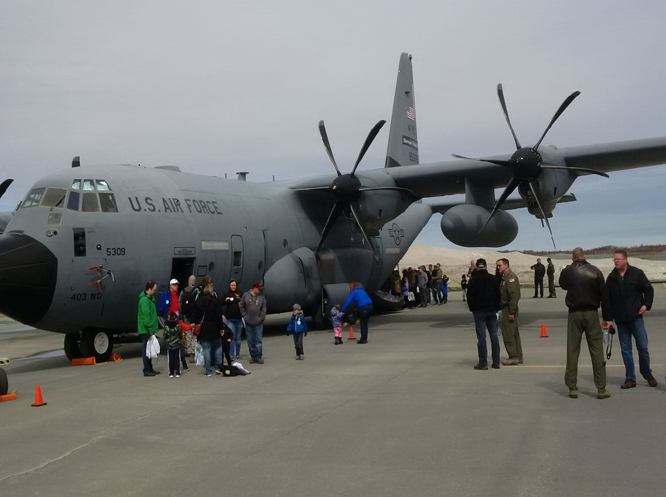
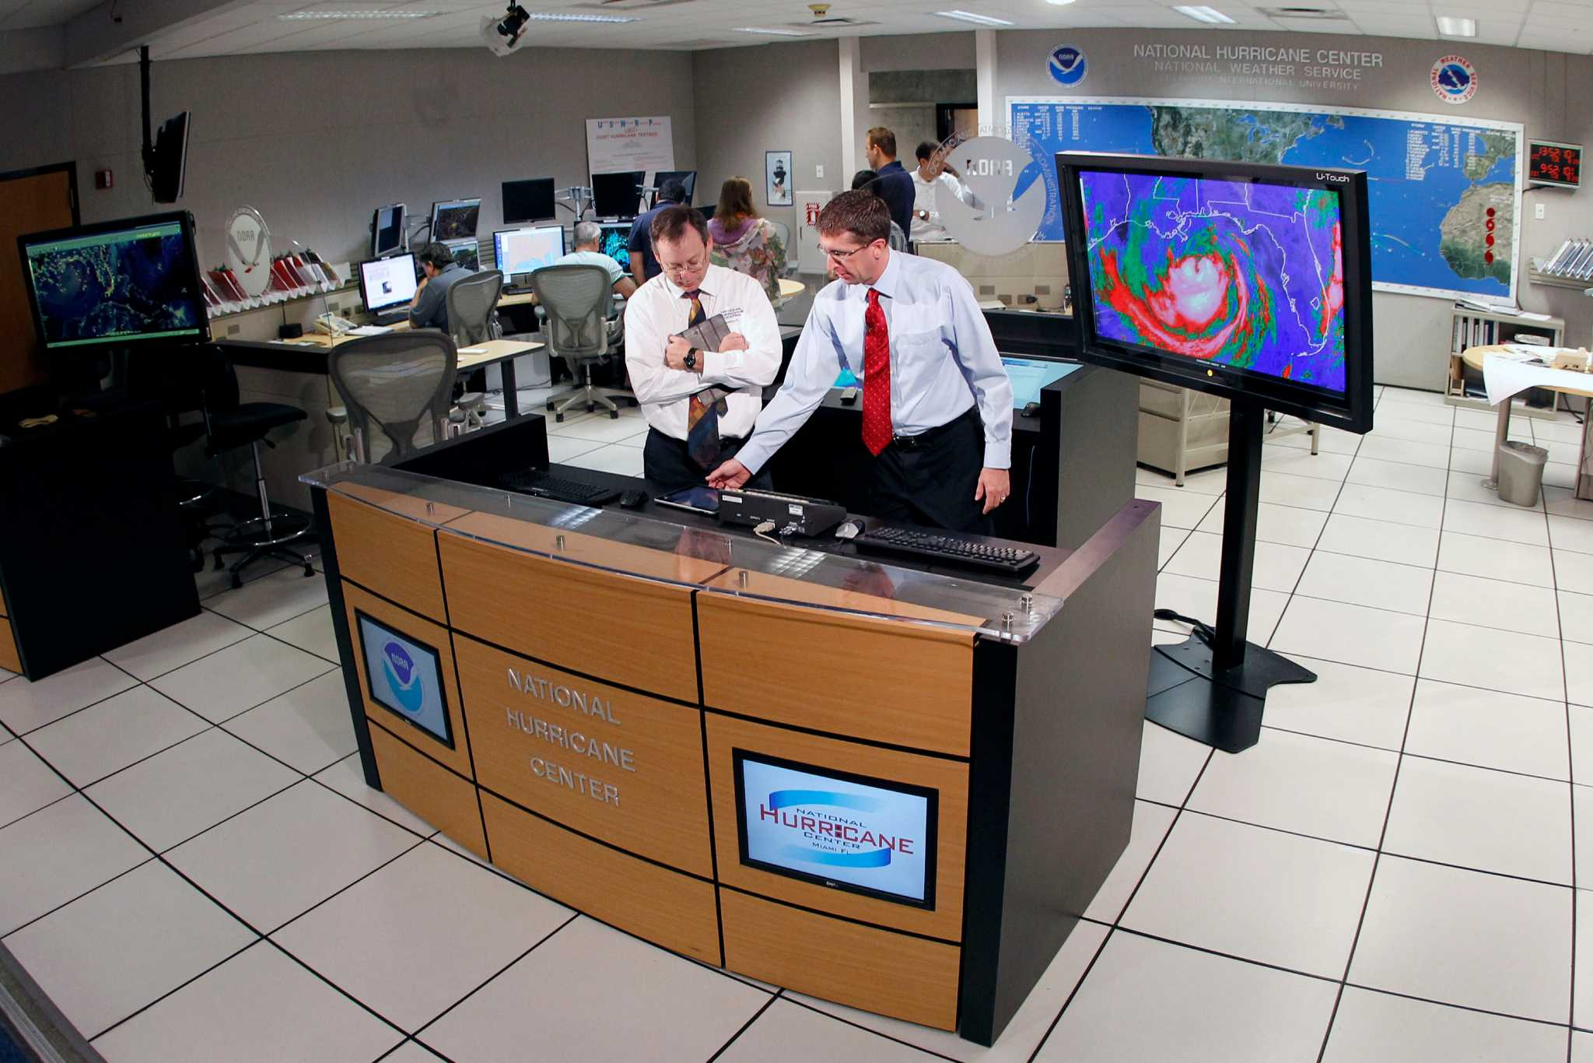
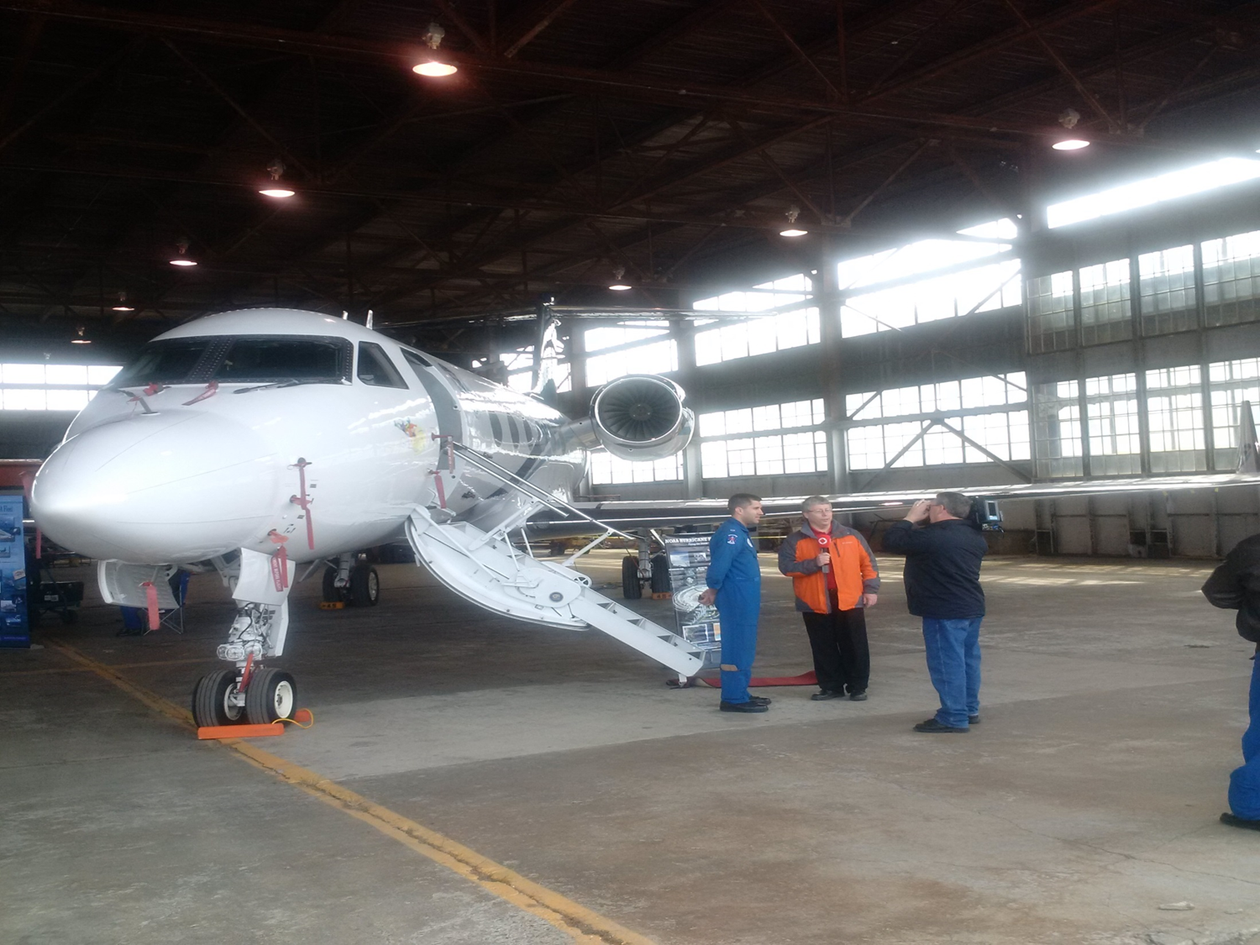
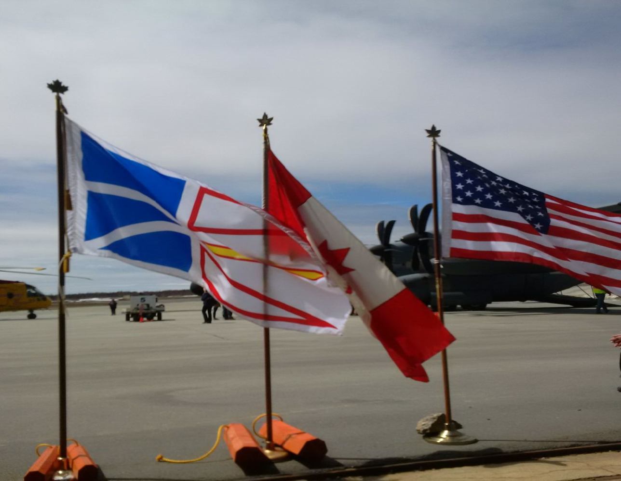
CHC: U.S. and International Collaboration
Hurricane Collaboration
The CHC represents Canada on the World Meteorological Organization’s (WMO) Regional Association IV Hurricane Committee
There is extensive collaboration with the United States (NHC-NOAA) as the CHC sends forecasters to the National Hurricane Center in Miami annually for training
Close collaboration also takes place through daily storm coordination calls between the NHC and the CHC when a hurricane threatens Canada
The U.S. Hurricane Hunters have been to Canada on two occasions in recent years as part of their annual hurricane awareness tour (similar to an airshow) showcasing the close relationship between our two countries

Slide 18
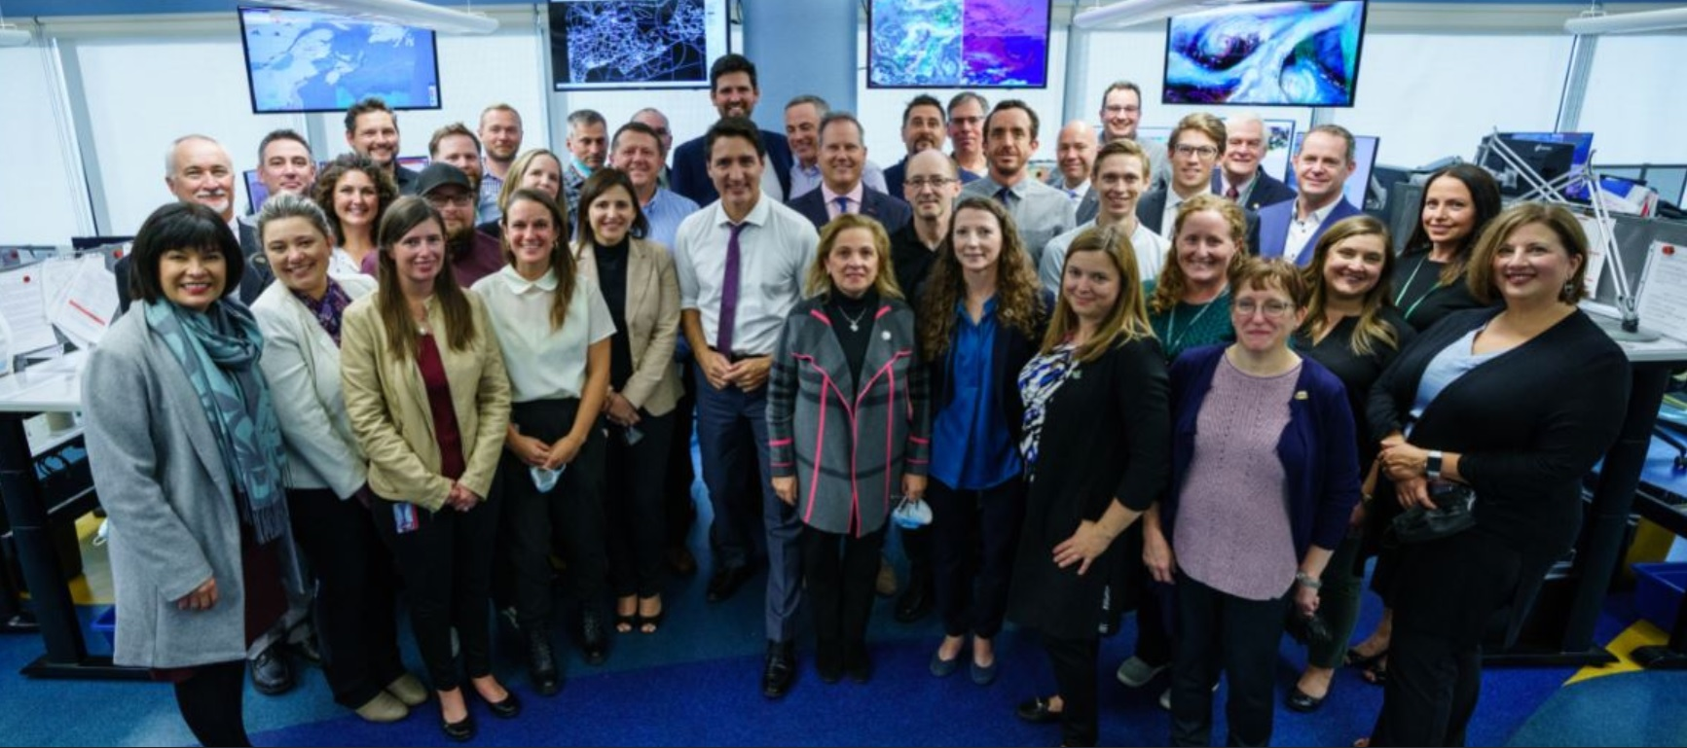
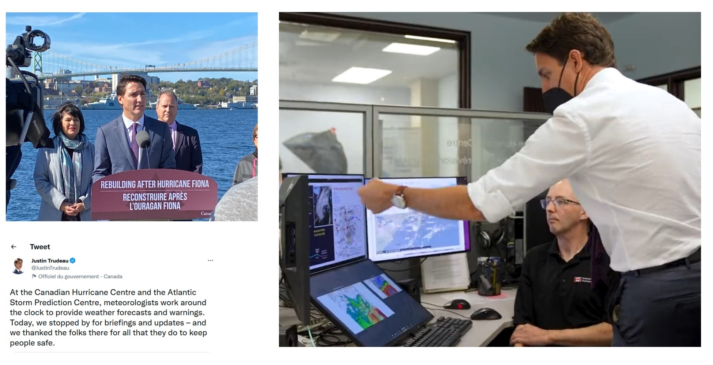
PM at ASPC/CHC early
Oct 2022 post Fiona

