Slide 1
MODIS satellite image comparison before and after Typhoon Haima

Slide 2
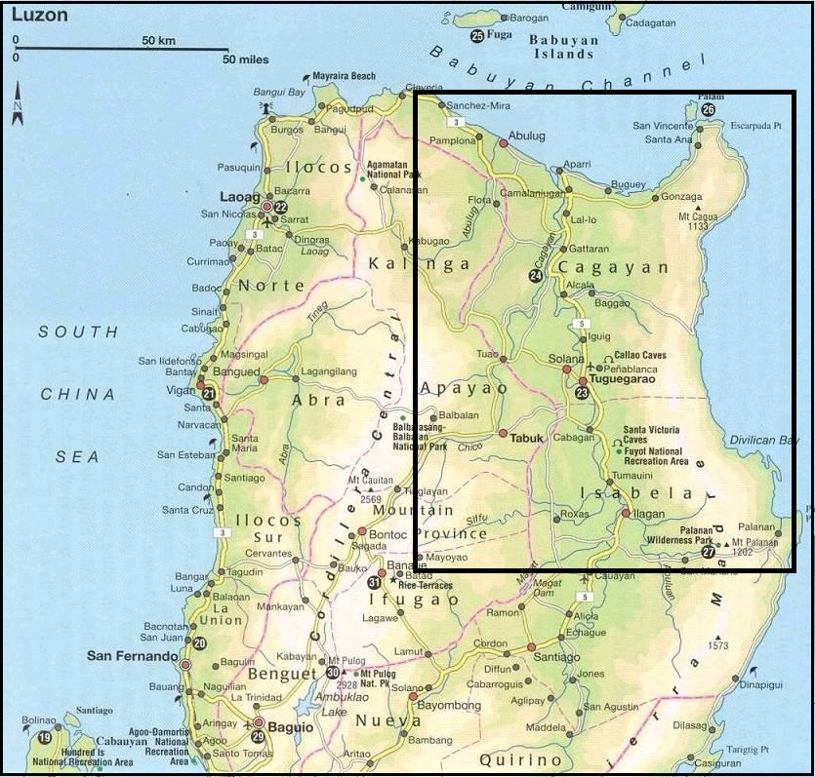
satellite
window

Slide 3
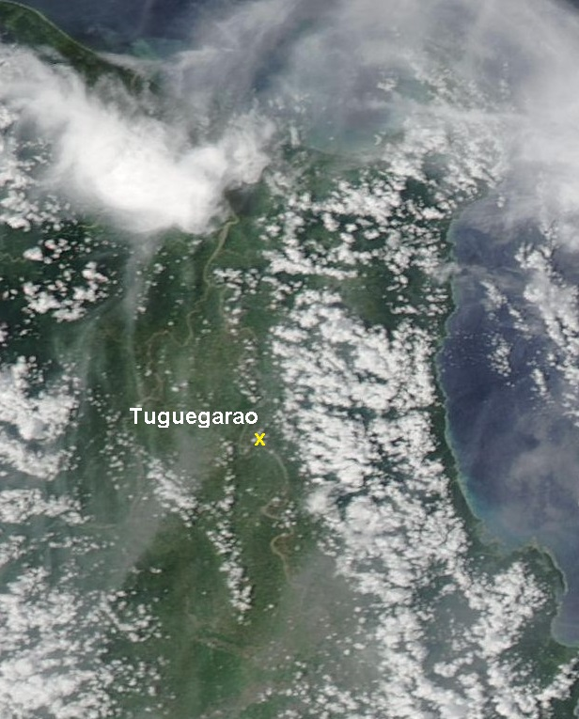
Sept 15, 2016

Slide 4
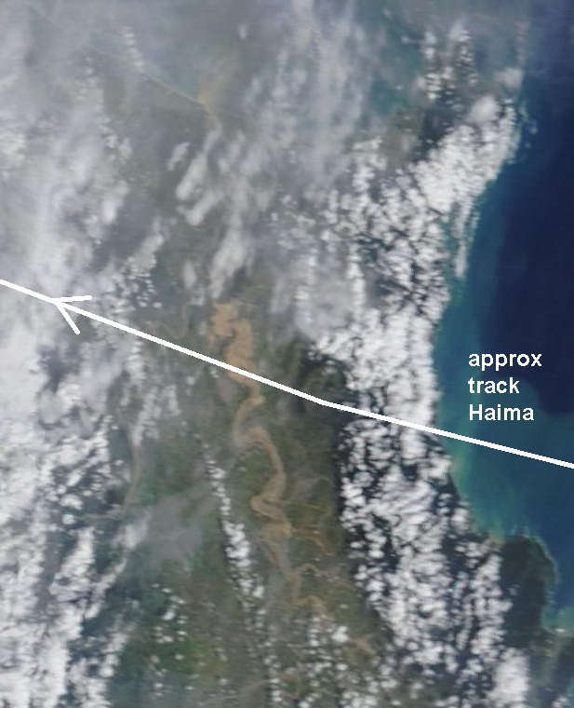
Oct 21, 2016

Slide 5
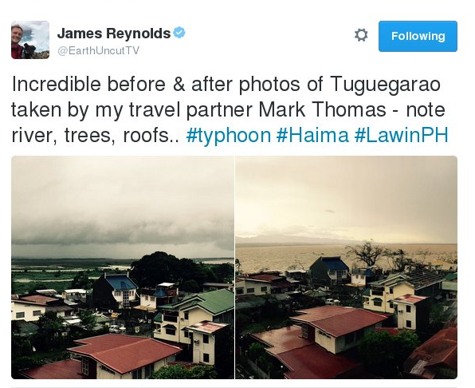
https://twitter.com/EarthUncutTV/status/788986547089448960

