Slide 1
TS Eta off the coast of South Carolina 12 Nov 2020

Slide 2
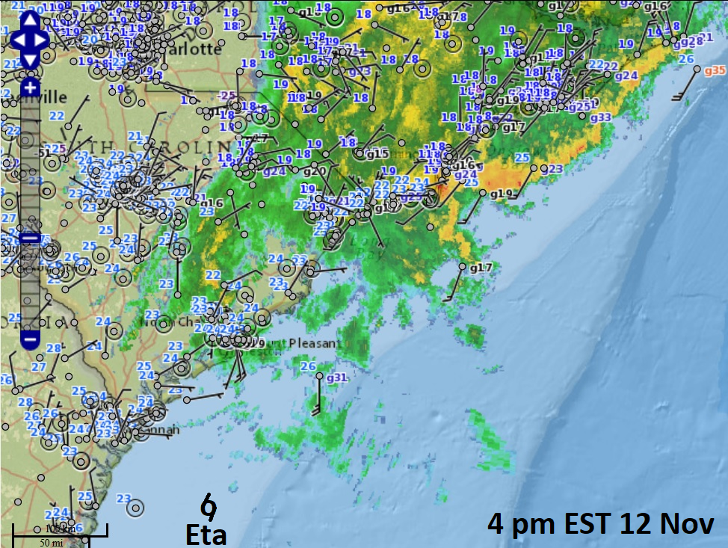

Slide 3
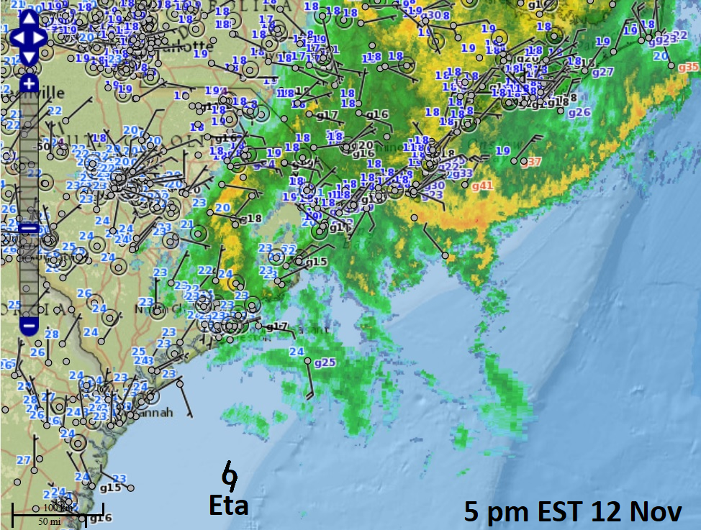

Slide 4
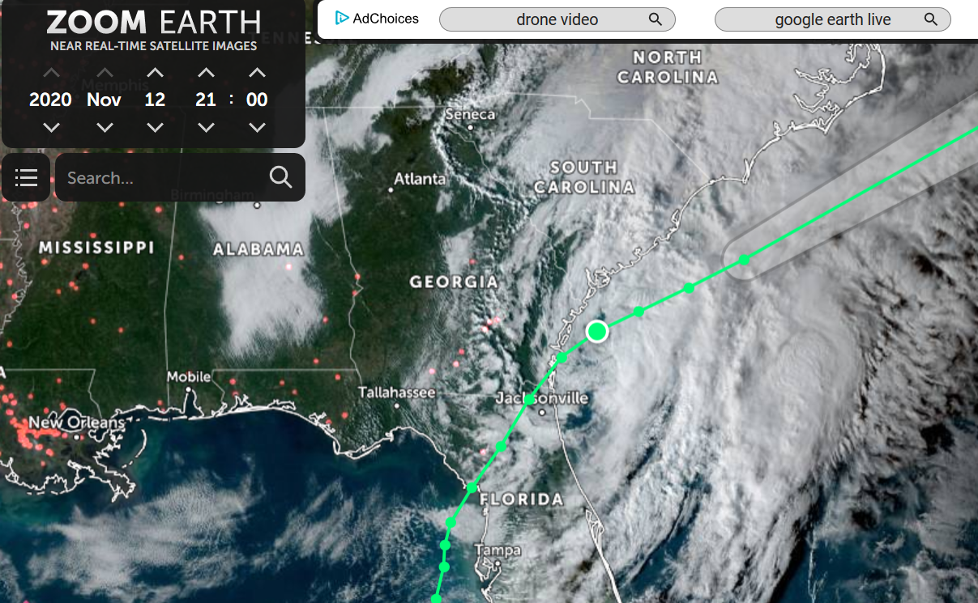
4 pm EST

Slide 5
