Slide 1

Advances in Storm Impact Communication at the Canadian Hurricane Centre (CHC)
Dr. Chris Fogarty, Manager – Canadian Hurricane Centre,
Dartmouth, NS, Canada
ECCC/MSC – CMOS Congress 2025

Slide 2
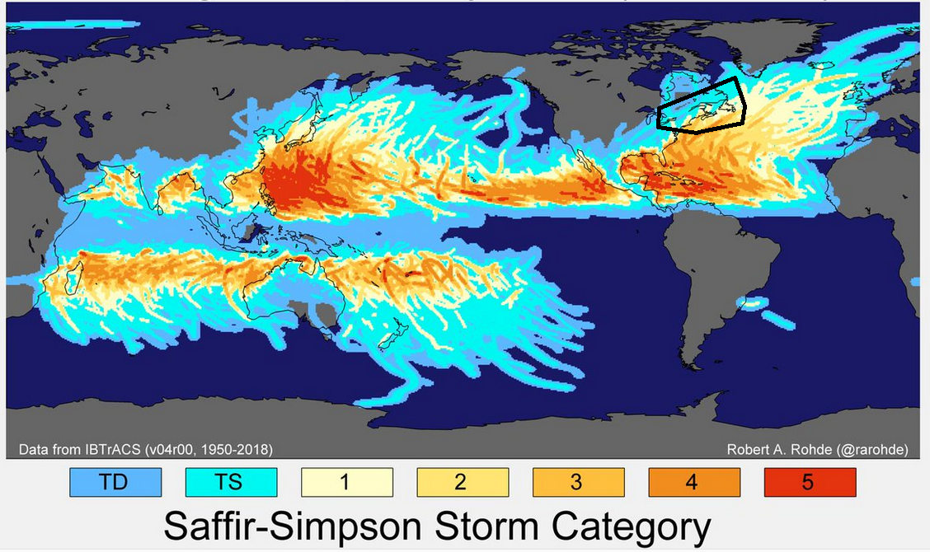
Tropical Cyclones 1950-2018

Slide 3
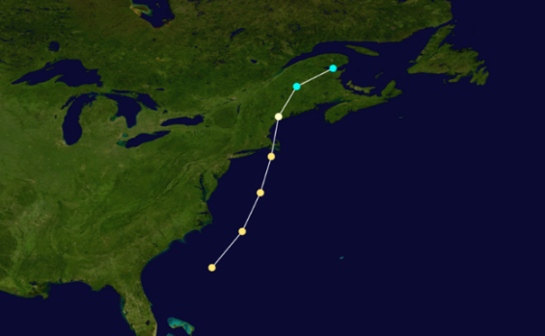
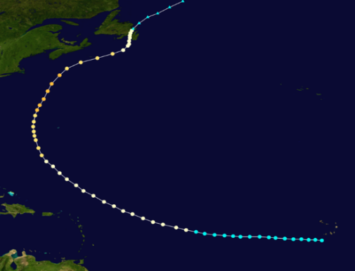
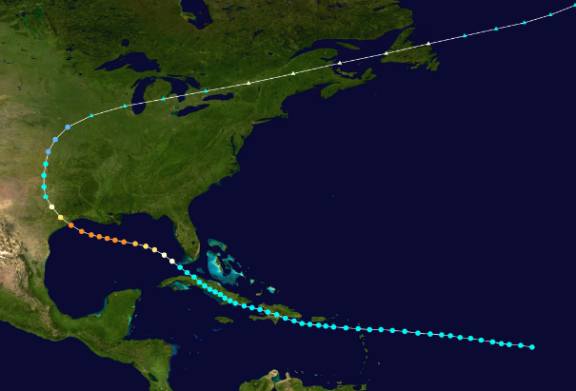
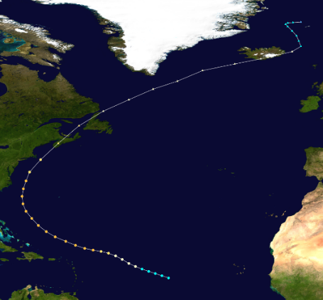
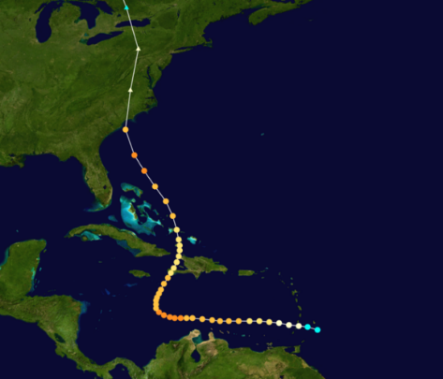
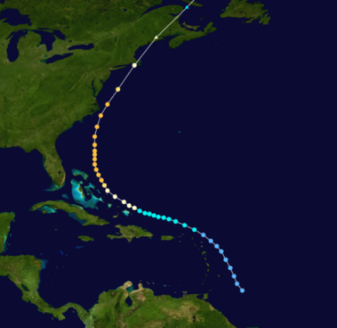
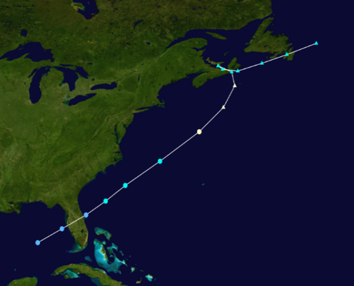
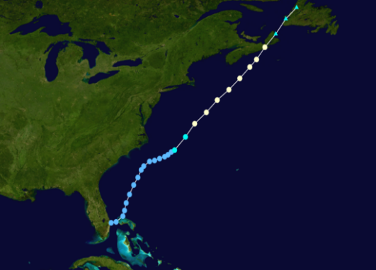
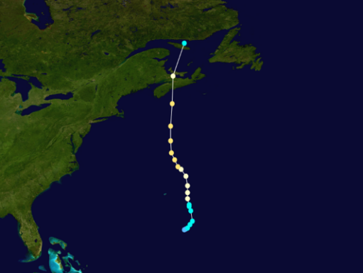
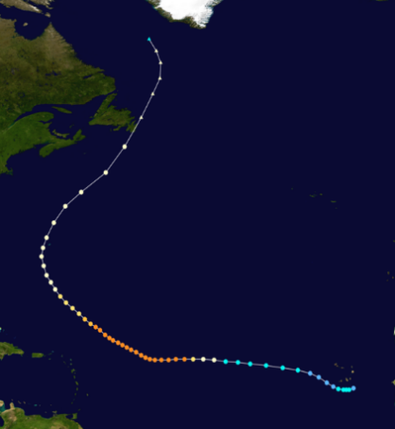
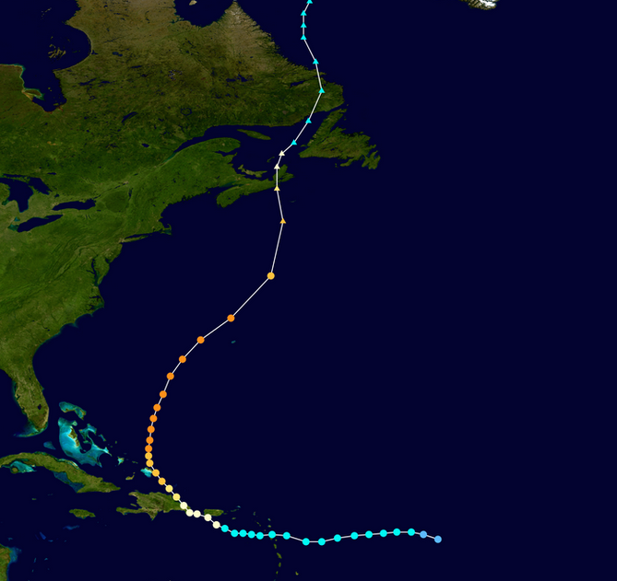
On average there is 1 severe event (>100 million $ damages) every ~10-15 years
‘these would be the ‘RED’ events in the new color-coded system’
“Great Nova Scotia
Cyclone”
Aug 1873
“Galveston Hurricane”
Sept 1900
“Saxby Gale”
Oct 1869
“Hazel”
Oct 1954
“Edna”
Sept 1954
“Great August Gale”
1927
“Escuminac Disaster”
Jun 1959
“Juan”
Sept 2003
“Igor”
Sept 2010
“Beth”
Aug 1971
“Fiona”
Sept 2022
Abnormally long gap of ~30 years = complacency

Slide 4
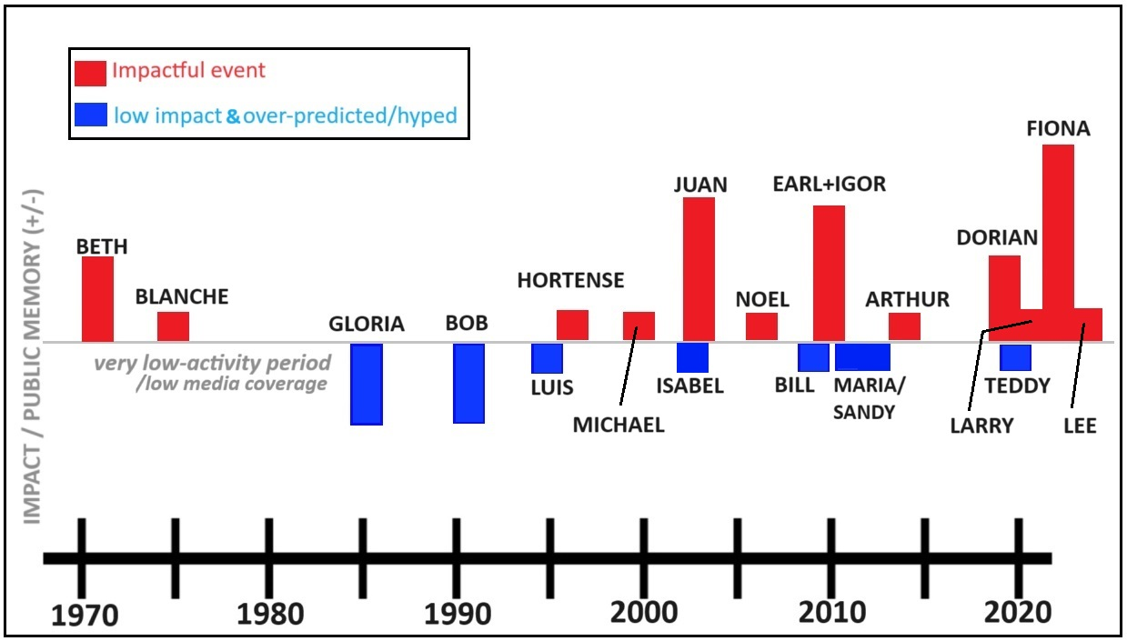
Storm History and Public Awareness
Subjective accounting of tropical cyclone events on public impression, awareness, memory over the past ~50 years in Atlantic Canada
Just so happens that we
(meteorologists AND public)
have lots of recent experience
with impacts
More red than blue means
A more weather-aware /
weather-ready nation

Slide 5
Hurricane Juan 2003 – first use of
impact statement in CHC products
Prior to Hurricane Juan forecasters were discouraged from making statements
about impacts from the weather
Forecasters were conditioned to forecast the weather only – wind speeds, rainfall
amounts, wave heights, etc
CHC director and research meteorologist (Fogarty) made conscious decision to
include phrase ‘toppling of some trees’ in the forecast bulletin
We felt this necessary to get peoples’ attention and take at least some action (had
been ~30 years since the last big hurricane-related impact in Canada)

Slide 6
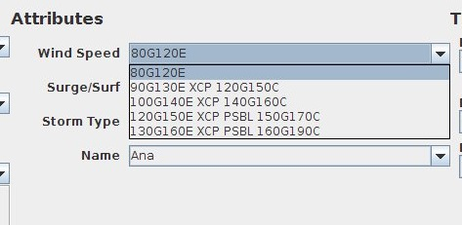
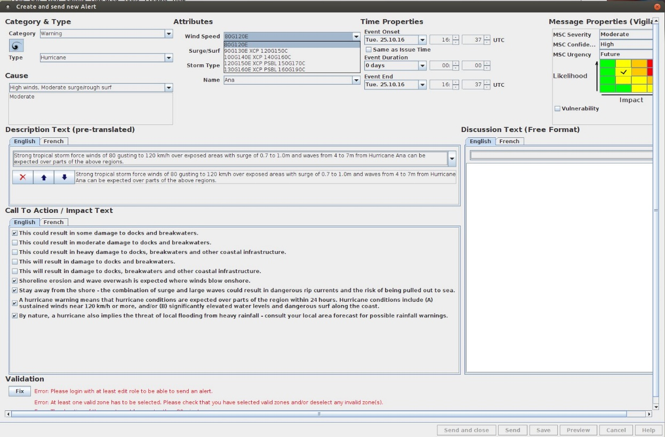
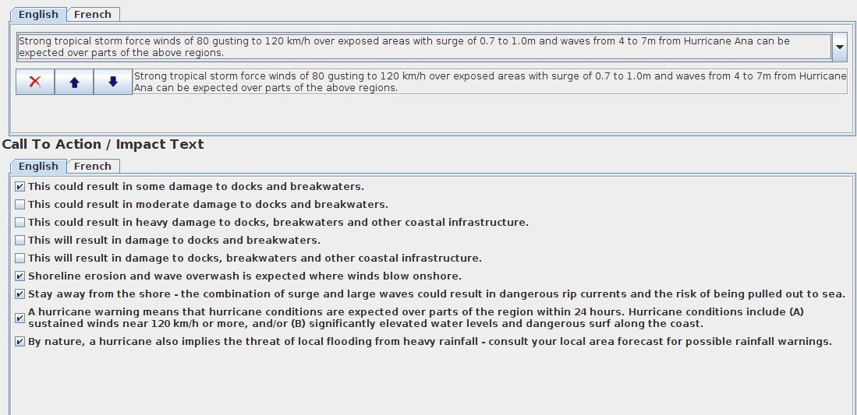
Alert production at CHC – fully assembled in ‘NinJo’
[NinJo is meteorologist’s production software]
Forecaster decides on the
wind category from their ADP process and the software handles the phrase mapping automatically
These so-called ‘CAISE’ phrases were struck ~2012 with the “WaRP2 project”
(Warning re-engineering effort within the Weather Service)

Slide 7
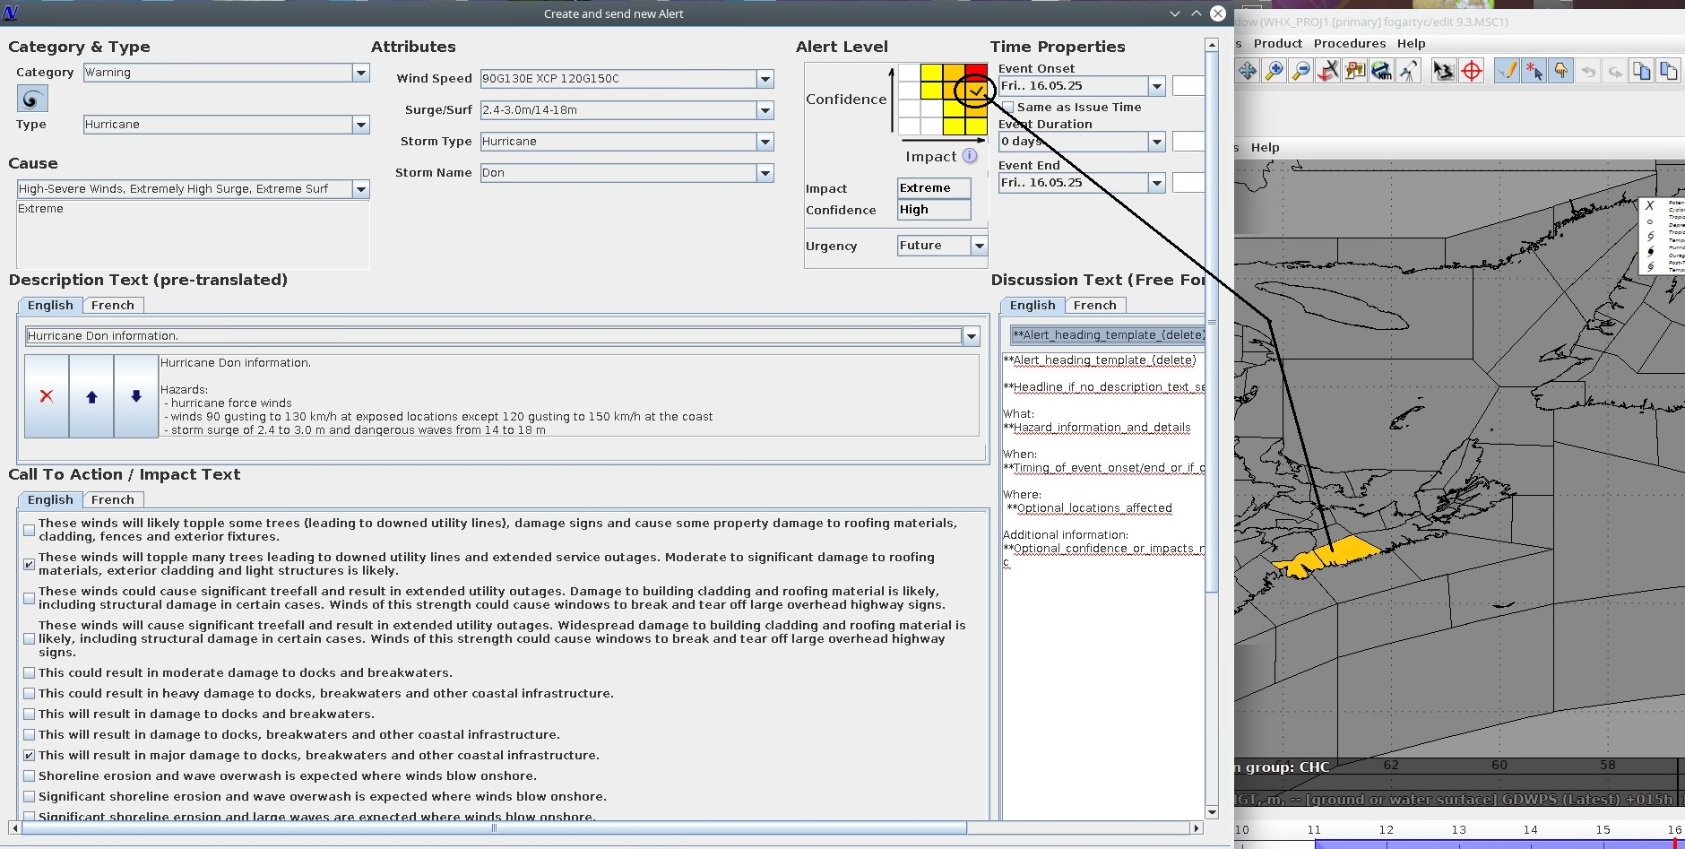
The software system makes maintaining consistency among the forecasters much easier with pre-established phrasing built in

Slide 8
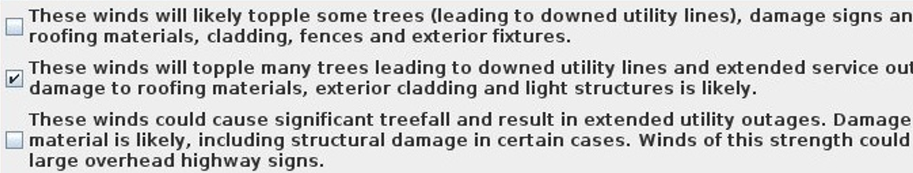
Sample impact phrasing and categories
Impact categories: Property, Transportation (Travel), Utilities, Personal Injury,
Vegetation (trees) – CHC specific
At the CHC (MSC – Met Service of Canada) we are currently undertaking a complete
review/revamp of many of these impact phrases that were established about 12
years ago – CAISE – ‘Call-to-Action / Impact Statements / Education statements
Tropical alerts already have some impact-tiered aspects built in, although they are technically based on wind speed thresholds
The new system gives the forecasters more freedom to emphasize the risk even if the official wind criteria is not met

Slide 9
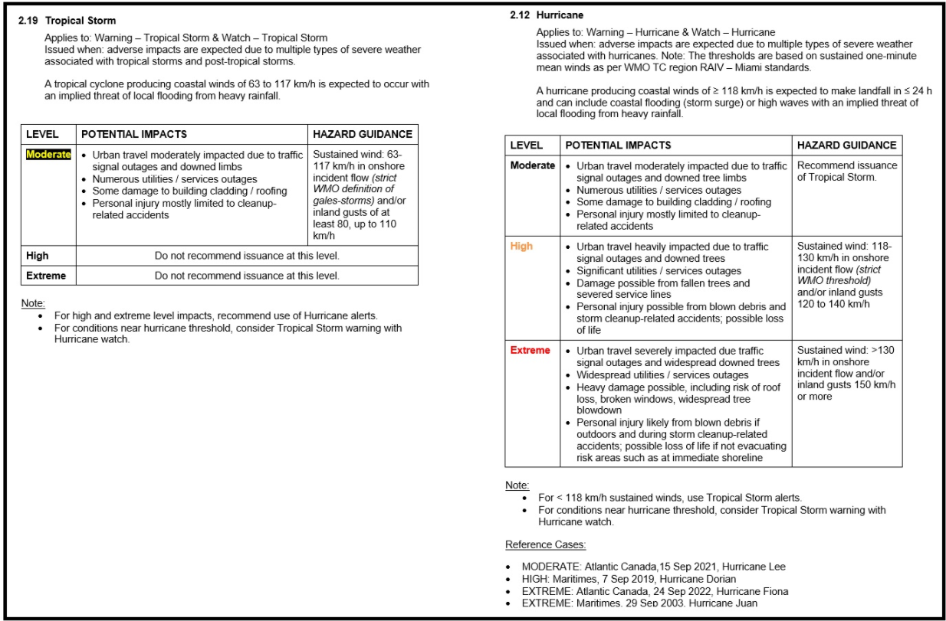
Color-coded alerting – Tropical
…from our new operational forecast document
Tropical Storm Warning is often concurrent
with a Hurricane Watch – in this case, the
Hurricane Watch will be yellow
Examples ->

Slide 10
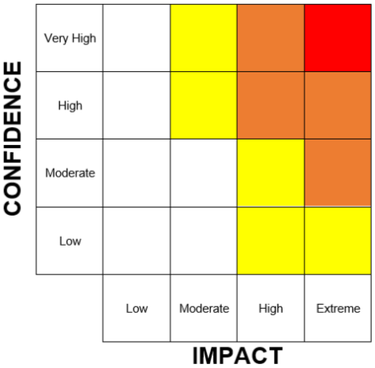
“WEATHER ALERT MATRIX”
Confidence Levels
Low | Unlikely or uncertain <40%
Moderate | Possible 40-60%
High | Probable 60-80%
Very High | Highly Likely 80-100%
Impact Levels
Low | Day to day activities not affected Minor, highly localized impacts possible Warnings not issued
Moderate | Limited disruption to daily life anticipated Some damage/impacts Relatively quick recovery, normally less than a day
High | Disruption to society expected Major damage/impacts Recovery could take several days
Extreme | Major, prolonged disruption to society expected Widespread, extensive damage/impacts Lengthy recovery period
Confidence is based on several sources, including model output, trends, historical model performance, antecedent conditions, vulnerability, exposure, etc.
Notes:
Definitions for impact and confidence (‘weather alert matrix’ axes)

Slide 11


UPDATED ALERT TITLES
Alert titles will include the colour levels to help improve risk communication.
Hazard
Alert type
Current:
TROPICAL STORM WATCH (BERTHA)
HURRICANE WARNING (WILMA)
Colour level
Alert type
Hazard
Future:
YELLOW WATCH – TROPICAL STORM (BERTHA)
ORANGE WARNING – HURRICANE (WILMA)
Notes:
From the partner context – simplified interpretation:
Colour will indicate the severity/risk level
Hazard indicates the meteorological condition

Slide 12
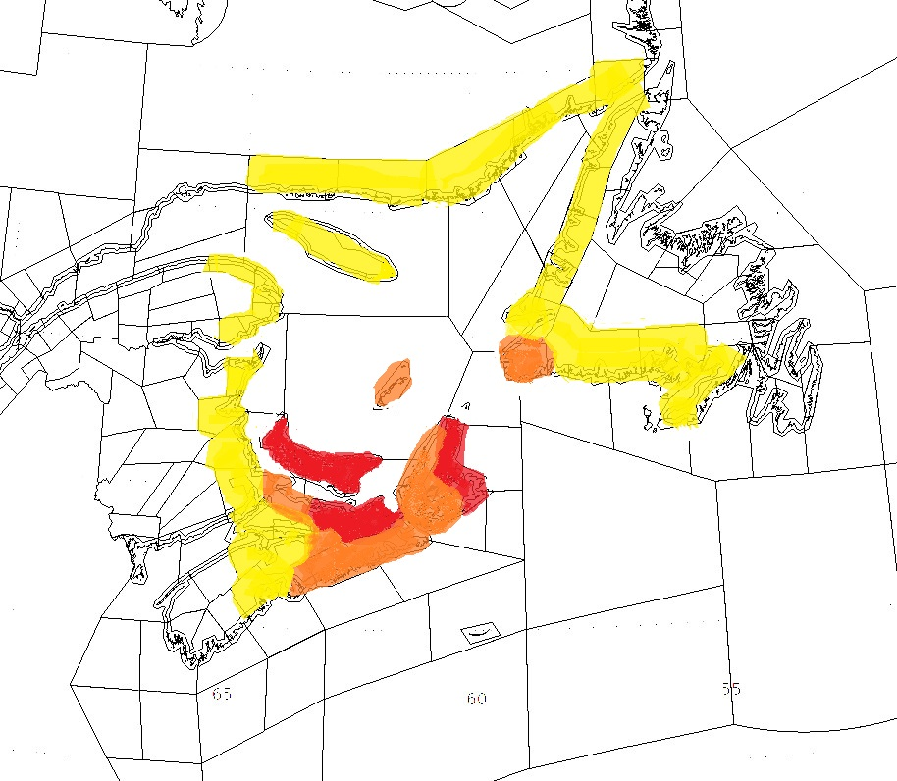
Wind alert levels for Fiona (i.e. hindcast)

Slide 13
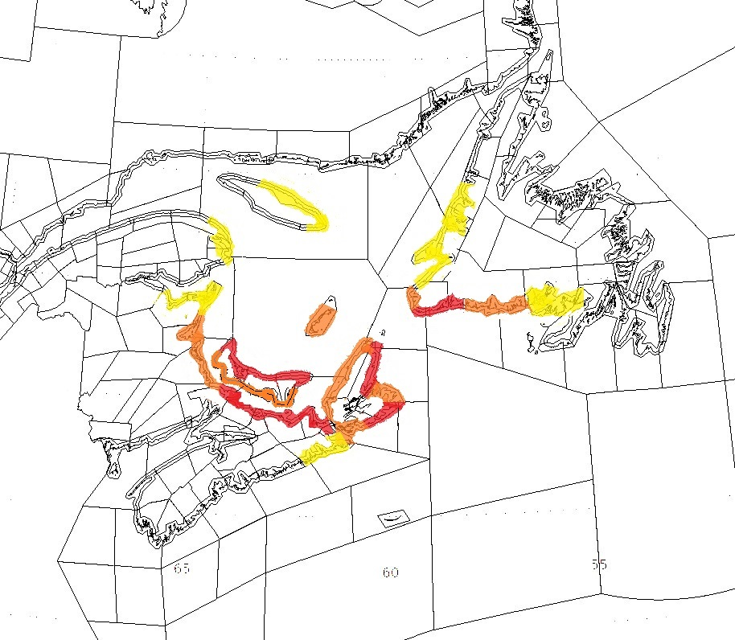
Coastal flooding alert levels for Fiona (i.e. hindcast)

Slide 14
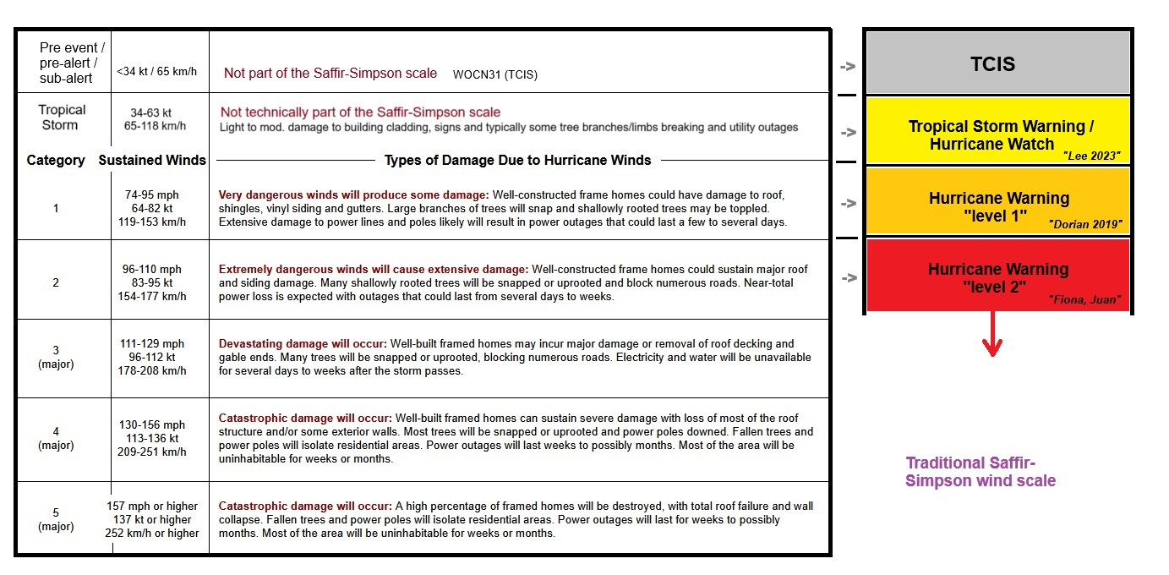
CHC application of color-coded alerts (wind only) in the context
of the Saffir-Simpson Hurricane Scale

Slide 15
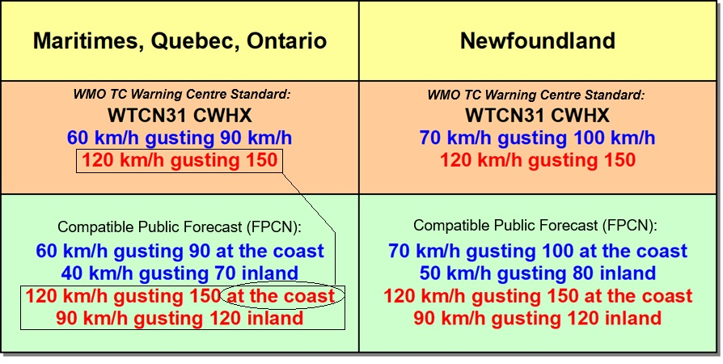
        Hurricane / Tropical Storm Warnings
        WTCN31 CWHX
Marginal Tropical Storm and Hurricane
…because a marginal cat-1 will not bring inland winds of 120 km/h sustained

Slide 16
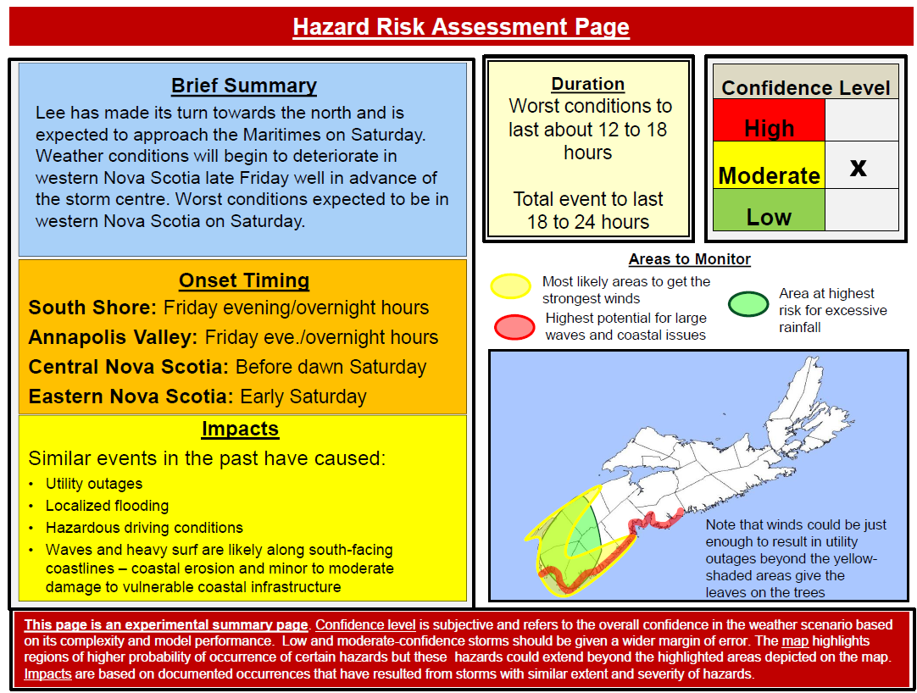
Warning Preparedness Meteorologist (WPM) Products – aka ‘Key Message’ graphics – in the spirit of WINGS Transformation ‘WxStory’
[WINGS is the latest transformation project at the Weather Service – MSC]
Colors have been used already in these products but color choice will have to be revisited by WPMs to align w/new color-coded
alerts
sample from briefing packages targeted for Emergency planners (EMOs)
More forthright with potential impacts – often cast in the sense of “similar storms in the past…”
Manual/subjectively-drawn by WPM

Slide 17
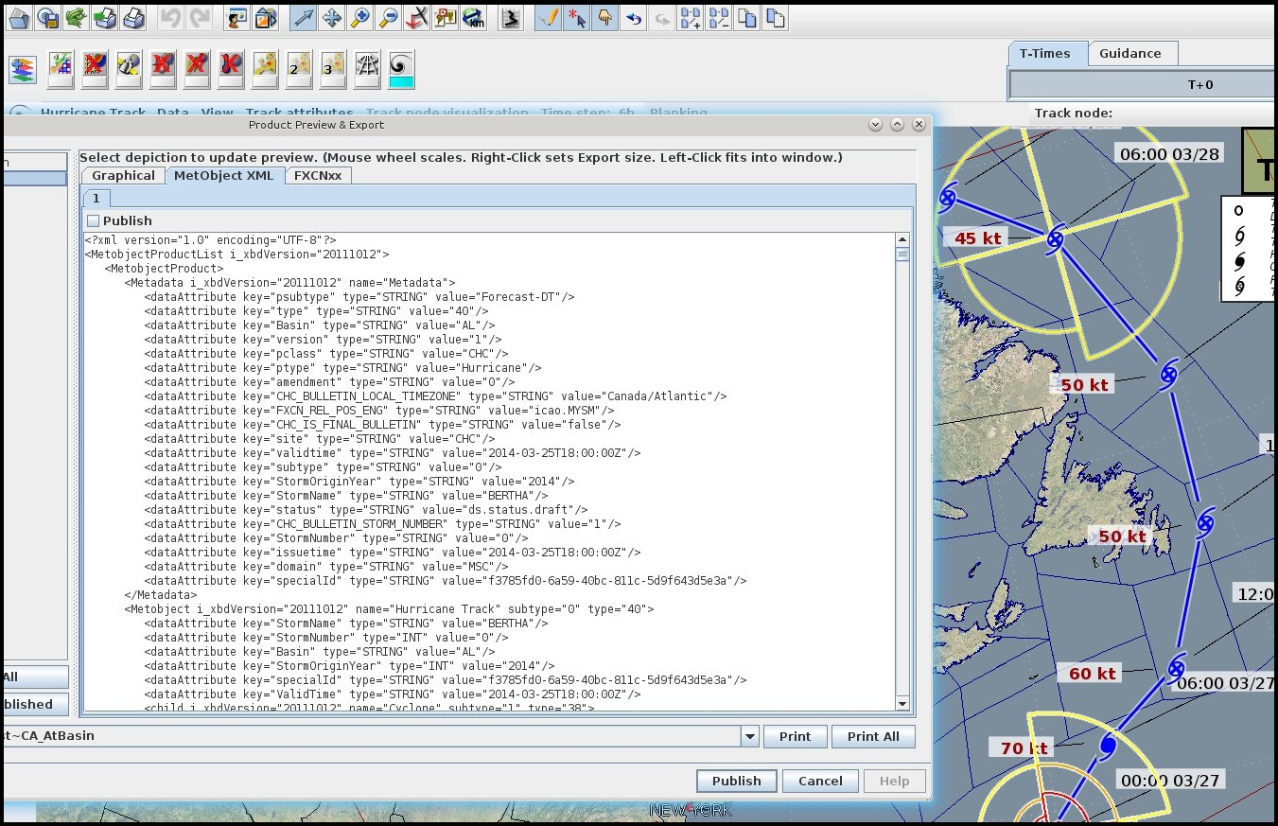
Modernized products - XML and GeoSpatial formats
‘GeoJSON’
Traditional
products

Slide 18
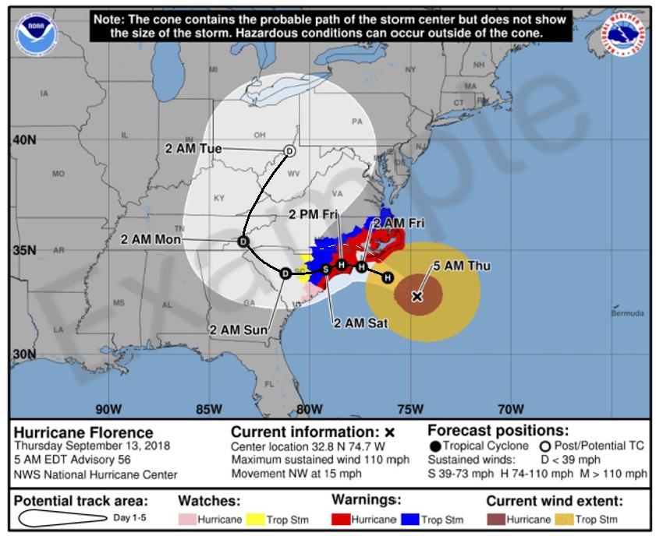
Show nhc’s 2024 plan
New presentation style –
overlay public alerts on the
track map drawing focus away from the ‘cone’.
Cone still has merit to show
uncertainty but the impact
‘swath’ (colors) is the focus
CHC should be able to do similar on weather.gc.ca once GeoJSON-based track is made interactive

Slide 19
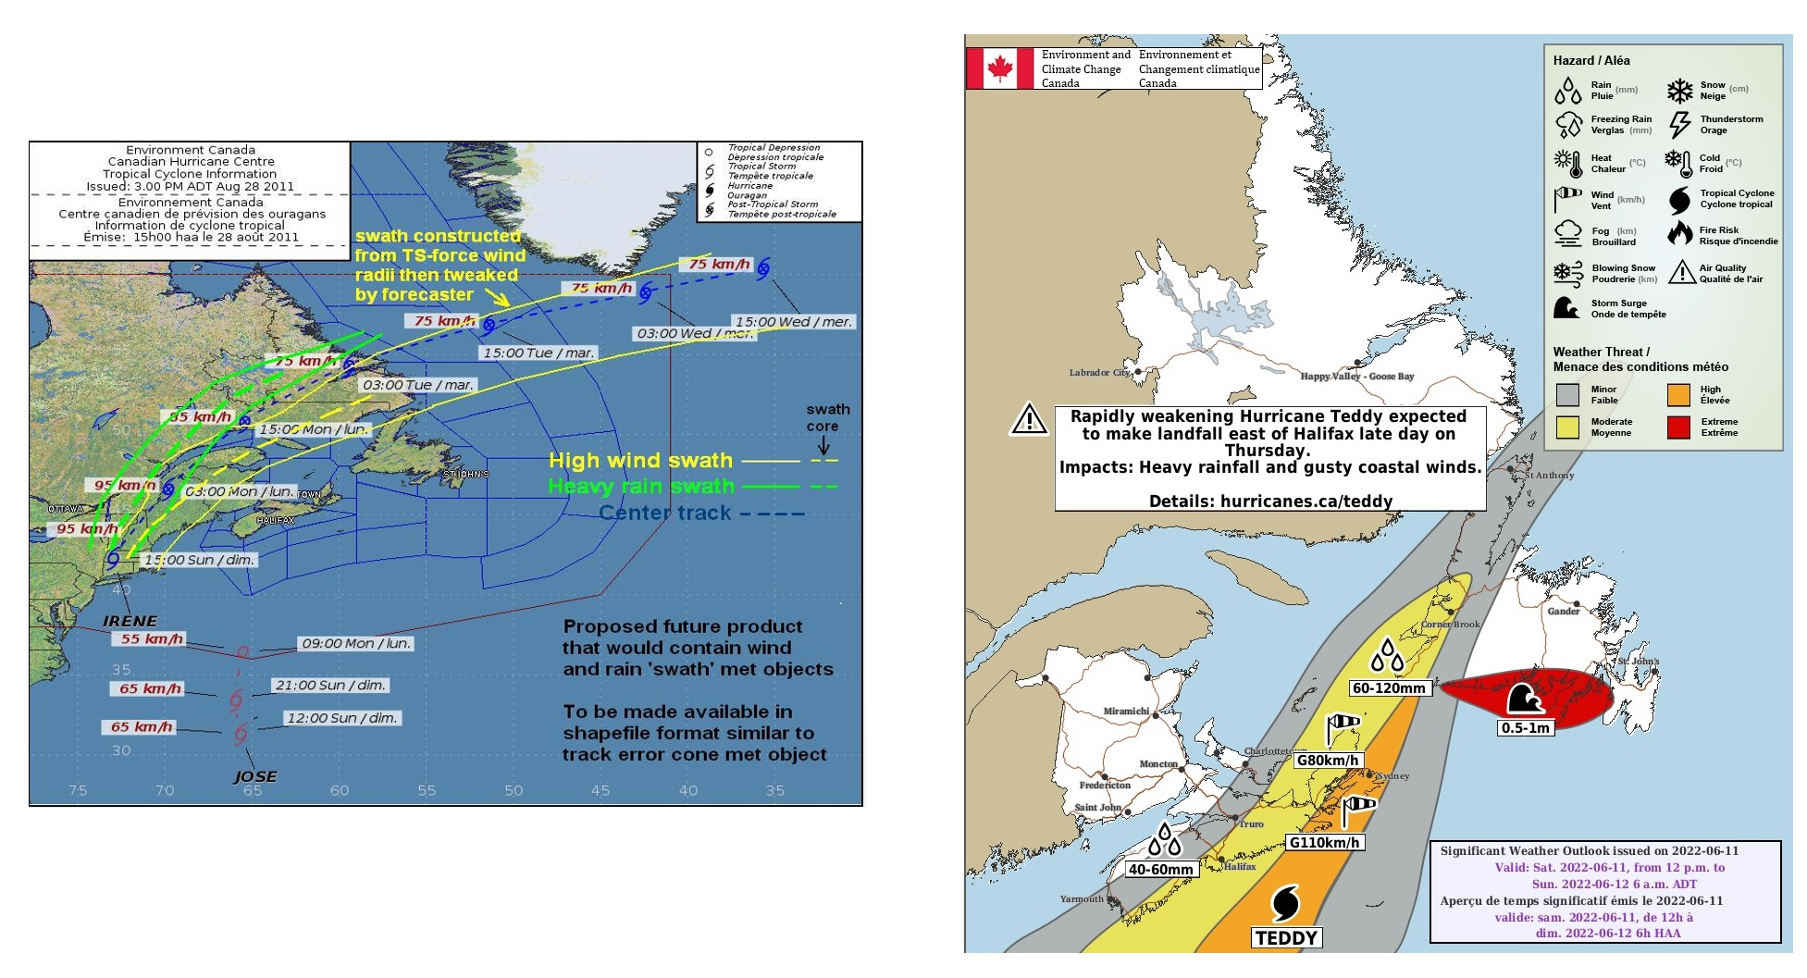
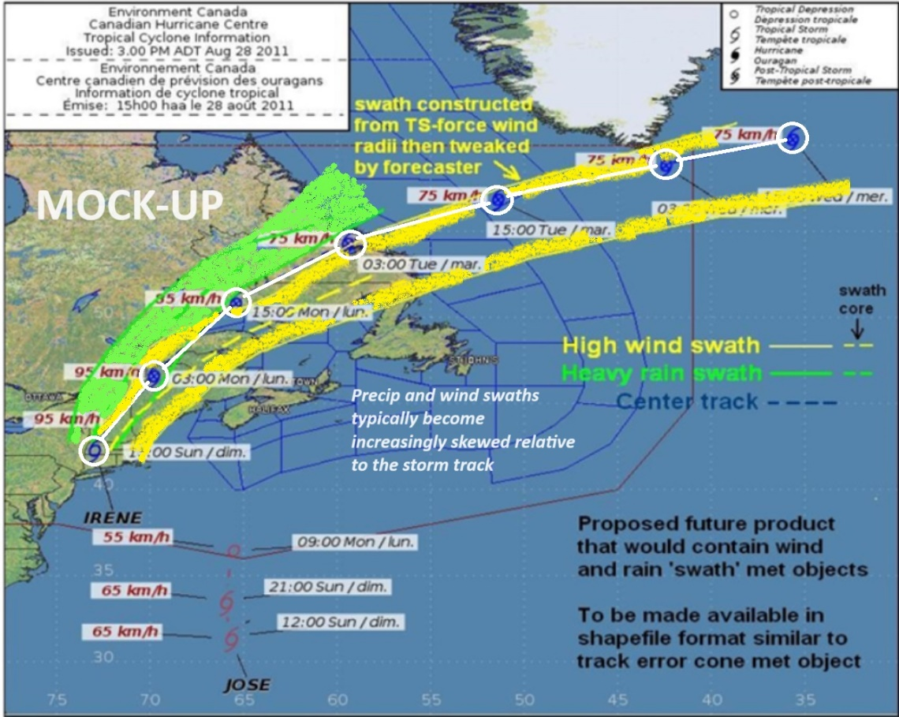
Future plans using the interface
Mock-up of met object-based depiction of threats such as wind and rainfall

Slide 20
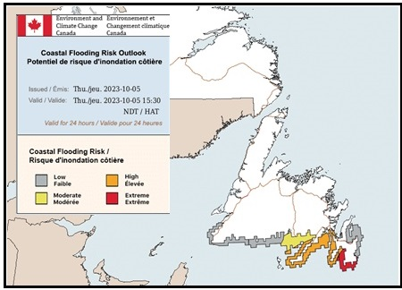
Also in NinJo PWB coastal flooding risk outlook (georeferenced data – GeoJSON)

Slide 21
Canadian Hurricane Centre Contact Information
Non storm events / off season:
Chris Fogarty, CHC Manager, ~9am-5pm Atlantic
email: chris.fogarty@ec.gc.ca (preferred for initial contact)
(I can provide appropriate Warning Preparedness Meteorologist contact depending on province impacted by event)
Storm events - primetime:
Fogarty, ~7am-10pm Atlantic - 902-222-0358 email chris.fogarty@ec.gc.ca
Storm events - overnight:
CHC Ops Desk, 10pm-7am Atlantic - 902-[unlisted] or email F.prev.CCPO-CHC.fcstrs.F@ec.gc.ca (only during those hours please – otherwise, Fogarty likely quicker and can triage)

