Slide 1
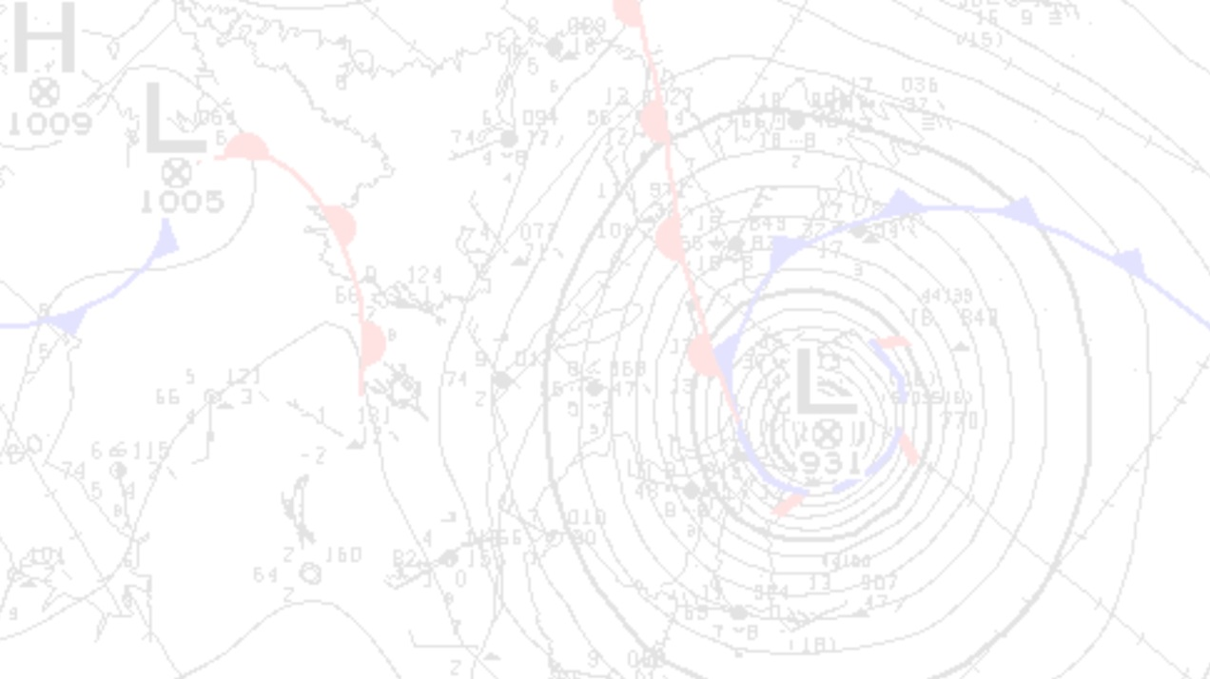
CHC Hurricane Program Review
NLWO CoSS

Slide 2
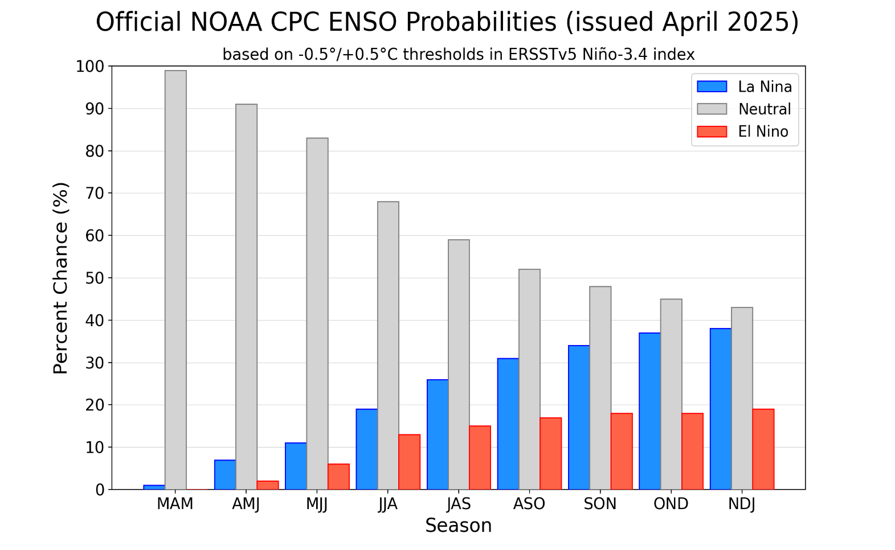
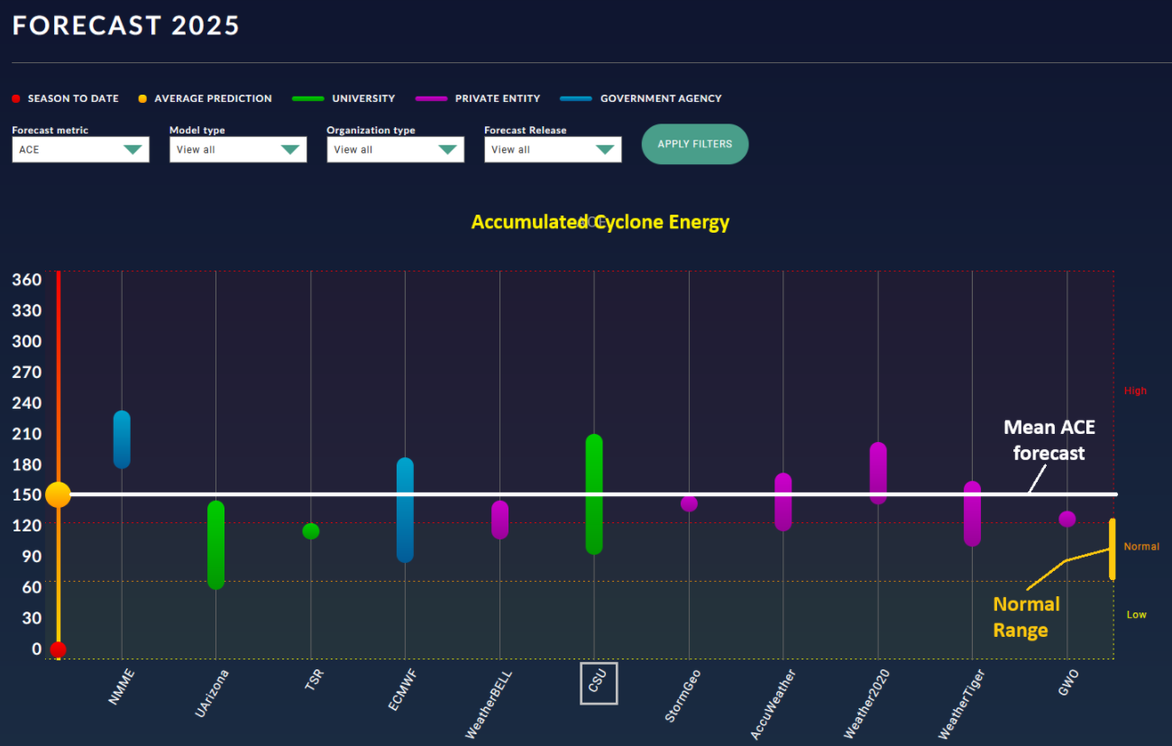
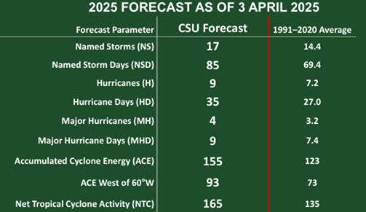
2025 season outlook

Slide 3
NHC Product Updates

Slide 4
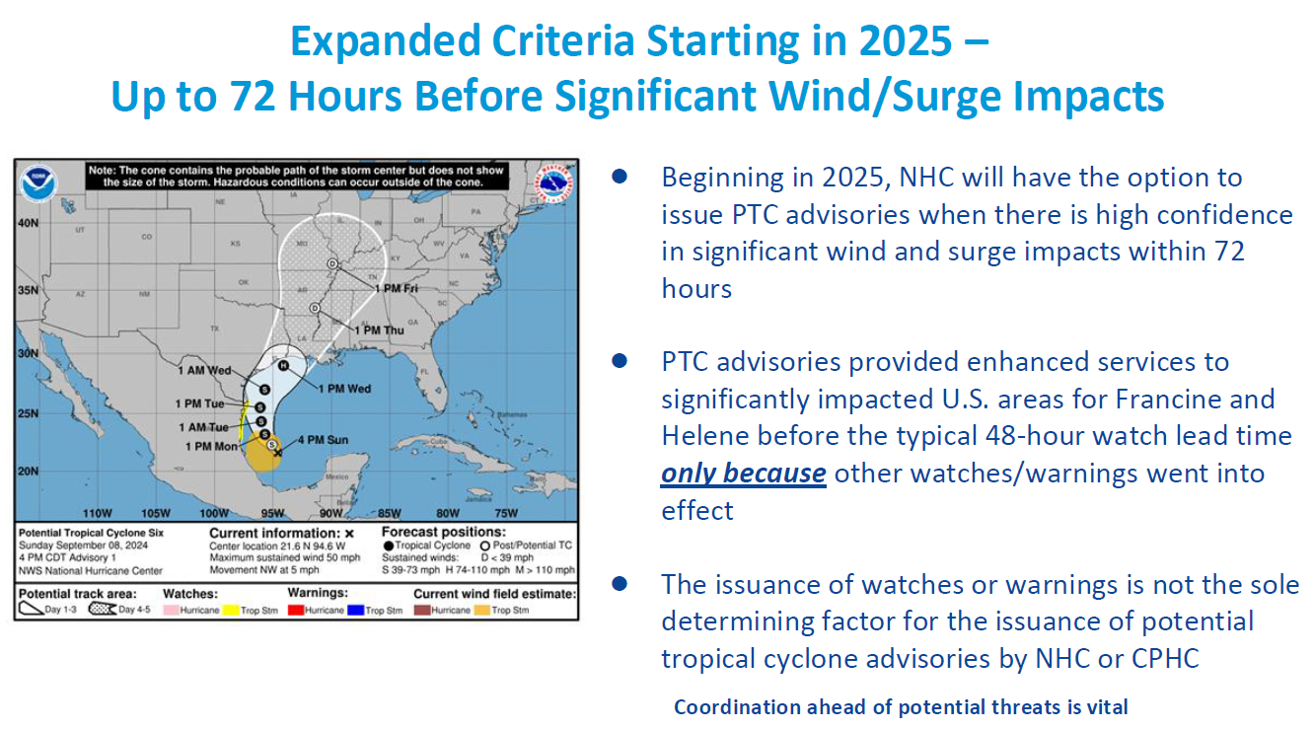

Slide 5
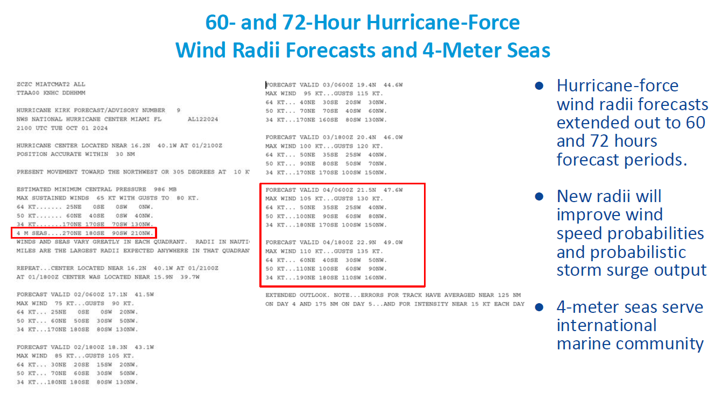

Slide 6
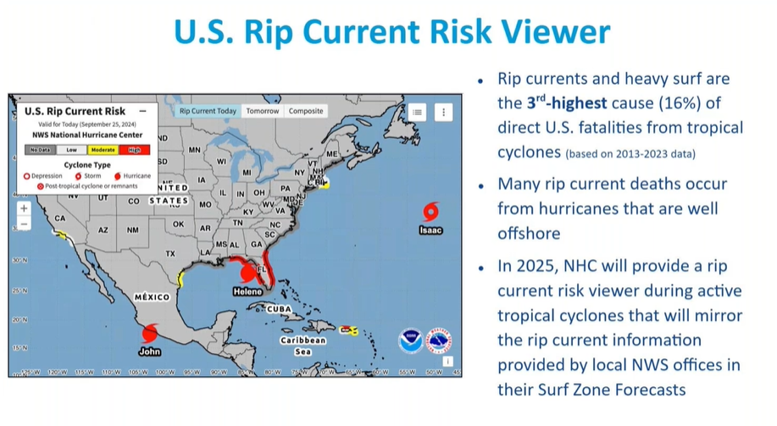

Slide 7
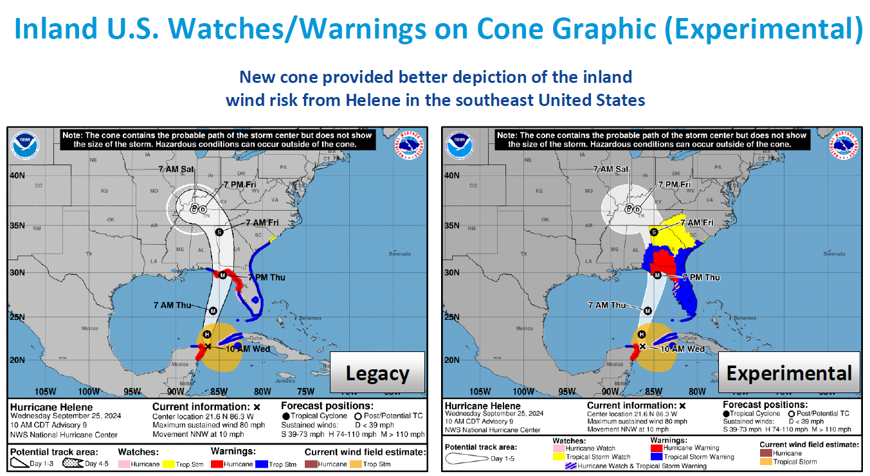

Slide 8
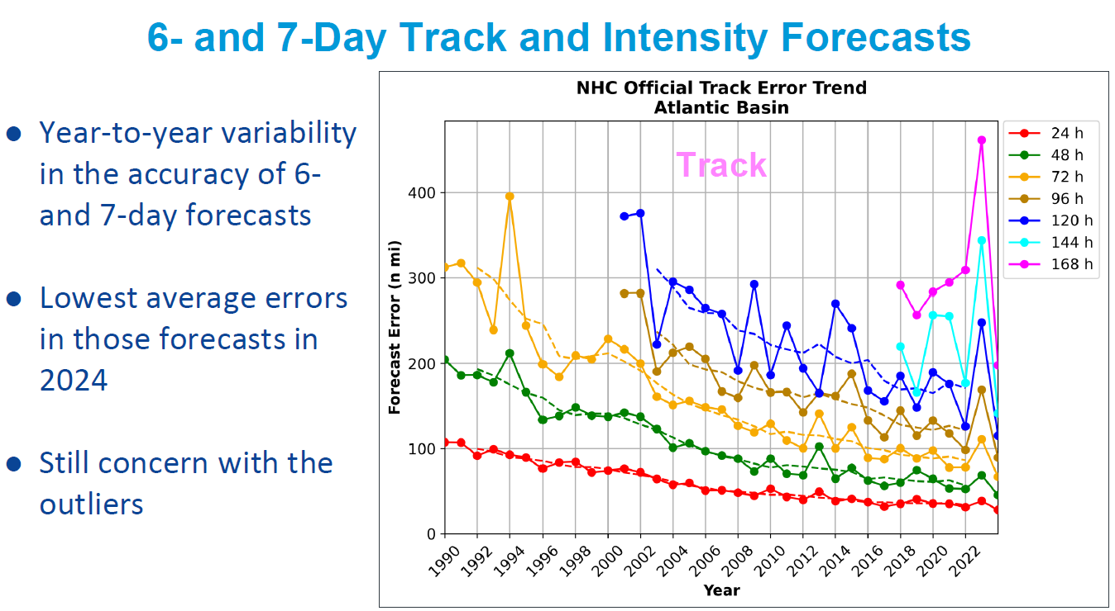

Slide 9
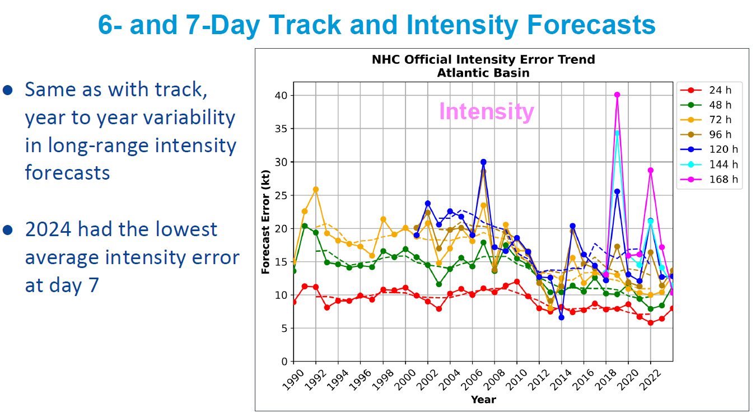

Slide 10
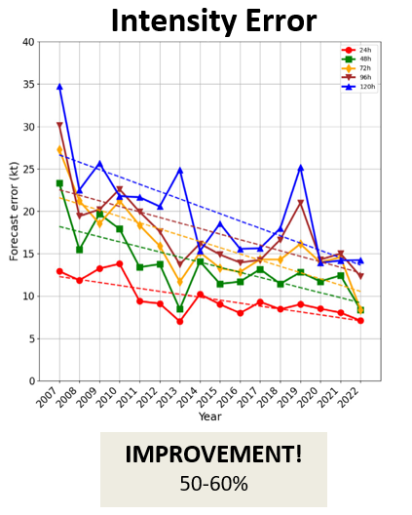
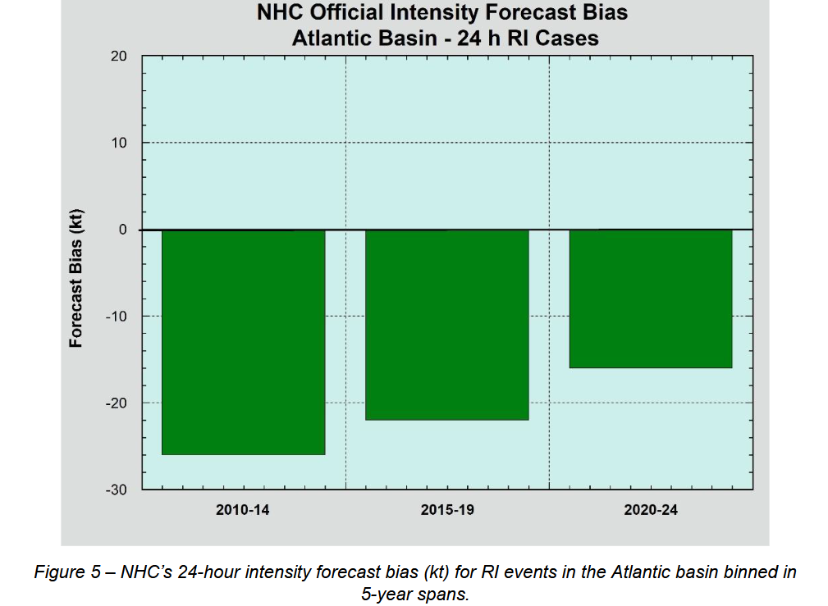
HWRF model trends
NHC rapid intensification error bias is decreasing

Slide 11
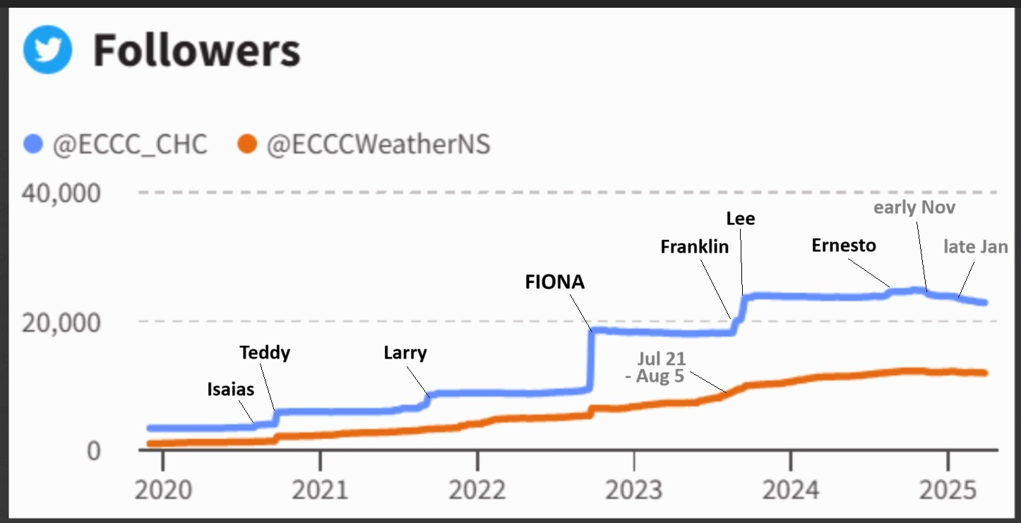
Social Media (X) Trends

Slide 12
Review of Staffing/Bulletin Issuance and some thoughts on how we would handle a ‘Hazel’ (1954) event

Slide 13
Regular 6-hourly bulletins (WO and FX – full staffing of the CHC desk) will commence when:
{one of the following storm systems} is expected to bring gale force winds into Canadian areas of responsibility within 72 hrs:
1. a potential tropical cyclone; 2. a tropical cyclone (hurricane, tropical storm, tropical depression); 3. a tropical cyclone that is in extratropical transition;
4. a post-tropical cyclone. Such storms usually retain significant tropical characteristics, such as intense rainfalls or abnormally high winds. The CHC will sometimes choose to issue weather statements (WOCN31) for these events if they are particularly intense and continue to pose a hazard to Canadians (land areas – e.g. Noel 2007).
Continental U.S.-tracking systems: Potential 6-hourly WO bulletins (staffing desk) without FX or semi-regular WOs (desk not staffed) when an inland-tracking system over the United States poses a heavy rainfall or wind threat to Canadian inland regions from Ontario eastward.
If the system is predicted to enter the inland portion of the Response Zone (RZ) at or near the stage of being post-tropical, then discretion will be exercised whether staffing the desk is needed, if a one-of WO may suffice, OR, if WOs are required at all, and coordination and information sharing can be done through other means (internal collab, social media, etc – e.g. Debby 2024).
Desk staffing
and related
decision making

Slide 14
Coordination with regional weather offices
(storm prediction centres)
Regions whose areas of responsibility will be affected by a tropical cyclone will issue appropriate public and marine warnings as part of the regular forecast program.
Regional weather centres will maintain close coordination with the CHC so that warnings and forecasts are consistent with the information contained in the CHC bulletins.

Slide 15
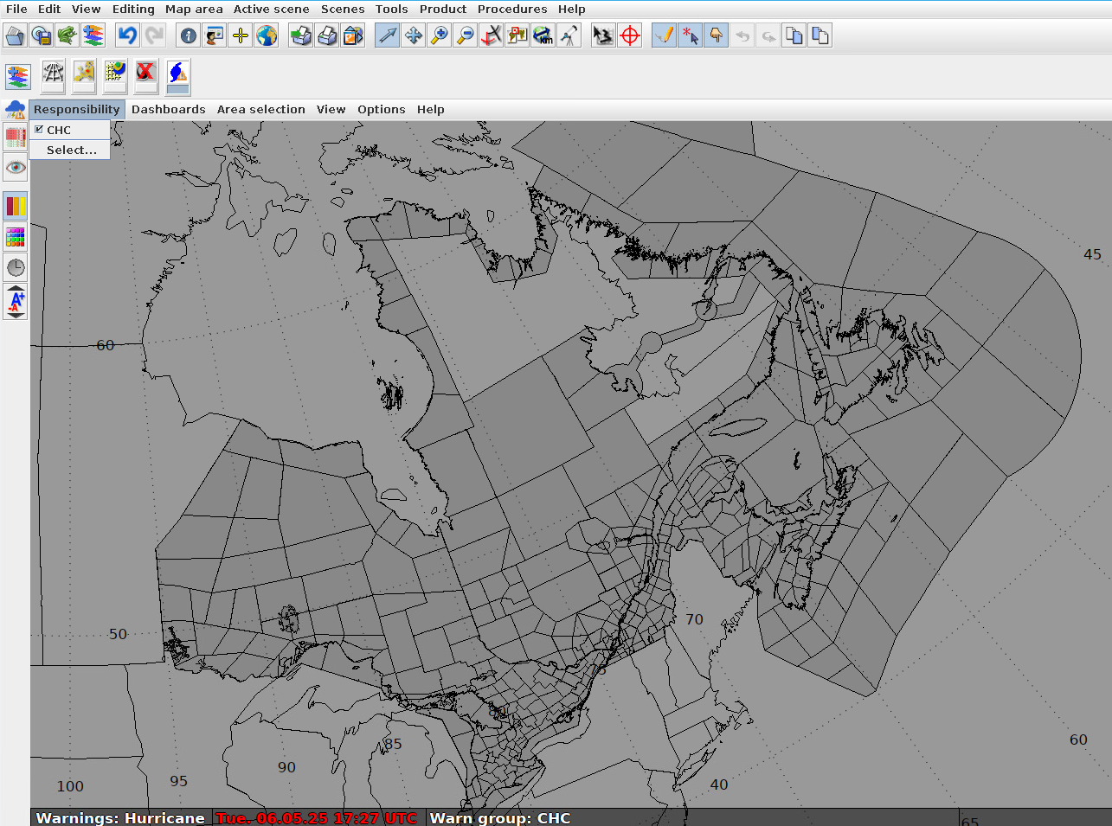
CHC NinJo Warning Layer WOCN31 TCIS can be issued for any regions in darker grey (marine only or combo marine/public)

Slide 16
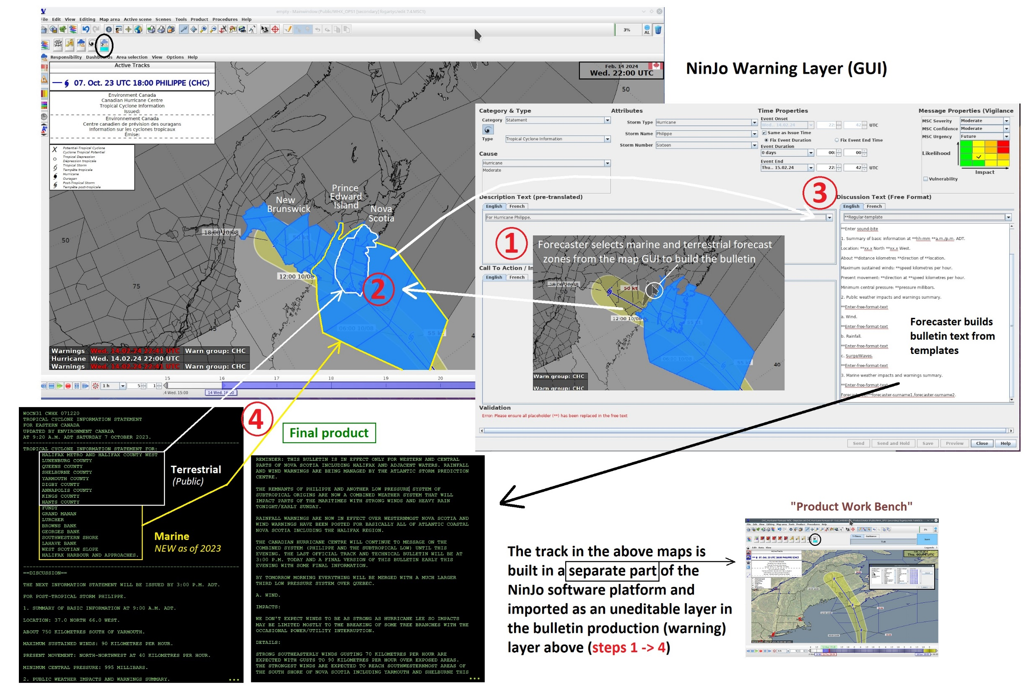

Slide 17
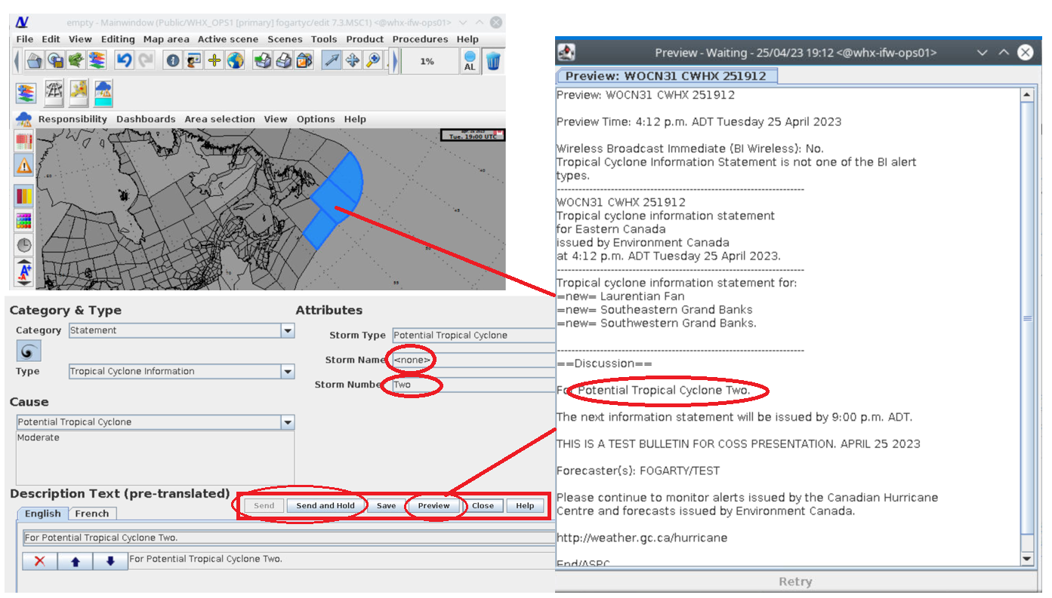
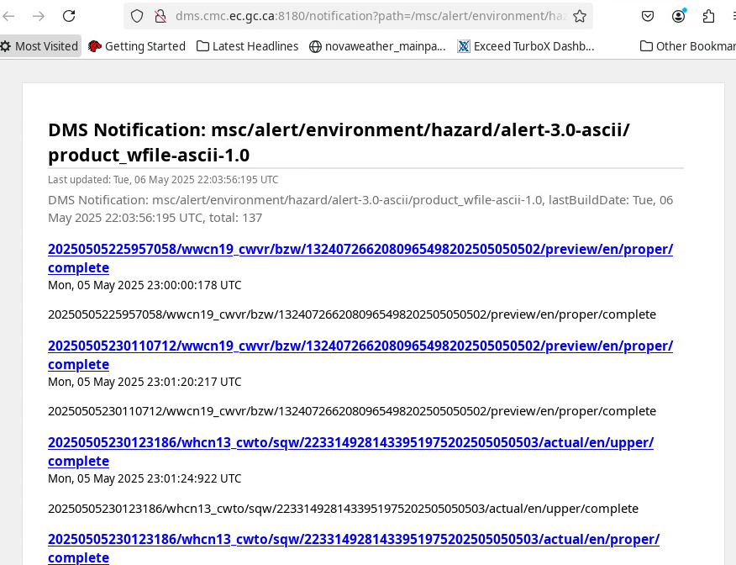
preview bulletin (internal
pre-issue)
Will allow MSC colleagues
To follow our work-in-
progress on DMS

Slide 18
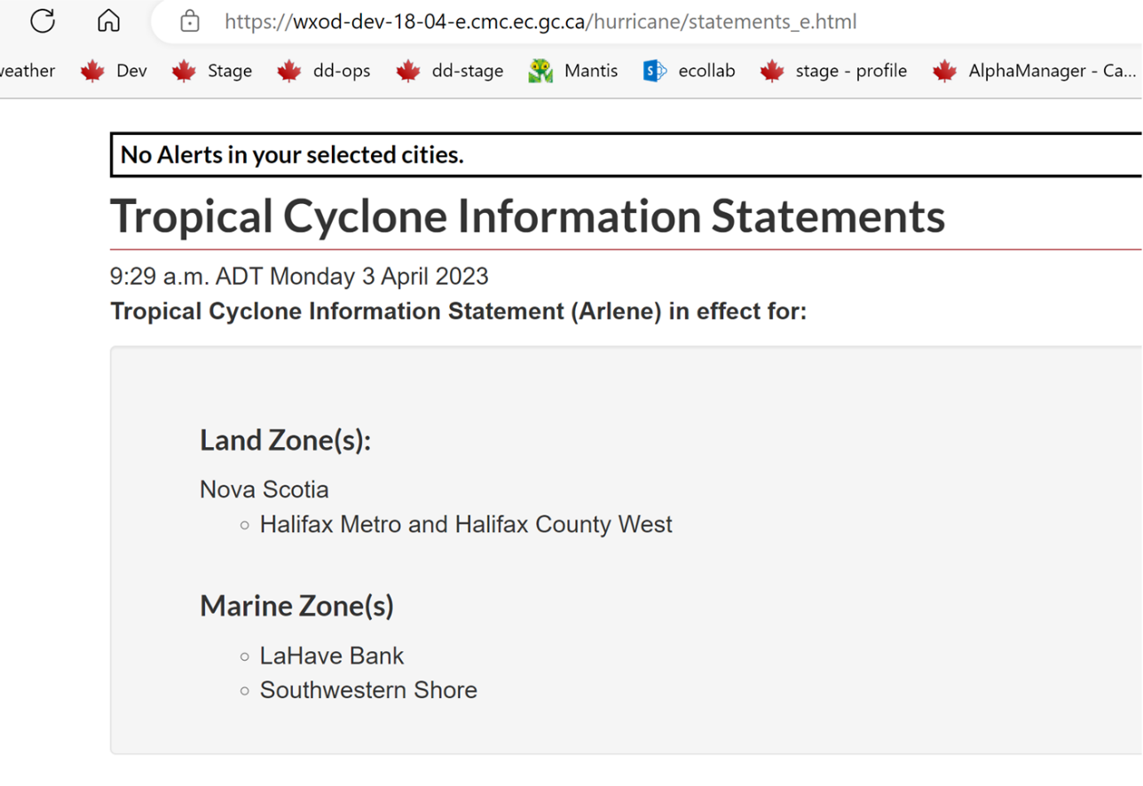
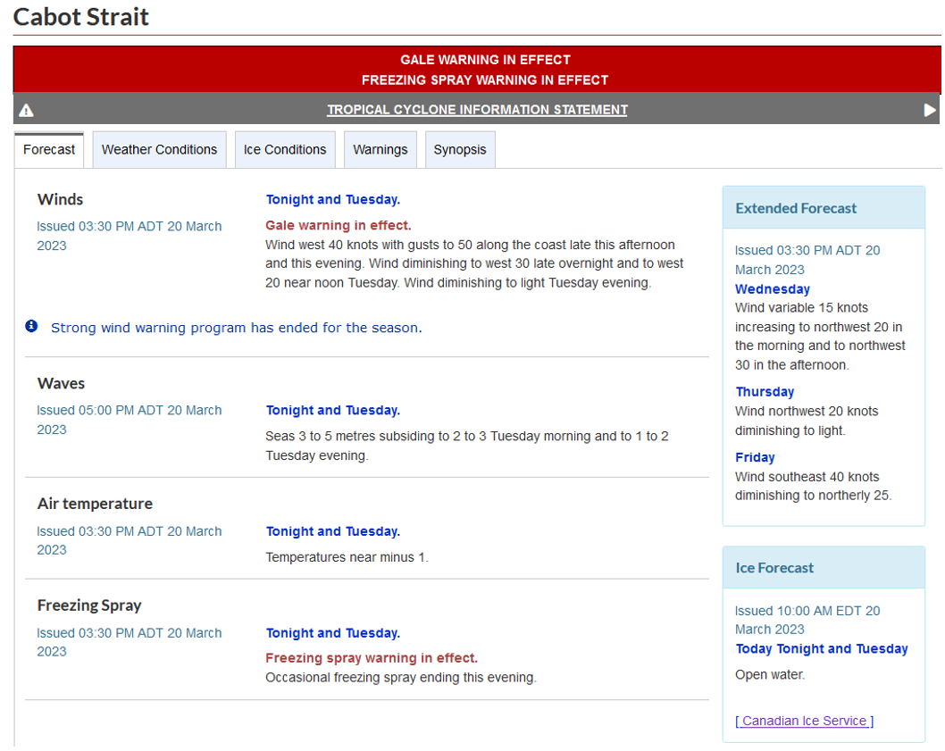
Reminder that the WO31 valid
for both public and marine

Slide 19
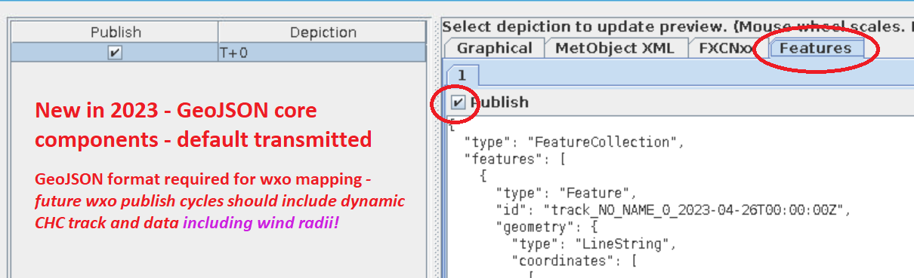
NinJo PWB NICHE (CHC Hurricane Layer)

Slide 20
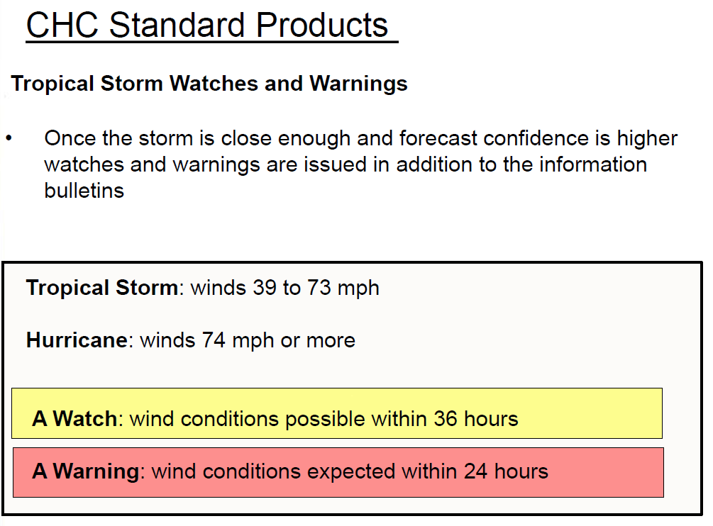
We don’t forecast to the ‘5’ km/h so
This will always be something like
60G90 or 70G100 km/h
Official WMO criteria:
Sustained winds 65-117 km/h
Sustained winds 118 km/h+

Slide 21
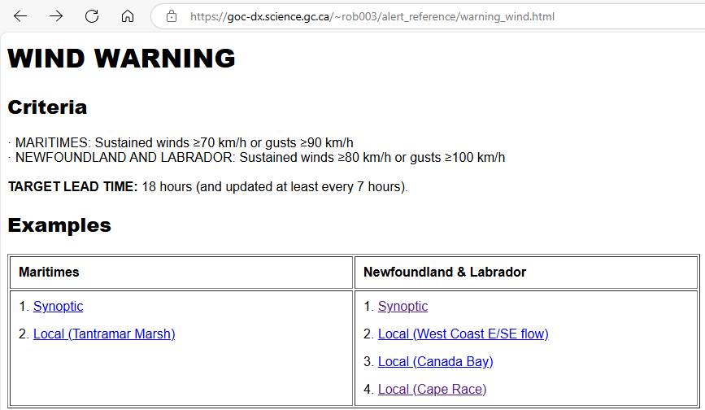
        Hurricane / Tropical Storm Warnings
        WTCN31 CWHX
Marginal Tropical Storm and Hurricane

Slide 22
Coord/Comm between CHC and NLWO
Prior to the desk being staffed (activated), coordination will typically be with CHC Program Lead (Fogarty)
When the desk is staffed 24/7, there will be communication between NLWO desks and the CHC desk (Program Lead is effectively an extension of the CHC desk from ~7 am to 10 pm)
Program Lead is always in close coordination with CHC desk (often via a small MS Teams chat with CHC desk)
To view the work-in-progress for CHC bulletins:
http://dms.cmc.ec.gc.ca:8180/notification?path=/msc/alert/environment/hazard/alert-3.0-ascii/product_wfile-ascii-1.0&time=3h&format=basichtml&filter=TCS
-> (also replace TCS with TSV, TSW, HRV or HRW for various tropical alerts from CHC)

Slide 23
Canadian Hurricane Centre Contact Information Card
(limited distribution / Government agencies only)
Non storm events / off season:
Chris Fogarty, CHC Lead (Manager), ~9am-5pm Atlantic - 902-222-0358
email: chris.fogarty@ec.gc.ca (or MS Teams (902-201-4297) preferred for initial contact)
(I can provide appropriate Warning Preparedness Meteorologist
contact depending on province impacted by event)
Storm events - primetime:
Fogarty, ~7am-10pm Atlantic - 902-222-0358 or MS Teams or email chris.fogarty@ec.gc.ca
Storm events - overnight:
CHC Ops Desk, 10pm-7am Atlantic - 902-244-4877 or email
F.prev.CCPO-CHC.fcstrs.F@ec.gc.ca (only during those hours please – otherwise, Fogarty likely quicker and can triage)
BIG-HURR auto forwarded to Chris 902-222-0358 after 4 rings year-round
Dial *79 to deactivate

Slide 24
Coordination between CHC and NLWO cont.’d…
Warnings:
-> NLWO issues WWs for rain, wind and coastal flooding via comm with the CHC. NLWO and CHC will generally aim to synchronize tropical warning (WTCN31) with wind warning in time (issue within +/- 2hrs) and space with lead ~18-24 hrs
NLWO may also chose to issue wind warnings IF the cause of wind is expected to NOT be related to the tropical cyclone itself e.g.: a local topographic effect or pressure gradient against a high pressure system not justifiably part of the tropical cyclone circulation.
-> NLWO and CHC also discuss best distribution for rainfall warnings - the NLWO is the sole issuer of rainfall warnings so no need to match with a CHC alert. Matching of alerts is only intended for winds.
Watches:
Via discussion with NLWO, the CHC may issue a tropical storm or hurricane watch within the WOCN31-covered area as a precursor (12 hours prior) to a WTCN31 / NLWO wind warning. NLWO (or any SPC) does not need to ‘match’ anything to CHC’s watch product. Also, after communication, we may agree to even drop the watch if situation ‘shifts’.
WOCNs:
We will try to avoid overlapping WOCN31 and a NLWO WO (redundant) but it isn’t a strict condition and sometimes for extreme event like Fiona additional messaging for the local level doesn’t hurt.
In Summary:
NLWO has full responsibility for issuing WWs for rain, wind or coastal flooding
NLWO generally aim to match WW wind warnings with CHC WT tropical warnings
The CHC has full responsibility for issuing tropical WT/W31, WO31 - but NLWO can ask CHC to add regions

Slide 25
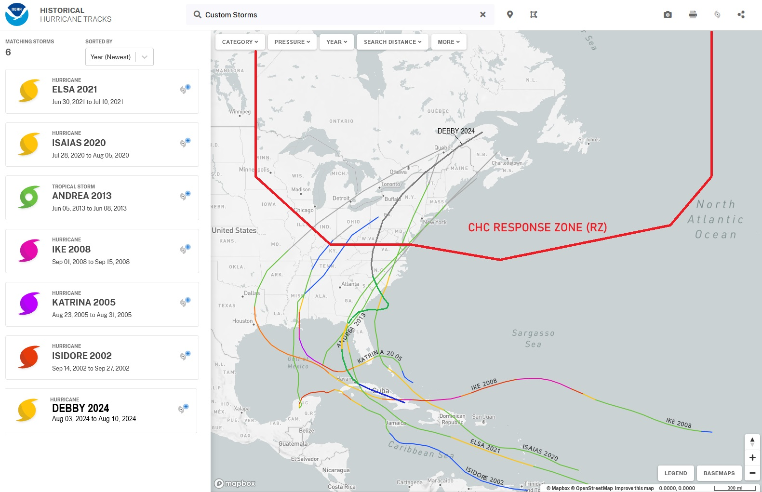
Some past cases

Slide 26
Notes on Past Cases (Southern US Landfalls)
- If storm predicted to be Post Tropical (PT) before entering the RZ (38N) over continental US then we issue WOCN31 in some cases. For Beryl and Debby in 2024 we chose not to, and instead coordinated with QSPC/OSPC mostly internally and on X(Twitter)
- In the past before we had well-established internal coordination mechanisms and before advent of social media we would sometimes issue WOCN31s for Gulf Coastal landfalls:
- Katrina 2005: - activated desk with WOCN31 bulletins (no FXCNs) despite remnant low being below TS strength when crossing the RZ (like Debby) but media interest very high and heavy rain was expected over S’rn ON/QC
- Ike 2008: CHC activated for a few shifts WOCN31 even though storm was predicted to be PT before entering the RZ. There was baroclinic reinvigoration hence the decision to staff and provide extra messaging for ON and QC due to anticipated wind impacts
- Elsa 2021: Desk was activated with WOCN31 and FXCN31 since it skirted along the US east coast still feeding off warm ocean. No impact in QC.
- Andrea 2013: Desk activated briefly with WOCN31 and FXCN31 similar track to Elsa. No impact in QC
- Isidore 2002: Desk NOT activated one WOCN31 bulletin – some heavy rainfall in southern ON/QC
- Isaias 2020: Desk activated with WOCN31 and FXCN31 and rainfall warnings but no tropical/wind warnings
- Debby 2024: Desk NOT activated and no WOCN31

Slide 27
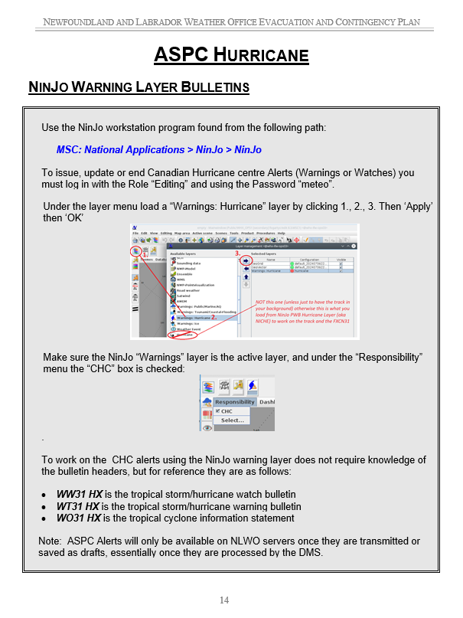
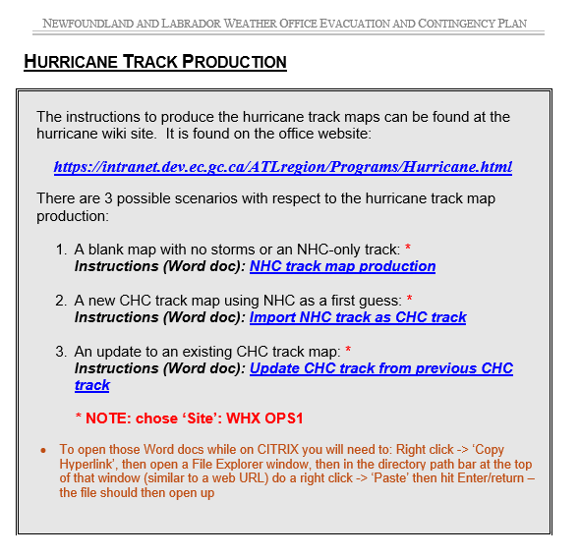
NLWO Contingency

Slide 28
How would the CHC handle a Hazel ‘54 scenario?
If we had a Hazel setup nowadays with models showing the deep secondary non-tropical low forming northwest of the remnant core of Hurricane Hazel - then impacting southern ON - we would certainly staff the desk 24/7 with WO31s due to the high profile and impacts of the storm
Whether tropical wind alerts would be issued for the Great Lakes is another story since it was from a secondary non-tropical low
Need for extra eyes on the situation 24/7. We would still also likely prepare our own track and wind radii (i.e. prepare FXCNs) – although wind radii over continent don’t make a lot of sense due complex terrain effects. They could be required as a guide for OSPC’s wind forecasts over the Great Lakes. Not trivial with non-tropical/secondary low
Extra help would be required for media without a doubt

Slide 29
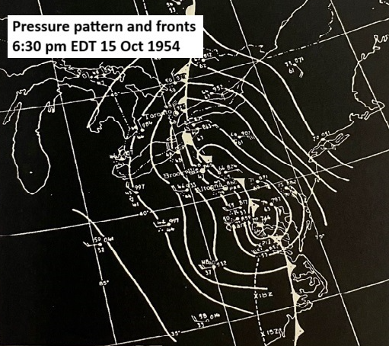
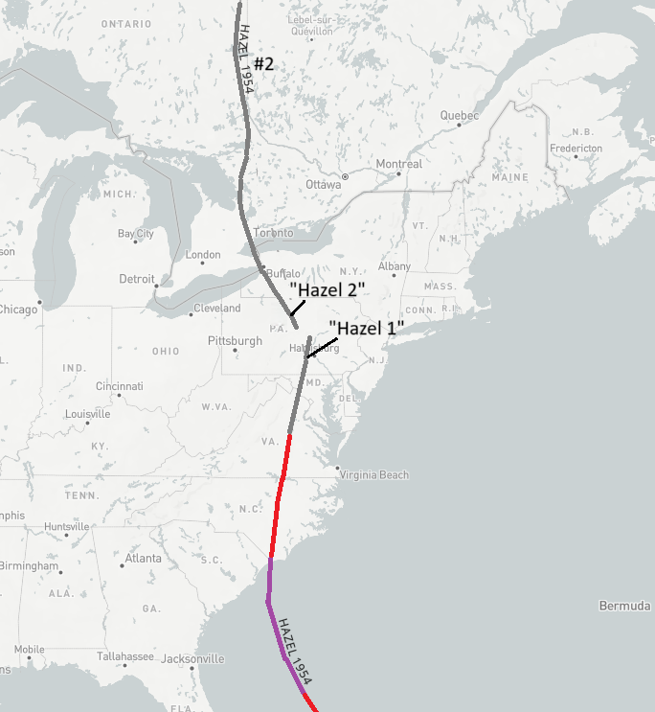
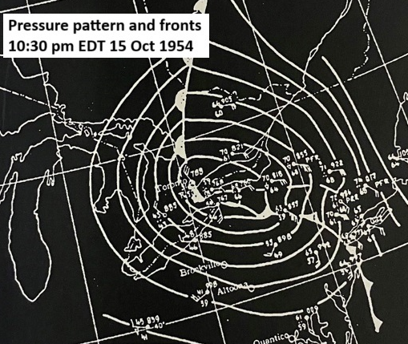
Unique case of “The Hazels”
Severe flooding

Slide 30
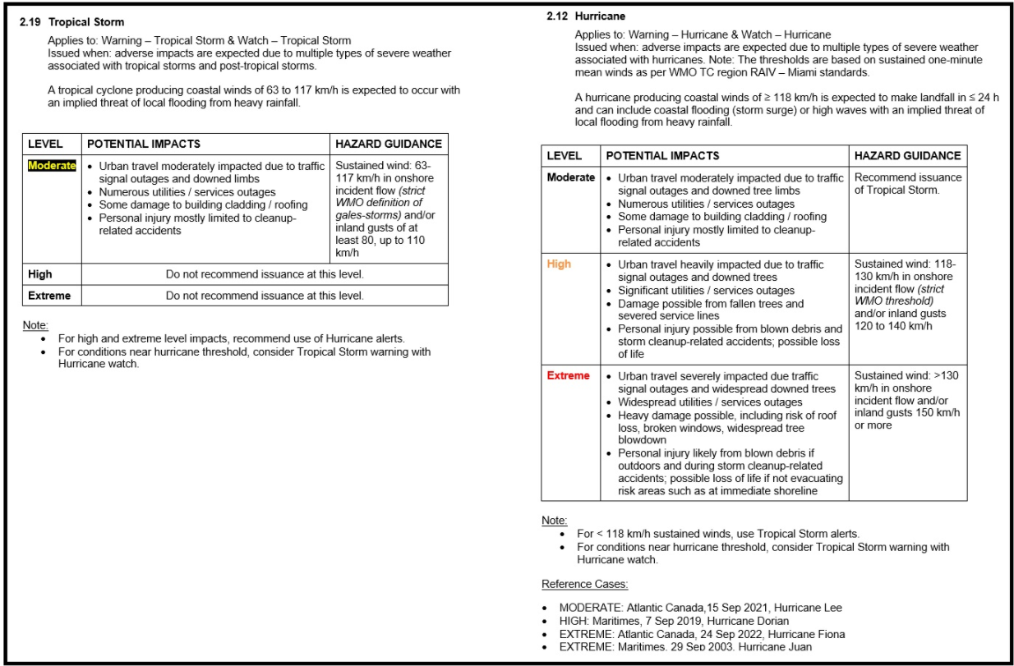
RiTA – Tropical
…from the ~32-page doc
Examples ->

Slide 31
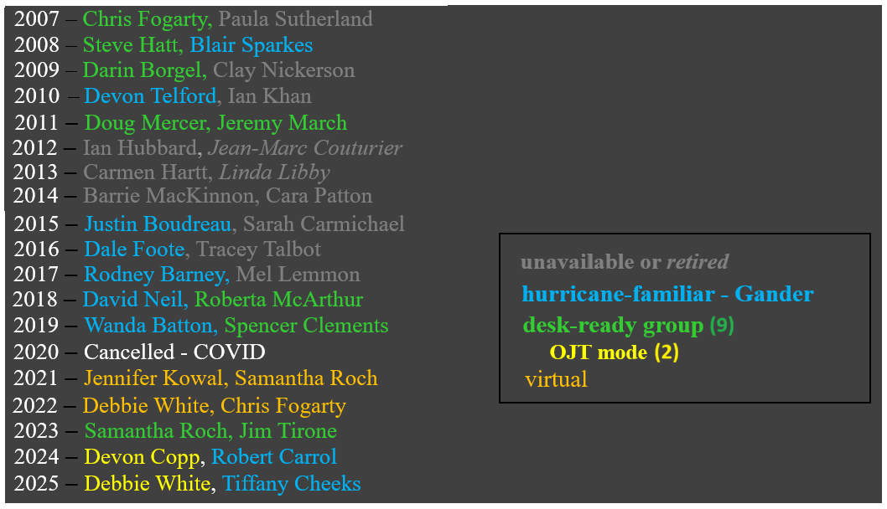
Staff (listed by year NHC-trained)

Slide 32
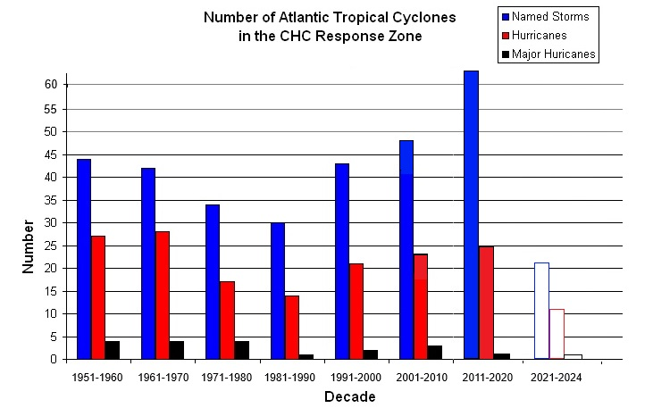

Slide 33
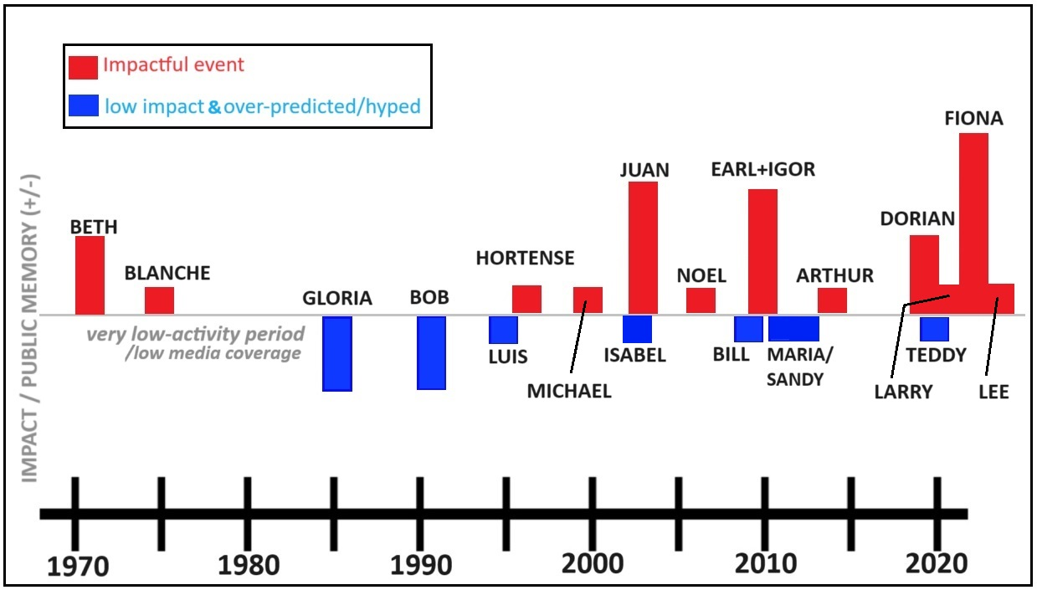

Slide 34
A few notes/reminders (CHC staff specifically)
Plan is that we will continue with post on ‘X’ – usually done by Chris and Bob
This year we will aim to do regular 6-hourly tweets from CHC desk. Instructions.
In addition to daily (~4:40 pm ADT) videocon with NHC for landfall systems, we should have coordination with them before they make an official landfall point declaration
We may aim to advertise ‘next WO31 bulletin available by HH:30’ to manage expectations accounting for translation delays

